Slide 1

Draft USCDI Version 7
Sara Armson
Health IT Specialist, Development Lead of USCDI
sara.armson@hhs.gov

Slide 2
Background: United States Core Data for Interoperability
Draft USCDI Version 7: Development Overview
What’s New in Draft USCDI v7
Questions & Discussion

Slide 3

US Core Data for Interoperability (USCDI)
The minimum dataset of the health care delivery system
Notes:
USCDI is a standardized set of data elements for interoperability and serves as a baseline for data exchange in the US.

Slide 4
Core Principles
Comprises a core set of data needed to support patient care and facilitate patient access using health IT
Establishes a consistent baseline of data for other use cases
USCDI
Expands over time via a predictable, transparent, and collaborative public process

Slide 5
Why USCDI Matters
ONC Cures Act Final Rule established USCDI v1 in 2020, and replaced the Common Clinical Data Set
USCDI serves as the baseline data set for the ONC Certification Program
USCDI also defines required data for other uses, such as CMS Patient Access and Payer-to-Payer API, TEFCA, and California Data Exchange Framework (v2)
USCDI v5 was included in 2025 Standards Version Advancement Process (SVAP) standards
SVAP allows health IT developers to voluntarily update their products to newer versions of standards
*Health Data, Technology, and Interoperability: Certification Program Updates, Algorithm Transparency, and Information Sharing
Notes:
This means that Certified Health IT must have the capability to exchange the USCDI data elements. At the end of this month, certified health IT will need to be compliant with USCDI version 3.1.
We are here today to talk about Draft USCDI v7. There is an interval between the finalization of a version of USCDI and the compliance deadline in regulation.
However, Health IT developers can opt to update their products to newer versions of USCDI than through the ASTP Standards Version Advancement Process (SVAP). Last year, USCDI v5 was included in SVAP, and this year, USCDI version 6 will be included in SVAP.

Slide 6
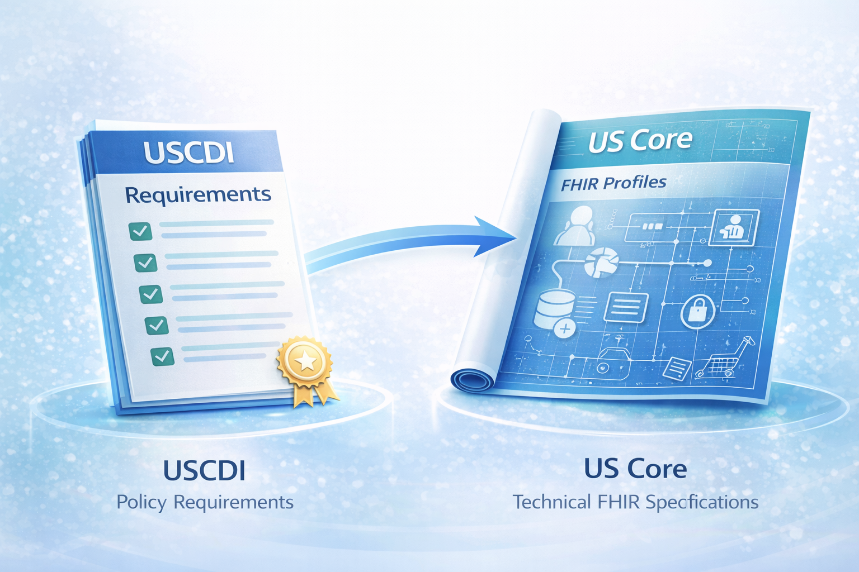
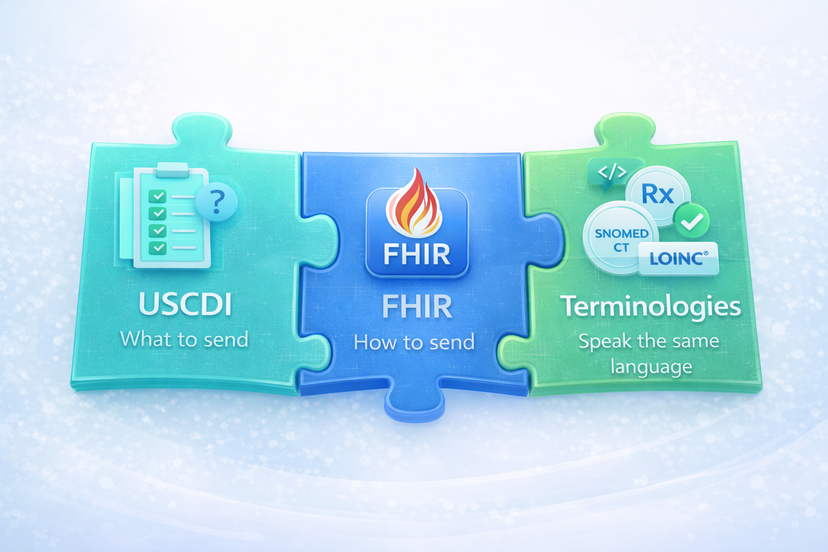
USCDI Data Elements Are Part of the Interoperability Ecosystem
Notes:
In addition to the requirement for certified health IT, how does USCDI fit into the interoperability ecosystem?
The data elements in USCDI inform the development of the exchange specifications in the US Realm – US Core and Consolidated Clinical Document Architecture (C-CDA)
USCDI is what to send, the exchange specification is the structure and how to send it, and that data exchange is given sematic meaning through standard terminologies

Slide 7
Draft USCDI Version 7: Development Overview

Slide 8
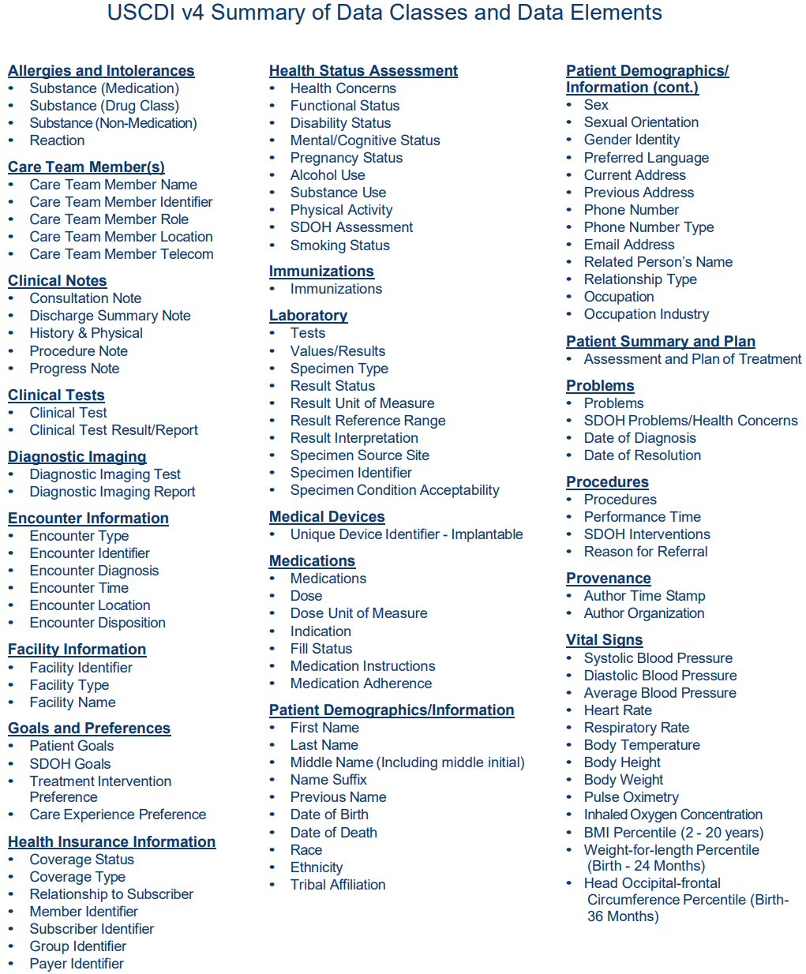
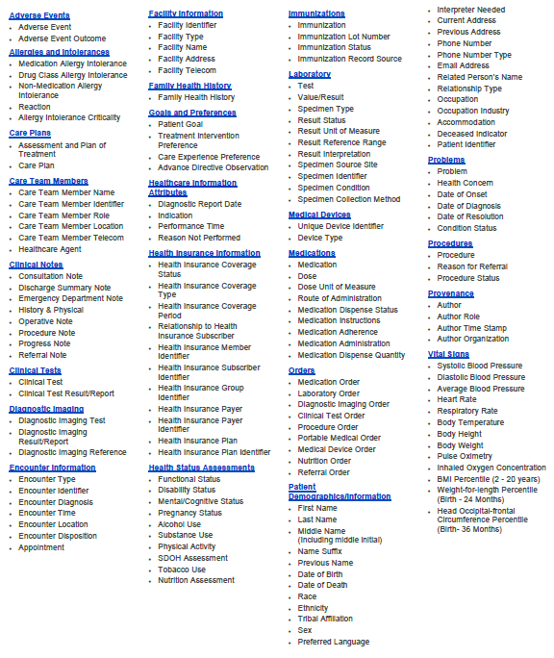
USCDI: Transparent, Predictable, Collaborative
USCDI v1 Summary of Data Classes and Data Elements
USCDI v1 includes 52 data elements and is required by Cures Act Final Rule and added data classes clinical notes and provenance, and data elements pediatric vital signs and address
USCDI v3 expanded to 92 data elements and is required in HTI-1, effective January 1, 2026 (Note: Enforcement discretion until March 1, 2026)
USCDI v5 is included the 2025 SVAP Standards, released May 2025
Draft USCDI v7 includes 156 data elements, including 30 proposed additions, to advance interoperability, released in January 2026
USCDI v2 Summary of Data Classes and Data Elements
USCDI v3 Summary of Data Classes and Data Elements
USCDI v4 Summary of Data Classes and Data Elements
USCDI v5 Summary of Data Classes and Data Elements
Draft USCDI v7 Summary of Data Classes and Data Elements
*Health Data, Technology, and Interoperability: Patient Engagement, Information Sharing, and Public Health Interoperability Proposed Rule
Notes:
ASTP releases a new version of USCDI every years, starting with a draft version, like the just released Draft v7, and then with a final version published in the summer.
USCDI version 1 started with 52 data elements, and Draft v7 includes 156 data elements.

Slide 9

ASTP/ONC Publishes Draft USCDI v7
Jan 2026
We are here
ASTP/ONC prepares Draft USCDI v7
Sept 2025 – Jan 2026
Public feedback period on Draft USCDI v7
Jan – Apr 2026
Jan
Dec
Feb
Nov
Mar
USCDI
2025/2026
Oct
Apr
Sep
May
Public submission period for USCDI v7
Jul – Sept 2025
ASTP/ONC prepares USCDI v7 (Final)
Apr – Jul 2026
Aug
Jun
Jul
ASTP/ONC publishes USCDI v6
July 2025
ASTP/ONC publishes USCDI v7
July 2026
USCDI v6
USCDI v7
Notes:
Here is a big picture view of the yearly USCDI activities. When we released Draft v7, we kicked of a public comment period that will last until April. The feedback we receive during this time will help shape Final v7.

Slide 10
New USCDI Data Elements: Where Do They Come From?
Public Feedback – Submissions through ONDEC
Technically mature & broadly applicable data elements
USCDI+ Domains
Notes:
Getting into the details of USCDI development –
How does a data element become a USCDI data elements?
Through public feedback, specifically through our online submission system called ONDEC
The public feedback helps us identify and advance in USCDI data elements that are technically mature (as in ready for exchange across systems) and broadly applicable cross use-cases and specialties

Slide 11
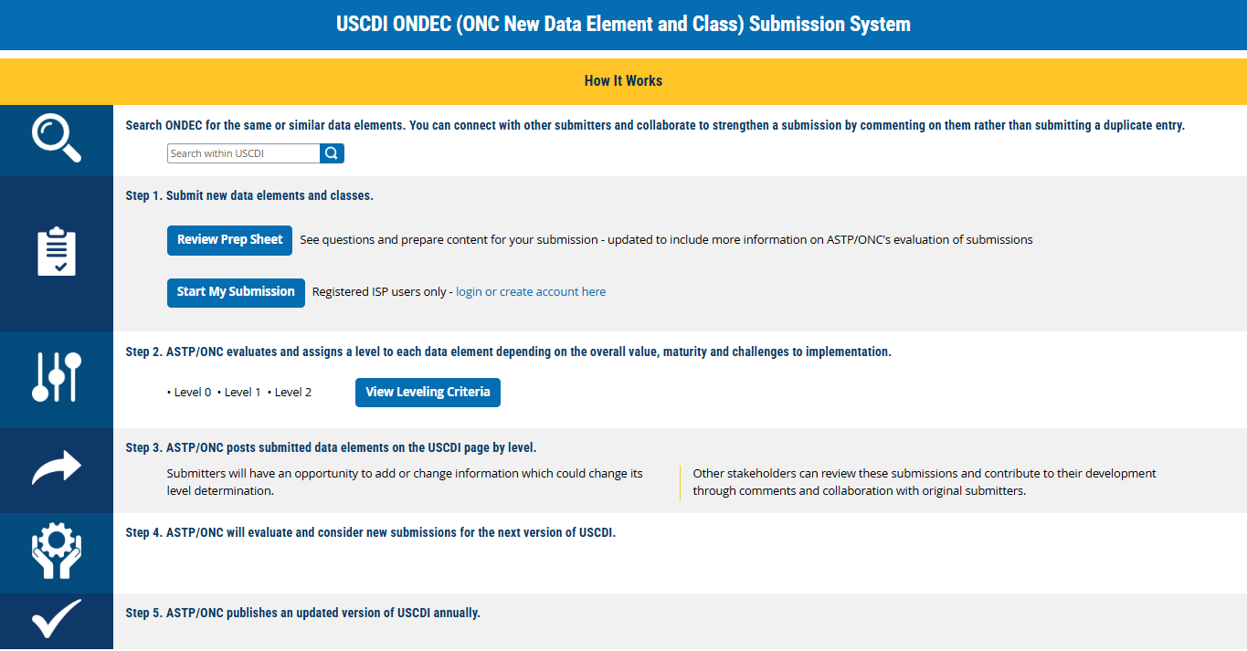
USCDI ONDEC Submission System
Notes:
Through the USCDI page on healthit.gov, you can access the ONC New Data Element and Class submission system.
To help you gather your submission information, you can download a submission prep sheet.
ASTP will use the information in your submission to assess the technical maturity for exchange and breadth of applicability of the data element

Slide 12
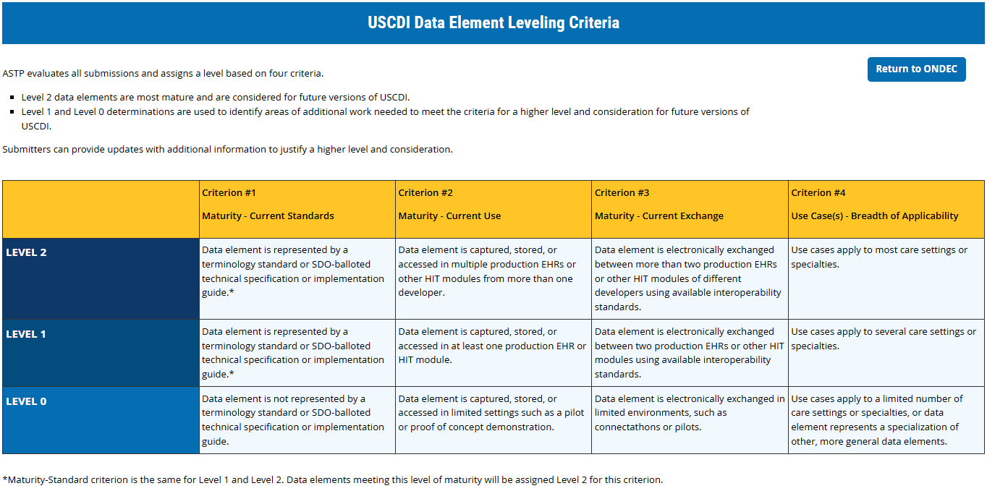
Level Criteria Language
Notes:
The “View Leveling Criteria” button on the ONDEC page will take to our level table with the general guidelines.
You’ll also find this level criteria at the top of each USCDI Level page

Slide 13
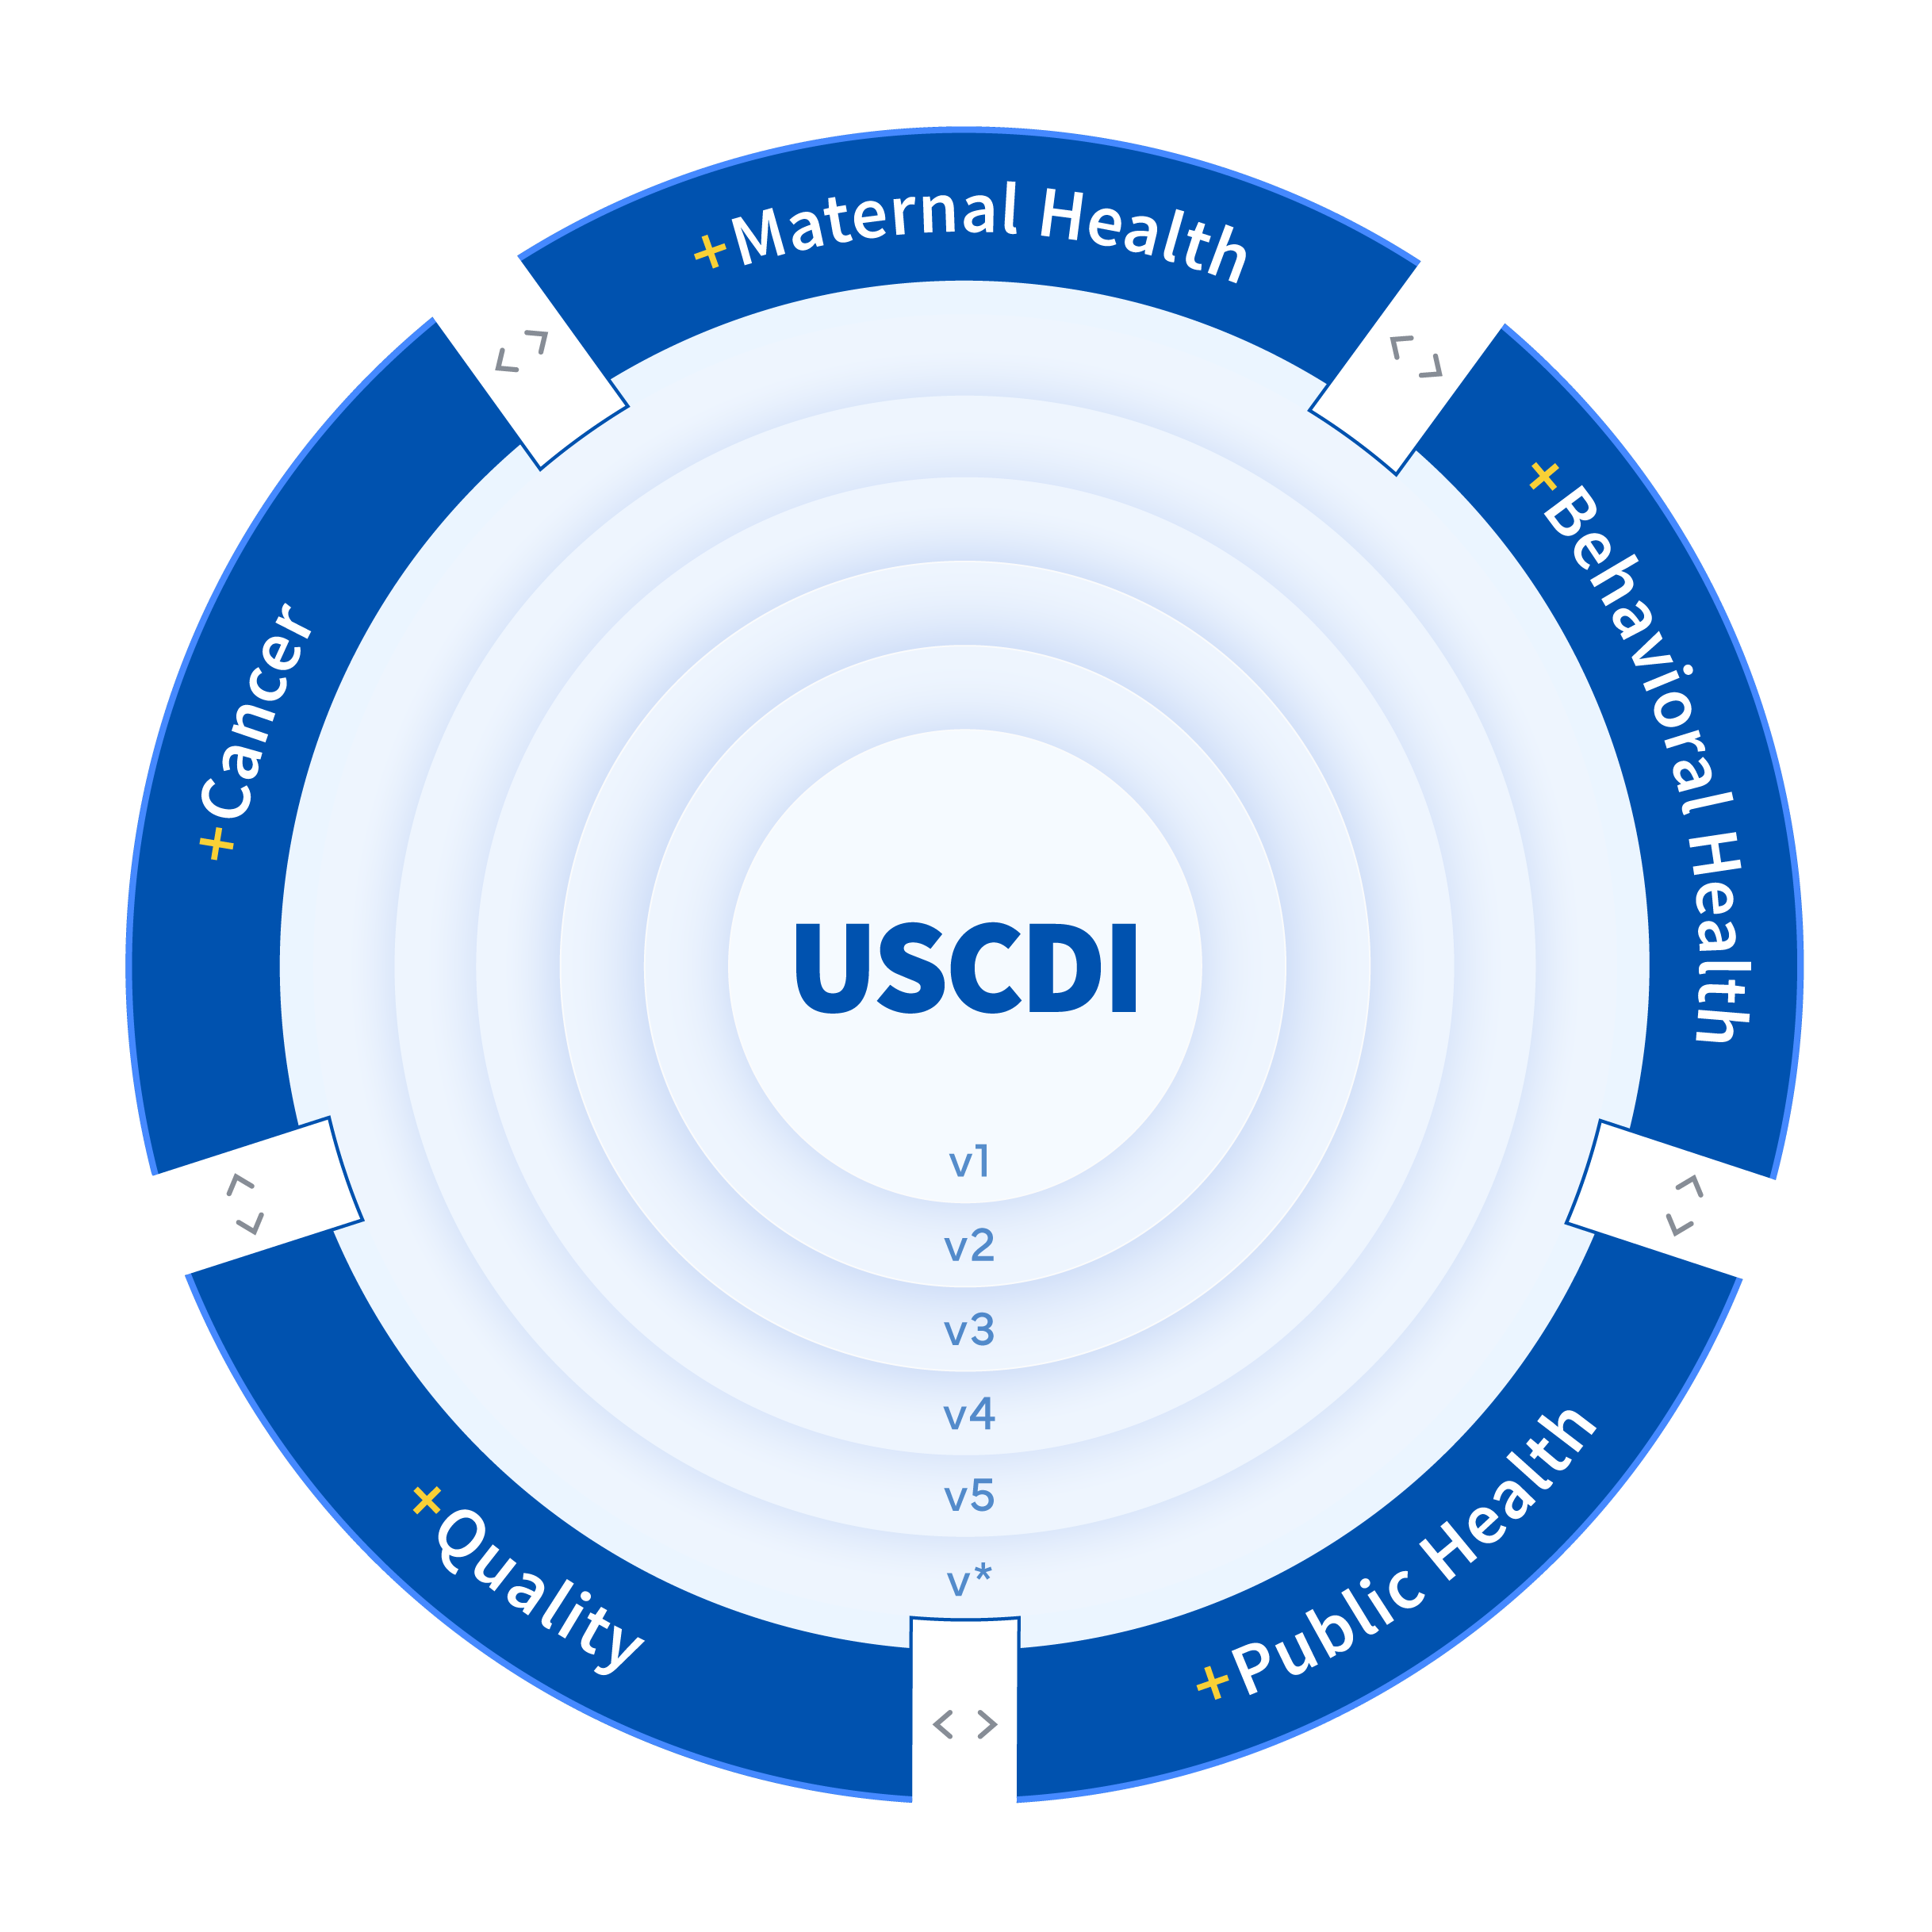
United States Core Data Interoperability (USCDI)+
Extending Beyond the USCDI
Unique program and use case-specific data needs are sometimes not fully met by USCDI.
ASTP’s USCDI+ initiative helps government and industry partners build on USCDI to support specific program needs.
Applies USCDI processes for submission and harmonization while focusing on programmatic priorities.
Seeks to leverage programs and authorities across HHS to drive adoption

Slide 14










USCDI+ Initiatives
Quality
Cancer
Harmonized data for quality measurement and reporting.
Real-world data for cancer care, trials, and registries.
Behavioral Health
Data for mental health and substance use disorder programs.
Public Health
Aligns with CMS eCQMs, HRSA UDS modernization, and FHIR-based reporting.
Enhances trial matching, irAE tracking, and registry data collection.
Supports SAMHSA grantees, reduces reporting burden, improves data quality.
Data elements for case reporting, lab exchange, and situational awareness.
Supports CDC’s OPHDST and public health interoperability across jurisdictions.
Impact
Notes:
A highlight of some of the USCDI+ domains

Slide 15
USCDI+ Quality: Standardizing Digital Quality Measurement
Purpose
Dual Release Structure
Establishes standardized, interoperable data elements for digital quality measurement and reporting, aligning federal and non-federal quality programs.
USCDI+ Quality V1 (Final): Implementation-ready elements supporting eCQMs
Quality Overarching: Strategic roadmap for future development
Development Approach
Next Steps
Six Core Criteria: Community Input • Readiness • Policy Alignment • Measure Relevance • Harmonization • Standards Alignment
Engagement for Draft V1: 30+ commenters | 400+ comments
Federal partner coordination on implementation
Draft V2 open for comment until March 17, 2026
Ongoing evaluation of challenges and priorities
Notes:
USCDI+ Quality released the v1 data element set on at the end of January
There is an open feedback period that will inform the Draft version 2 – open until March 17th

Slide 16
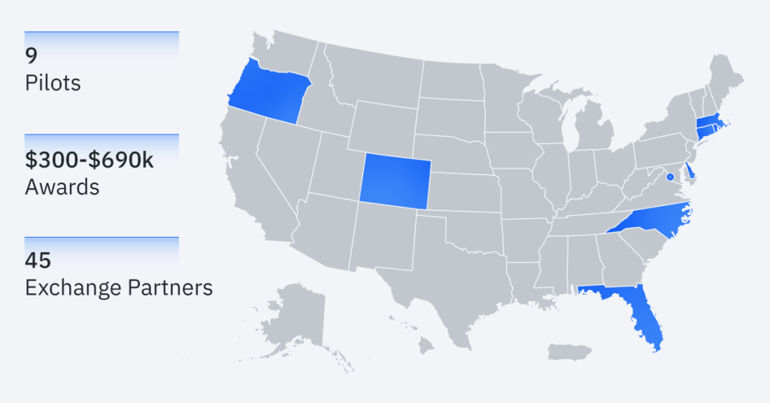
USCDI+ Behavioral Health: New Pilot Projects Launched
Notes:
USCDI+ BH was developed by ASTP/ONC and SAMHSA
Behavioral Health Information Technology (BHIT) Initiative recently launched 9 pilots that will test the USCDI+ Behavioral Health dataset and the FHIR Behavioral Health Implementation Guide (BH IG) in real-world behavioral health settings

Slide 17
What’s New in Draft USCDI v7

Slide 18

Draft USCDI v7
NEW
NEW
Adverse Events
Adverse Event
Adverse Event Outcome
Allergies and Intolerances
Medication Allergy Intolerance
Drug Class Allergy Intolerance
Non-Medication Allergy Intolerance
Reaction
Allergy Intolerance Criticality
Care Plans
Assessment and Plan of Treatment
Care Plan
Care Team Members
Care Team Member Name
Care Team Member Identifier
Care Team Member Role
Care Team Member Location
Care Team Member Telecom
Healthcare Agent
Clinical Notes
Consultation Note
Discharge Summary Note
Emergency Department Note
History & Physical
Operative Note
Procedure Note
Progress Note
Referral Note
Clinical Tests
Clinical Test
Clinical Test Result/Report
Diagnostic Imaging
Diagnostic Imaging Test
Diagnostic Imaging Result/Report
Diagnostic Imaging Reference
Encounter Information
Encounter Type
Encounter Identifier
Encounter Diagnosis
Encounter Time
Encounter Location
Encounter Disposition
Appointment
Facility Information
Facility Identifier
Facility Type
Facility Name
Facility Address
Facility Telecom
Family Health History
Family Health History
Goals and Preferences
Patient Goal
Treatment Intervention Preference
Care Experience Preference
Advance Directive Observation
Healthcare Information Attributes
Diagnostic Report Date
Indication
Performance Time
Reason Not Performed
Health Insurance Information
Health Insurance Coverage Status
Health Insurance Coverage Type
Relationship to Health Insurance Subscriber
Health Insurance Member Identifier
Health Insurance Subscriber Identifier
Health Insurance Group Identifier
Health Insurance Payer Identifier
Health Insurance Coverage Period
Health Insurance Payer
Health Insurance Plan
Health Insurance Plan Identifier
Health Status Assessments
Functional Status
Disability Status
Mental/Cognitive Status
Pregnancy Status
Alcohol Use
Substance Use
Physical Activity
SDOH Assessment
Tobacco Use
Nutrition Assessment
Immunizations
Immunization
Immunization Lot Number
Immunization Status
Immunization Record Source
Laboratory
Test
Value/Result
Specimen Type
Result Status
Result Unit of Measure
Result Reference Range
Result Interpretation
Specimen Source Site
Specimen Identifier
Specimen Condition
Specimen Collection Method
Medical Devices
Unique Device Identifier
Device Type
Medications
Medication
Dose
Dose Unit of Measure
Route of Administration
Medication Dispense Status
Medication Instructions
Medication Adherence
Medication Administration
Medication Dispense Quantity
Orders
Medication Order
Laboratory Order
Diagnostic Imaging Order
Clinical Test Order
Procedure Order
Portable Medical Order
Medical Device Order
Nutrition Order
Referral Order
Patient Demographics/ Information
First Name
Last Name
Middle Name (Including middle initial)
Name Suffix
Previous Name
Date of Birth
Date of Death
Race
Ethnicity
Tribal Affiliation
Sex
Preferred Language
Interpreter Needed
Current Address
Previous Address
Phone Number
Phone Number Type
Email Address
Related Person’s Name
Relationship Type
Occupation
Occupation Industry
Accommodation
Patient Identifier
Deceased Identifier
Problems
Problem
Health Concern
Date of Onset
Date of Diagnosis
Date of Resolution
Condition Status
Procedures
Procedure
Reason for Referral
Procedure Status
Provenance
Author
Author Role
Author Time Stamp
Author Organization
Vital Signs
Systolic Blood Pressure
Diastolic Blood Pressure
Average Blood Pressure
Heart Rate
Respiratory Rate
Body Temperature
Body Height
Body Weight
Pulse Oximetry
Inhaled Oxygen Concentration
BMI Percentile (2 - 20 years)
Weight-for-length Percentile (Birth - 24 Months)
Head Occipital-frontal Circumference Percentile (Birth- 36 Months)
NEW
NEW
NEW
NEW
NEW
NEW
NEW
NEW
NEW
NEW
NEW
NEW
NEW
NEW
NEW
NEW
NEW
NEW
NEW
NEW
NEW
NEW
NEW
NEW
NEW
NEW
NEW
NEW
Notes:
Draft USCDI v7 advances the Make America Healthy Again agenda by expanding standardized health data needed to support disease prevention, nutrition, healthy lifestyles, and safer care across settings.
Find the full Standard Document and the Standards Bulletin on the USCDI from healthit.gov

Slide 19
Draft USCDI v7 – 30 Proposed New Data Elements
Adverse Events | Allergies and Intolerances | Care Team Members
Adverse Event + Adverse Event Outcome | Allergy Intolerance Criticality | Healthcare Agent +
Clinical Notes | Diagnostic Imaging | Encounter Information
Referral Note | Diagnostic Imaging Reference + | Appointment
Facility Information | Healthcare Information Attributes | Health Insurance Information
Facility Telecom + S | Reason Not Performed + Diagnostic Report Date + S | Health Insurance Coverage Period + S Health Insurance Payer S Health Insurance Plan + S Health Insurance Plan Identifier + S
Health Status Assessments | Immunizations | Laboratory
Nutrition Assessment + Tobacco Use | Immunization Status + S Immunization Record Source + S | Specimen Collection Method
Medical Devices | Medications | Orders
Device Type + S | Medication Administration + Medication Dispense Quantity + S | Medical Device Order + Nutrition Order + Referral Order
Patient Demographics/Information | Problems | Procedures
Accommodation Deceased Indicator + Patient Identifier + S | Condition Status + S | Procedure Status + S
New
New
Notes:
Draft USCDI v7 includes two new data classes and 29 proposed data elements and one significantly revised data element (Tobacco Use, an evolution of the Smoking Status data element) for a total of 30 proposed additions.

Slide 20
Proposed Data Elements Adverse Events and Safety
Allergy Intolerance Criticality
Reason Not Performed
New Data Class: Adverse Events
Explanation or justification provided when an order or practice guideline is not carried out. ​
Usage note: Should be included with a procedure, immunization, and medication.
Estimate of the potential clinical harm, or seriousness, of a reaction to an identified substance.
Notes:
High level walk through of the new data elements, and some deeper dives into a few of them
For the purpose of our time together today, we’ll walk through the data element by broad theme
In the Q&A at the end, we can revisit any of the data elements

Slide 21
New Data Class: Adverse Events
Adverse Event
A change to patient condition that could be an unintended effect of clinical interventions.
Standard: SNOMED
Adverse Event Outcome
Result or impact of an adverse event.​
Examples include but are not limited to hospitalized, recovered, recovered with sequelae, and death.​
Supports patient safety monitoring
Enables quality improvement and reporting
Improves awareness of prior adverse events across care settings
Notes:
New safety‑oriented elements, including Adverse Event and Adverse Event Outcome, support more complete tracking of unintended effects of clinical interventions (such as medication reactions or vaccination reactions) and improve patient safety monitoring.

Slide 22
Proposed Data Elements Care Coordination & Patient Context
Appointment
A planned healthcare event for a future date/time.​ Usage note: Created, tracked and managed for planned participation. An appointment may be called a future encounter and may result in one or more Encounters.​
Healthcare Agent
Individual legally authorized to make healthcare decisions on behalf of a patient when the patient is unable to do so because of an illness or injury.
Accommodation
Modifications, tools, technologies, and other supports necessary to access care.
Standard: SNOMED
Deceased Indicator
Indicates if the person is deceased or not.
Notes:
Appointment – a future healthcare event
Healthcare agent – the person designated to make decisions on behalf a patient who cannot make decisions
Accommodation – the supports a person needs to access care
Deceased Indicator – In addition to the USCDI data element Data of Death, this data element indicates deceased or not, which is helpful in cases when the patient is deceased, and the date of death is unknow.

Slide 23
Care Coordination Across the Health Ecosystem
Referral Order
Provider-authored request to another provider, specialist, or organization for care services. ​
Examples include but are not limited to referral orders to a wound care specialist and to a podiatrist.
Referral Note
Narrative summary requesting an opinion advice or service from a clinician.
Examples include but are not limited to primary care referral to dermatology, dentistry, and acupuncture.
Standard: LOINC, At minimum: 57133-1​
Supports the referral workflow
Reduced redundant communication
Improved coordination across specialties and organizations

Slide 24
Proposed Data Elements Clinical Care
Medical Device Order
Nutrition Assessment
Nutrition Order
Specimen Collection Method
Medication Administration
Provider-authored request for medical devices.​
Assessment of a person’s dietary intake.
Standard: LOINC
Provider-authored request for therapeutic diet, nutrition support, and nutrition to promote and maintain health.​
Examples include but are not limited to cardiac diet, Mediterranean diet, whole food diet, clear liquid diet, enteral nutrition, and nutritional supplement.
Examples include but are not limited to therapeutic footwear, insulin infusion pump, and continuous positive airway pressure (CPAP) machine.
Technique or procedure used to obtain a specimen. ​
Examples include but are not limited to venipuncture, swab, biopsy, aspiration, and catheter collection.
Information about the event of a patient consuming or otherwise being given a medication. ​
Examples include but are not limited to swallowing a tablet, administering an injection, and a long running infusion.

Slide 25
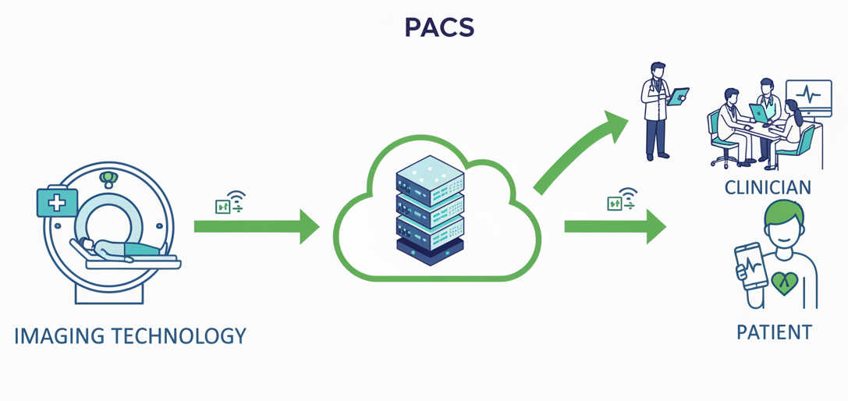
Diagnostic Imaging Reference
The information that can be used to access a diagnostic imaging study.​
Examples include but are not limited to imaging study endpoint weblink, unique identifiers, and contextual information needed to retrieve a diagnostic imaging study.​
Notes:
In this simplified picture of the complex flow of imagining data, the image lives in a PACS (Picture Archiving and Communication System) which can be accessed by providers and patients.
The Diagnostic Imaging Reference is the end point of that PACS and the unique identifiers that allow access to the image.

Slide 26
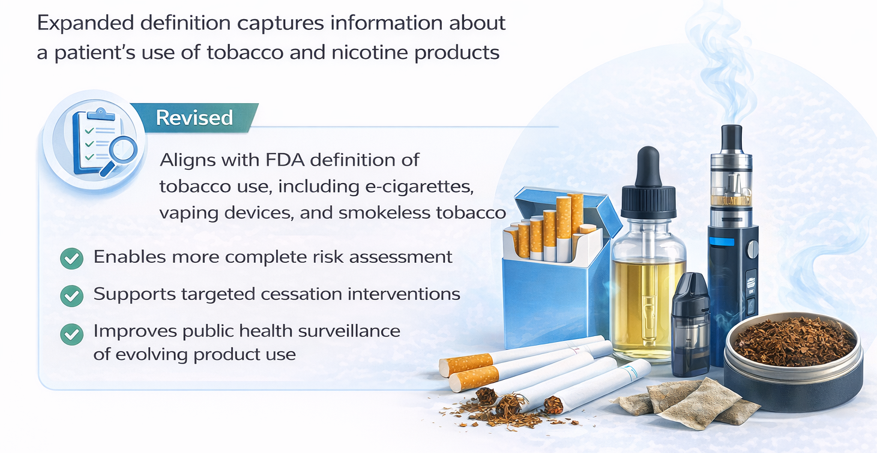
Tobacco Use
Assessment of a patient’s tobacco product use behaviors. Tobacco products may include smokeless tobacco, cigarette tobacco, cigars, pipe tobacco, waterpipes (or hookah), nicotine pouches, nicotine gum, e-cigarettes, and other electronic nicotine delivery systems.
Examples include but are not limited to duration and frequency of use, mode of consumption, and type of product used.
Standard: LOINC, SNOMED CT

Slide 27
New Data Class: Healthcare Information Attributes
Reason Not Performed
Explanation or justification provided when an order or practice guideline is not carried out. ​
Usage note: Should be included with a procedure, immunization, and medication.
Diagnostic Report Date
Date and time a report containing test results or clinical interpretation was made available to providers.​
New
New
Indication
Sign, symptom, or medical condition that is the reason for a care activity.
Usage note: Indication may be included with a procedure, medication, and an order.
Performance Time
Time and/or date a care activity is performed.
Examples include but are not limited to vaccine and medication administration times, surgery start time, time ultrasound performed, and laboratory specimen collection time..
Notes:
A data class that cuts across many domains is the new Healthcare Information Attributes data class
It includes Indication, which was moved from the Medications data class, Performance Time, moved from the Procedures data class
And two new data elements, Reason Not Performed and Diagnostic Report Data

Slide 28
Proposed Data Elements – Already supported in Certified HIT
13 proposed data elements are already supported in certified health IT
These improvements can be realized with minimal additional implementation burden
Facility Telecom
Diagnostic Report Date
Health Insurance Coverage Period
Health Insurance Payer
Health Insurance Plan
Health Insurance Plan Identifier
Immunization Status
Immunization Record Source
Device Type
Medication Dispense Quantity
Patient Identifier
Condition Status
Procedure Status
Notes:
13 proposed data elements that are already must support in US Core, and therefore already a capability required of certified health IT
There are many must support elements of US Core. These data elements are a selection that were being requested by USCDI public feedback or an opportunity to align with a USCDI+ initiative

Slide 29
ASTP/ONC Wants Your Feedback on Draft USCDI v7
Are the proposed data elements being exchanged today in health IT systems?
Are these data elements broadly usable across health use cases and specialties?
Should any data element names or definitions be revised?
Are there other widely exchanged data elements missing from the USCDI floor?
ONDEC is open and accepting data element recommendations
Feedback period open until:
April 13, 2026, at 11:59 pm ET

Slide 30





Reach out via phone or web
202-690-7151
Feedback Form: https://www.healthit.gov/form/healthit-feedback-form
Stay connected, follow us on socials
@HHS_TechPolicy
Office of the National Coordinator for Health Information Technology
https://www.youtube.com/user/HHSONC
Subscribe to our weekly eblast at healthit.gov for the latest updates!

