Slide 1
Progress on Interoperability and Ongoing Improvements
Vaishali Patel, Chelsea Richwine, Meghan Gabriel, Wei Chang, and Wes Barker
Technical Strategy & Analysis Division and Data Analysis Branch
February 11, 2026

Slide 2
The rapid digitization of health care via EHRs serves as a foundation for opportunities and advancements in patient access, health information exchange, research, AI and other areas.
Source: American Hospital Association Information Technology Survey; National Electronic Health Record Survey (NEHRS).

Slide 3
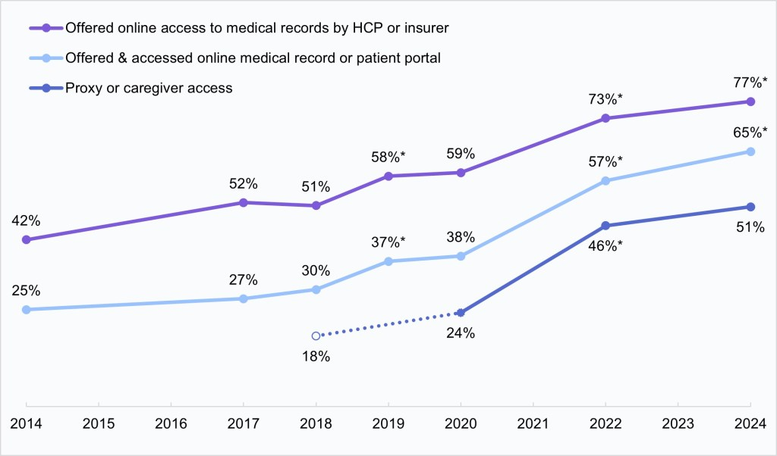
Rapid change in patient access of their electronic health information over the last decade.
Percent of individuals nationwide who were offered and accessed a patient portal, 2014-2024.
Source: https://healthit.gov/data/data-briefs/individuals-access-and-use-patient-portals-and-smartphone-health-apps-2024/.

Slide 4
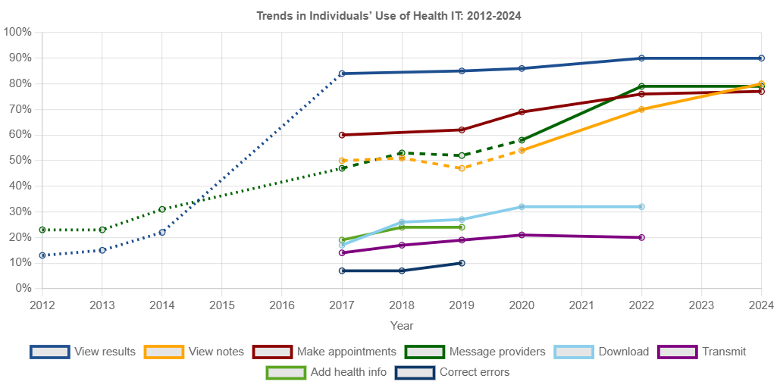
Patient access has unleashed patients’ use of their health information
Trends in Individuals’ Use of Health IT (Among Portal Users), 2012-2024
Source: https://healthit.gov/data/quickstats/trends-individuals-use-health-it-2012-2024/
Notes:
Fifteen years ago, some patients could schedule an appointment, check lab results, and message their provider online. Now those capabilities are nearly ubiquitous.
Ten years ago, some patients could electronically view their doctor’s notes and virtually speak to a provider face-to-face. Now those capabilities are nearly ubiquitous.
Five years ago, patients were beginning to aggregate their medical records across different sources. Now, patients are able to use AI tools to generate new insights from those aggregated records.

Slide 5






Measuring Health IT Use and Interoperability from Multiple Perspectives
End Users of certified health IT
Entities enabling exchange
Health care providers
Patients/Caregivers
Clinicians
Health information exchange networks
Third-party app developers
Certified health IT developers

Slide 6

Survey-Based Data Sources
Survey | IT Survey | Continuous Certification Questionnaire​ (CCQ) | National Substance Use and Mental Health Services Survey (N-SUMHSS) | Digital Health Company Survey | Health Information National Trends Survey | Health Information Exchange Organization Survey
Organization(s) | American Hospital Association (AHA) | American Board of Family Medicine (ABFM) | Substance Abuse and Mental Health Services Administration (SAMSHA) | California Health Care Foundation, UCSF, Scale Health | National Cancer Institute | Civitas, UCSF
Year | 2023, 2025 | 2024 | 2024 | 2022 | 2024 | 2024/2025
Number of Respondents | 2500+ non-federal, acute care hospitals | 8,000+ family medicine physicians | 21,000+ unique treatment facilities (substance use and/or mental health treatment) | 141 digital health companies | 7,278 individuals | 76 HIOs (out of 87)
Response Rate | 50-60% | 100%* | 90% | 20% | 27% | 87%
Note: * Due to the required nature of the questionnaire. Find more information at https://healthit.gov/data/about/#understanding-survey-data-collection.

Slide 7
Hospital interoperability and Barriers to Exchange
Physician Experiences with Administrative Burdens and Interoperability
Behavioral Health Interoperability
Interoperability between EHRs and Third-Party Technology

Slide 8
Hospital Interoperability and Barriers to Interoperable Exchange
Findings from the 2025 American Hospital Information Technology Supplement

Slide 9
U.S. non-federal acute care hospital engagement in interoperability has more than tripled in the last decade
Source: American Hospital Association Information Technology Survey
Notes:
Hospital engagement in interoperable exchange has more than tripled in the past decade: less than a quarter (23%) were able to find, send, receive, integrate in 2014 and now more than three-quarters report engagement in all 4 aspects of interoperable exchange.
Notably nearly all non-federal acute care hospitals can find, send, and receive information but integration without special effort has remained fairly stagnant over the last few years

Slide 10

Methods used by hospitals to send patient health information
71%
73%
76%
78%
75%
61%
59%
62%
43%
35%
Source: American Hospital Association Information Technology Survey
HIE = Health Information Exchange Organizations (state, local, regional)
HISP = Health Information Service Providers that enable messaging via DIRECT protocol
Notes:
While network-based exchange is increasing—62% of hospitals using vendor networks, 75% using national networks, and 78% using local HIEs—rates of mail or fax are not decreasing.

Slide 11
Methods used by hospitals to receive patient health information
76%
80%
73%
74%
67%
61%
49%
46%
41%
32%
Source: American Hospital Association Information Technology Survey
HIE = Health Information Exchange Organizations (state, local, regional)
HISP = Health Information Service Providers that enable messaging via DIRECT protocol
Notes:
80% of hospitals still receive information via mail or fax but rates of this happening “often” are decreasing. As of 2025, more than half of hospitals often receive information via network-based exchange. Note very low rates of sending and receiving information through a vendor-based network “sometimes” – when a hospital participates in a vendor-based network, information appears to flow freely.

Slide 12
80% of hospitals reported participating or planning to participate in TEFCA in 2025.
80% participate or plan to participate in TEFCA
Source: American Hospital Association Information Technology Survey
Notes:
In addition to specific methods of exchange we’ve also been tracking hospital awareness & participation in the Trusted Exchange Framework & Common Agreement over time
For the first time in 2025 hospitals started writing in “TEFCA” as a method of exchange, often in addition to the designated Qualified Health Information Network (QHIN) they partnered or contracted with for participation. Going forward we will start asking hospitals to indicate this on the survey alongside their participation in other types of health information networks they use for exchange.

Slide 13
In 2025, most hospitals report being able to send and receive information from most or all external hospitals and ambulatory care providers with whom they want to exchange
Source: American Hospital Association Information Technology Survey
Survey questions: “When a patient transitions to another care setting or organization, to what extent does your hospital electronically send or make available (receive or query) patient health information to (from) the following partners in a structured format (e.g., CCDA) that they (you) are able to use?”
Notes:
Last slide was about methods of exchange; this figure illustrates breadth of exchange with different types of providers.
More hospitals indicate they can send information to most/all providers with whom they want to exchange than receive from these types of providers.
Exchange is most difficult with LTPAC and behavioral health: less than half can send to most/all; less than a quarter can receive from most/all.

Slide 14
Frictions to interoperable exchange persist…
  Customized interfaces needed to exchange with outside orgs
  Data formatting – exchange partners do not provide data in requested format
  Patient matching – difficult to match or identify the correct patient between systems
  Providers lack EHR or other electronic system capable of receiving data (send barrier)
  Providers with shared patients don’t send data (receive barrier)
  Difficult to local provider address (e.g., lack of provider directory)
  Different vendor – difficult to exchange across vendor platforms
Source: American Hospital Association Information Technology Survey
Notes:
This slide shows some of the most common major and minor barriers to interoperable exchange I 2023 and 2025
Note that overall barriers are similar or slightly higher in 2025
As breadth of exchange increases, minor barriers that modestly reduces the value or frequency of exchange are also increasing with more exchange partners.

Slide 15
But major barriers that prevent exchange are diminishing
  Customized interfaces needed to exchange with outside orgs
  Data formatting – exchange partners do not provide data in requested format
  Patient matching – difficult to match or identify the correct patient between systems
  Providers lack EHR or other electronic system capable of receiving data (send barrier)
  Providers with shared patients don’t send data (receive barrier)
  Difficult to local provider address (e.g., lack of provider directory)
  Different vendor – difficult to exchange across vendor platforms
Source: American Hospital Association Information Technology Survey
Notes:
On the bright side, major barriers that prevent exchange are going down. Taken together this story

Slide 16
Physician Experiences with Administrative Burdens and Interoperability
Findings from the 2024 American Board of Family Medicine Continuous Certification Questionnaire

Slide 17
Administrative burdens are pervasive in family medicine, with substantial effort devoted to after-hours documentation, prior authorization, and obtaining external information.
Burden | Survey Question
Pajama Time | On average, how many hours per day do you spend outside of regular office hours documenting clinical care in your main outpatient EHR system?
Prior Authorization | How much time and effort do you or your staff spend completing prior authorizations for insurance or coverage purposes?
Tracking External Information | How much time and effort do you or your staff spend obtaining health information from outside organizations (e.g., scanning or uploading records)?
Source: The American Board of Family Medicine’s 2024 Continuous Certification Questionnaire

Slide 18
Administrative burdens are commonplace and cumulative
Notes: Burdens defined as substantial effort spent on tracking down external information, prior authorization, and after-hours documentation (“pajama time”).
Source: The American Board of Family Medicine’s 2024 Continuous Certification Questionnaire

Slide 19
Tracking down external information is a driver of documentation burden
Physicians who are dissatisfied with EHR support for obtaining health information from outside organizations or that have systems that do not support this task, report higher effort.
Source: The American Board of Family Medicine’s 2024 Continuous Certification Questionnaire
Notes:
29% are satisfied with EHR support for tracking down external health information, 15% are neither satisfied nor dissatisfied, 32% are dissatisfied. 16% EHR doesn’t have the capability.

Slide 20
Reported prior authorization burden remains high regardless of whether physicians can complete prior authorization within the EHR.
Notes: PA = Prior Authorization Source: The American Board of Family Medicine’s 2024 Continuous Certification Questionnaire
Notes:
25% can often complete PA within EHR, 35% can somewhat complete PA within EHR, and 17% cannot

Slide 21
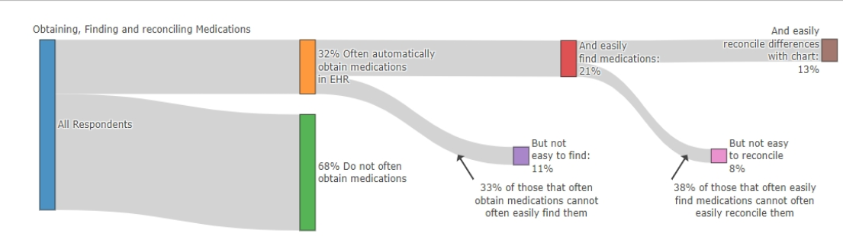
Ideal medication interoperability remains rare among physicians
13% of physicians that met this high-bar definition, reported that medications are automatically obtained, easy to find, and easy to reconcile within the EHR
Obtain → Find → Reconcile
Notes: Ideal interoperability defined as information being automatically obtained, easy to find, and easy to reconcile.
Figure from: Everson, J., Adler-Milstein, J., Phillips, R. L., Bazemore, A. W., & Patel, V. (2025). EHR Interoperability Experiences Reported by Family Physicians. JAMA Network Open, 8(11), e2542460-e2542460.
Notes:
The analysis simulated what would happen if more physicians reported that medication information was easy to obtain, find, and reconcile by randomly improving some survey responses and repeating the process 1,000 times to estimate the overall effect. It also modeled how improvements in one area of interoperability are linked to improvements in others, using observed patterns in the data to estimate how coordinated changes could increase ideal interoperability.

Slide 22
Nearly half of physicians experience ideal medication interoperability at least sometimes. The foundation is in place.
Progress from 13% to 45% signals meaningful momentum toward making ideal medication interoperability routine for physicians.
Notes: Ideal interoperability defined as information being automatically obtained, easy to find, and easy to reconcile. Estimates reflect simulated interrelated improvements in medication information interoperability.
Figure adapted from Everson, J., Adler-Milstein, J., Phillips, R. L., Bazemore, A. W., & Patel, V. (2025). EHR Interoperability Experiences Reported by Family Physicians. JAMA Network Open, 8(11), e2542460-e2542460.

Slide 23
Behavioral Health Interoperability
Findings from the 2024 National Substance Use and Mental Health Services Survey (N-SUMHSS)

Slide 24
The majority of behavioral health facilities reported exclusively using an EHR system.
Note: Data brief on U.S. Substance Abuse Treatment Centers (2017) is available here.
Notes:
2017
57% both electronic and paper
29% electronic only
13% paper only
1% N/A

Slide 25
VA health care facilities and certified community behavioral health clinics lead in exclusive EHR adoption.

Slide 26
More than half of facilities had to manually enter clinical information received electronically from outside providers.

Slide 27
Most facilities lacked “read only” access to clinical information from external organizations and almost one-third had no capability to search or query.
Notes:
EHR3: Does this facility's EHR integrate clinical information received electronically from outside providers, without manual entry? (Q.EHR3)
EHR4: Do external organizations provide this facility with 'read only' access to EHR clinical information? (Q.EHR4)

Slide 28
Across facility types, around one-third of facilities are unable to electronically search for clients’ external health information.
Notes:
Close to half of VA health care facilities and separate inpatient psychiatric units of a general hospital electronically search clients' health information from external providers/sources almost every day.

Slide 29
As of 2024, less than 1 in 3 facilities reported being connected to an HIO.

Slide 30
Interoperability between EHRs and Third-Party Technology
Findings from various sources

Slide 31
From HITECH to 21st Century Cures
The 21st Century Cures Act recognized the mass changes created by rapid digitization and instructed federal agencies to implement new policies to ensure 21st century technology was implemented to follow through on the promises of the HITECH Act.
The “without special effort” provisions of the Cures Act in particular focused policy on curbing information blocking behaviors and enabling more seamless methods of exchange.
This has resulted in policies and program requirements focused on standards, trust, and openness.

Slide 32
FHIR, USCDI, and the opening up of the “app economy”.
ONC through its 2020 Cures Act Final Rule, began to implement these Cures Act provisions.
A primary focus was the finalization of a new standards-based application programming interface (API) supporting the HL7 Fast Healthcare Interoperability Resources (FHIR) standard, which enabled API access at a minimum to data elements adopted as part of the US Core Data for Interoperability (USCDI) standard.
Other policies included requirements on developers of certified APIs to publish their customer endpoints so third-party technology (in use by patients and providers) can securely access patient information via these APIs.
This was the start of building new infrastructure to enable more connectivity and interoperability between EHR systems and third-party technology to deliver more innovation and competition in the digital health marketplace.

Slide 33
What have been the results of these policies?

Slide 34
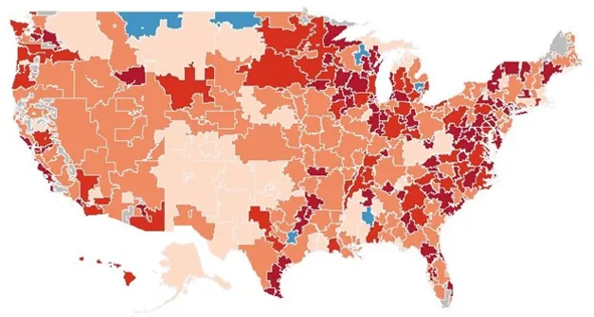
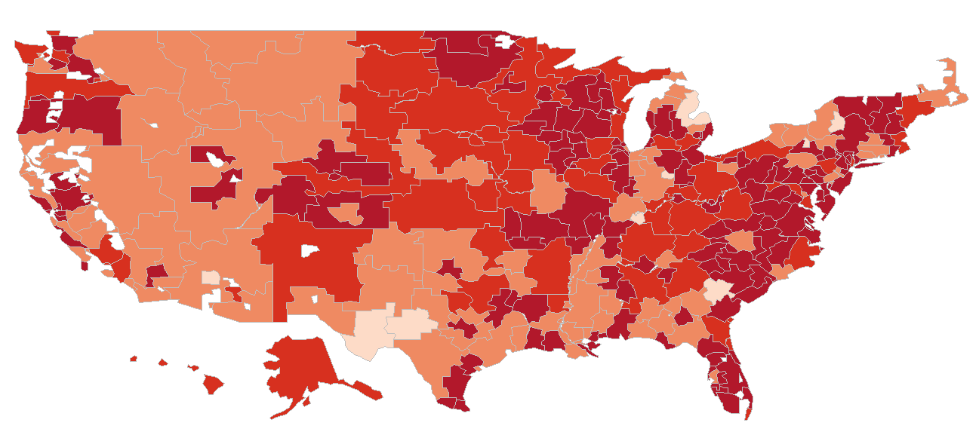
FHIR APIs have been broadly certified by developers of certified health IT and deployed by their customers.
Percent of hospitals (by hospital referral region) who have implemented FHIR-based APIs
2019 (84%)
2024 (93%)
Source: Certified Health Information Technology Reported by Hospitals for Promoting Interoperability Performance. https://healthit.gov/data/datasets/certified-health-information-technology-reported-by-hospitals-for-promoting-interoperability-performance/. Certified Health IT Product List (CHPL). https://chpl.healthit.gov/.

Slide 35
More data is accessible via these APIs as USCDI has advanced.
USCDIv3 required January 1, 2026
Source: Analysis of United State Core Data for Interoperability (USCDI) data element list, versions 1 through 6. https://isp.healthit.gov/united-states-core-data-interoperability-uscdi

Slide 36
More technology available to health care provider and patient EHR users (beyond what the EHR developer provides alone.)
Source: The Ecosystem of Apps and Software Integrated with Certified Health Information Technology. https://healthit.gov/data/datasets/app-marketplace-tech-ecosystem/

Slide 37
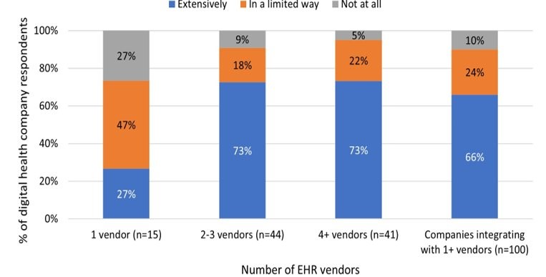
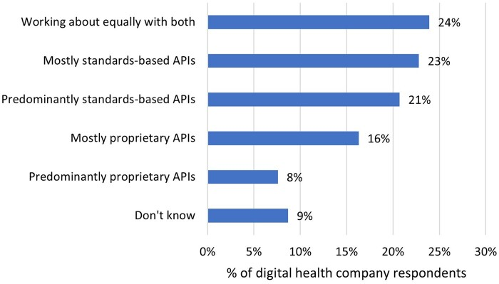
The third-party developer community has broadly embraced FHIR, but not all APIs are built on FHIR.
85% of companies reported use of FHIR, but it varies, 2022
Use of EHR APIs by third-party digital health companies, 2022
Source: A national survey of digital health company experiences with electronic health record application programming interfaces. https://doi.org/10.1093/jamia/ocae006.

Slide 38
The vast majority of hospitals share data with third-party technology for various clinical and administrative use cases.
% of hospitals sharing data with 3rd party tech for clinical uses
% of hospitals sharing data with 3rd party tech for admin uses
Source: Strawley C, Barker W. Hospital Use of APIs to Enable Data Sharing between EHRs and Third-Party Technology. Office of the Assistant Secretary for Technology Policy. Data Brief: 81. February 2026. https://healthit.gov/data/data-briefs/
Note: *Indicates significantly different from the corresponding method of exchange for "Provide." †Significantly different from "Other Approaches ONLY."

Slide 39
Third-party AI technology use cases increasingly implemented.
Percent of hospitals that adopted predictive AI models/tools by developer source, 2023-2024
 | EHR developed AI (80%)† |  | Other sources only (20%)†
 | 2024 | Change from 2023 | 2024 | Change from 2023
Predicting health trajectories or risks for inpatients | 93%* | -3% | 87%* | +12%
Identify high risk outpatients to inform care | 88%* | -3% | 82%* | +51%
Monitor health | 37% | -2% | 17% | +3%
Recommend treatments | 53% | +2% | 16% | -1%
Simplify billing | 58%* | +15% | 73%* | +60%
Facilitate scheduling | 67%* | +19% | 65% | +6%
Source: Chang W, Owusu-Mensah P, Everson J, Richwine C. Hospital Trends in the Use, Evaluation, and Governance of Predictive AI, 2023-2024. Office of the Assistant Secretary for Technology Policy. Data Brief: 80. September 2025. https://healthit.gov/data/data-briefs/hospital-trends-use-evaluation-and-governance-predictive-ai-2023-2024/
Note: *Indicates statistically significant difference relative to 2023 within a corresponding category (p<0.05). †AI source (denotes 2024 percentages).

Slide 40
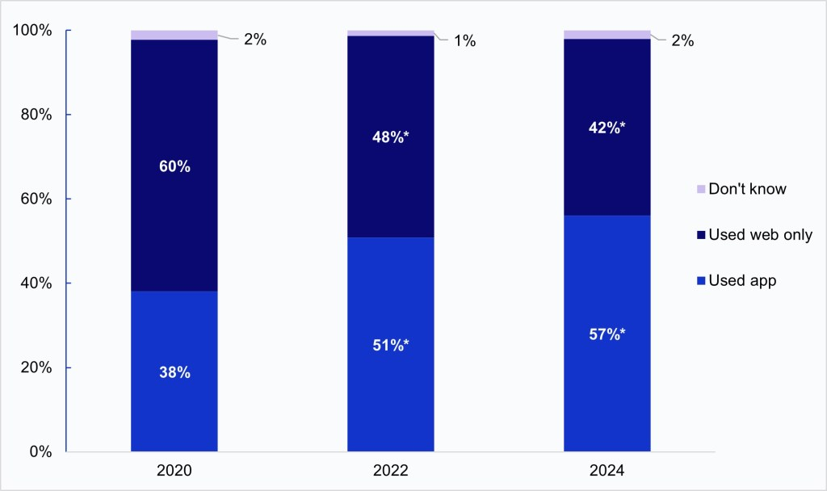
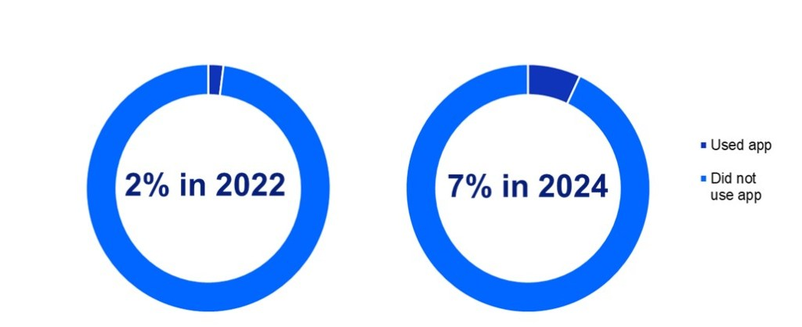
Patients increasingly use apps to access their records, but PHRs are not commonly used.
Individuals’ use of apps to access their online medical records, 2024.
Individuals’ use of portal organizing apps to combine medical information from different patient portals or online medical records into one place, 2022-2024
Source: HINTS 5, Cycle 4 (2020); HINTS 6 (2022); HINTS 7 (2024). http://healthit.gov/data/data-briefs/individuals-access-and-use-patient-portals-and-smartphone-health-apps-2024/
Note: *Significantly different from prior year.

Slide 41
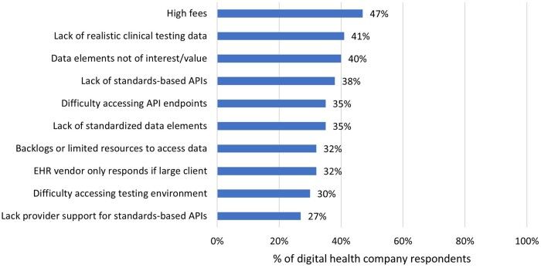
Connectivity is increasingly standards-based, but not free and easy.
Top 10 “substantial” barriers to integrate with EHRs via APIs, 2022 (as reported by digital health companies)
Source: A national survey of digital health company experiences with electronic health record application programming interfaces. https://doi.org/10.1093/jamia/ocae006.

Slide 42
Market leading EHRs and higher-resourced health care providers are leading implementation and taking most advantage of technological advancements.
AI implementation, 2023-2024
Third-party technology integrations, 2024
Hospital Characteristics | 2023 | 2024
Hospital Size
Small < 100 (ref) (n=951)† | 53% | 59%
Medium 100 – 399 (n=845) | 75%* | 80%*
Large > 400 (n=284) | 90%* | 96%*
Clinical Purposes |  |  |  | Administrative Purposes
Integrate |  | Provide |  | Integrate |  | Provide
Any method | Standard-based API | Any method | Standard-based API | Any method | Standard-based API | Any method | Standard-based API
91% | 52% | 83% | 39% | 87% | 35% | 86% | 32%
EHR (market leading (top 3) and all others)
94%* | 56%* | 87%* | 43%* | 90%* | 37%* | 90%* | 34%*
67% | 20% | 55% | 15% | 60% | 20% | 62% | 14%
Hospital Bed Size (>100 beds and <100 beds)
96%* | 56%* | 90%* | 44%* | 94%* | 38%* | 93%* | 35%*
85% | 47% | 76% | 34% | 80% | 33% | 79% | 29%
EHR (market leading (top 3))
Market leading vendor (n=1,197) | 87% | 90%
All other vendors (n=883) | 48%* | 50%*
Source: American Hospital Association Information Technology Survey
Note: *Significantly different from reference group.

Slide 43
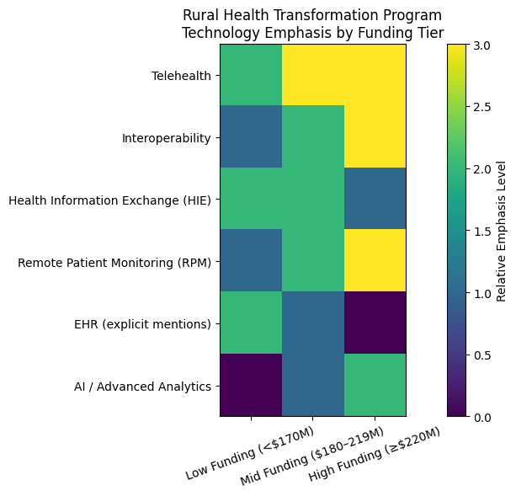
The Rural Health Transformation Program creates tremendous opportunities to states to invest in technology advancement in rural settings.
Analysis of the 50 state plans for the Rural Heath Transformation Program show how states plan to use funding to make technology investments in rural health care providers.
States who receive more funding are more likely to invest more in telehealth, remote patient monitoring, and information exchange, but all states plan to use some funding to make these technology investments over the next 5 years.
Note: Analysis by ChatGPT of RHTP 50 State Spotlight: https://www.cms.gov/files/document/rural-health-transformation-50-state-spotlights.pdf.

Slide 44
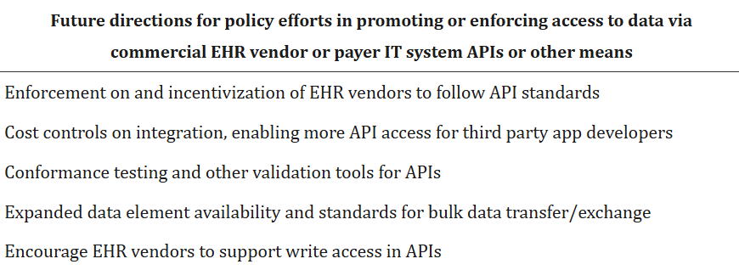
Regulated APIs and certification requirements are limited in scope and special effort still needed.
Source: A national survey of digital health company experiences with electronic health record application programming interfaces. https://doi.org/10.1093/jamia/ocae006.

Slide 45


Shape the Future of Health IT
Are you a digital health company integrating with EHRs?
UCSF and federal policymakers want to hear from you. Your experience with API-based electronic health record integration can directly inform national health IT policy.
>>>Take the survey now!

Slide 46



What
Participate in a national survey of digital health companies focused on API-based EHR integration. Your insights will inform future health IT policy.
Why Participate
Your input will help federal policymakers understand API use and real-world integration challenges.
Selected survey participants will have opportunities to participate in onstage panels with UCSF at national conferences.
Now Accepting Responses!
Scan the QR code to take the survey:
In partnership with:
Questions?
Julia.adler-milstein@ucsf.edu

Slide 47

@HHS_TechPolicy
Share your content on X and don't forget to use the hashtag #ASTP2026

