Slide 1
Where are we and where do we go from here?
February 11, 2026

Slide 2


Disclaimers & Reminders
  The contents of this presentation are based on cited references, including the provisions codified in 45 CFR part 171 and preamble discussion of these provisions in relevant final rules. While every effort has been made to ensure the accuracy of this presentation of those provisions, this presentation does not have the force of law. Statutes and regulations have the force of law. Therefore, in the event of any inconsistency between this presentation and any relevant statute or regulation, the statute or regulation controls.
  Please note that other Federal, state or tribal laws may also apply.
  This communication is produced and disseminated at U.S. taxpayer expense.
The HTI-5: Deregulatory Actions to Unleash Prosperity Proposed Rule includes several proposed revisions to information blocking regulations.​
Find the rule and link to submit public comments at: https://www.federalregister.gov ​
Public comment period closes Feb 27, 2026.​
​
Check Tomorrow’s Agenda for HTI-5 Breakout Session Details

Slide 3
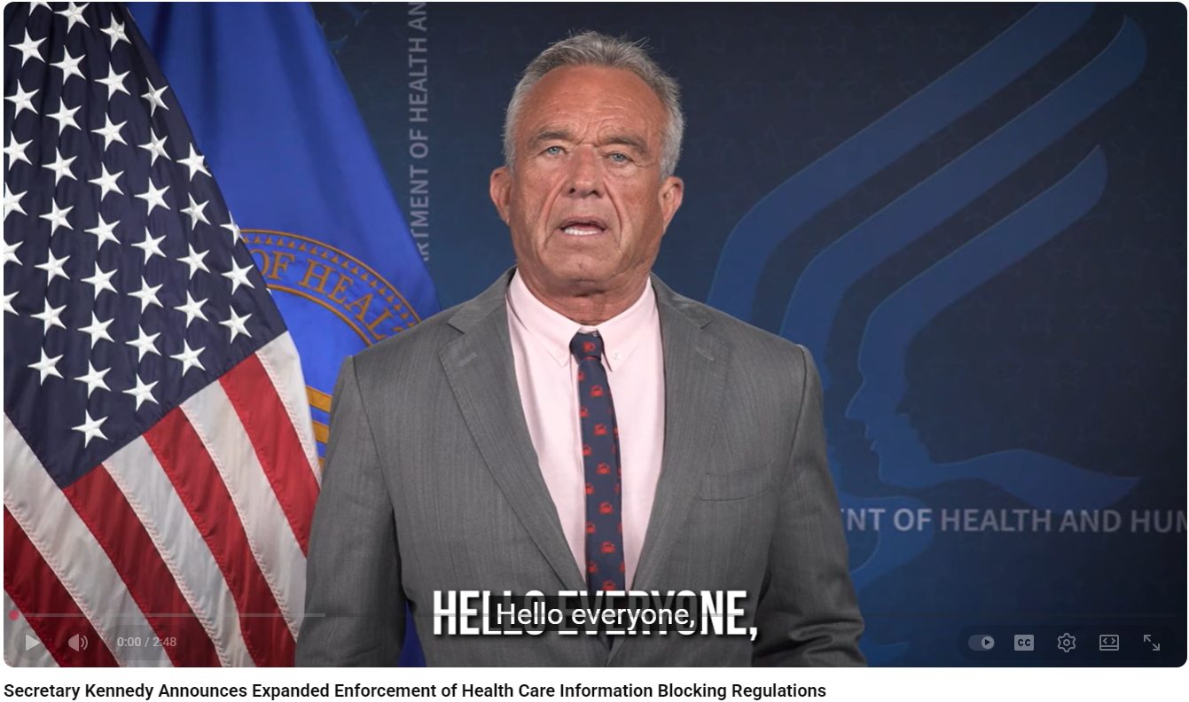
HHS Secretary Kennedy Announces Expanded Enforcement of Information Blocking Regulations
"We will not tolerate any company that blocks your right to access your health information—or your right to share it with the trusted parties you choose.“
-Secretary Kennedy
https://www.youtube.com/watch?v=u1N7bX0cgvI&t=19s

Slide 4
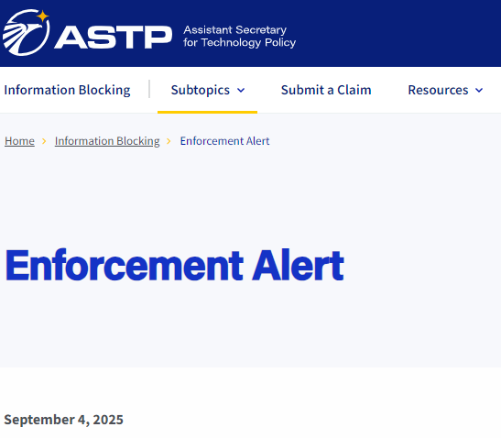
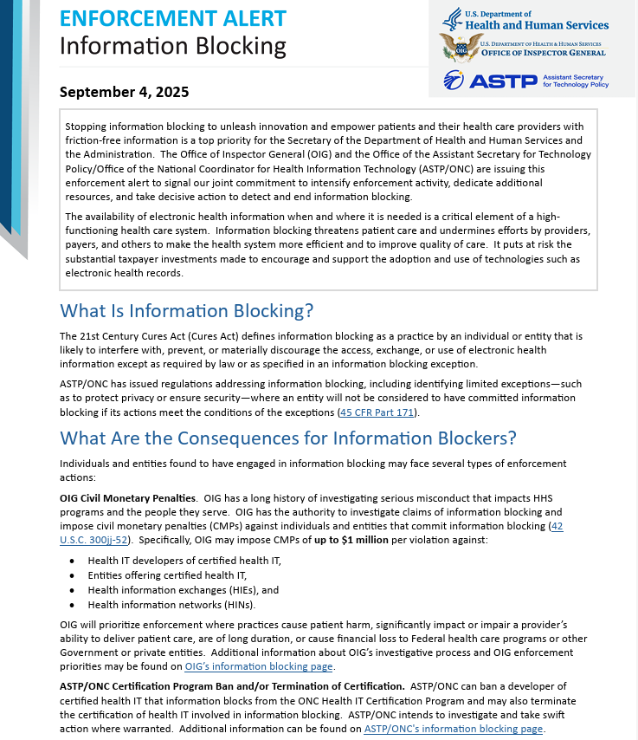
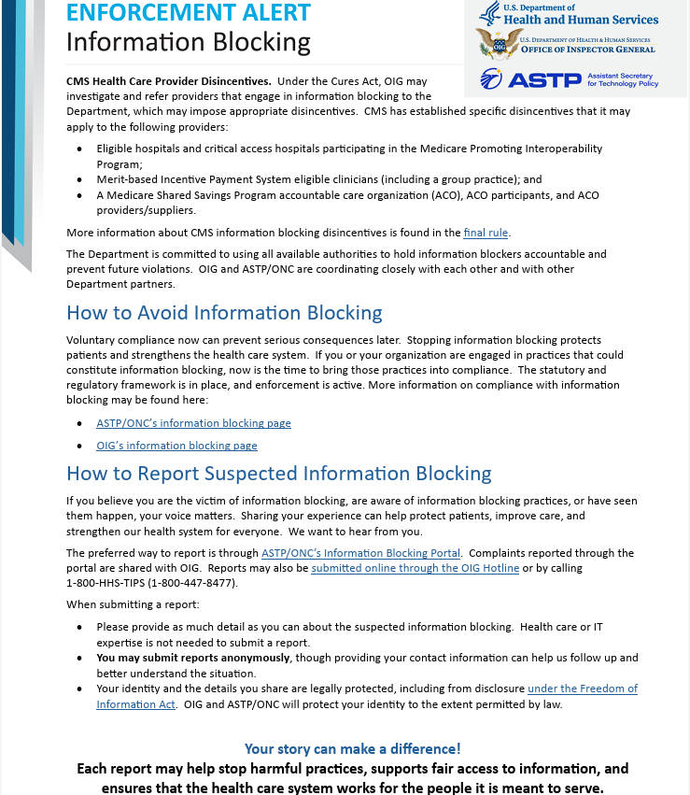
Enforcement Alert – Information Blocking

Slide 5
Interagency Coordination: Public Health Service Act – 300jj-52
(c) Identifying barriers to exchange of certified health information technology […]
(3) Referral The National Coordinator and the Office for Civil Rights of the Department of Health and Human Services may refer to the Inspector General instances or patterns of refusal to exchange health information with an individual or entity using certified electronic health record technology that is technically capable of trusted exchange and under conditions when exchange is legally permissible.
(d) Additional provisions
(1) Information sharing provisions The National Coordinator may serve as a technical consultant to the Inspector General and the Federal Trade Commission for purposes of carrying out this section. The National Coordinator may, notwithstanding any other provision of law, share information related to claims or investigations under subsection (b) with the Federal Trade Commission for purposes of such investigations and shall share information with the Inspector General, as required by law.
FTC Expresses Unanimous Support for ONC Cures Act Final Rule

Slide 6
Third Party Submitting IB Claim – New – June 2025
Can I have a third party submit an information blocking claim on my behalf?
Yes. Anyone, individually or as a group, can have a third party of their choosing submit a claim of possible information blocking to HHS on their behalf.
ID:IB.FAQ52.1.2025JUN
https://healthit.gov/faq/can-i-have-a-third-party-submit-an-information-blocking-claim-on-my-behalf/

Slide 7
Interference FAQ – New – July 2025
Would it be considered an interference under the information blocking regulations if a health IT developer of certified health IT limited a customer’s or a user’s choice of QHINs for the purposes of participating in TEFCA?
Yes, it would likely be considered an interference with the access, exchange, or use of EHI if an actor restricts or impedes a customer or user from obtaining or using the QHIN connectivity services of their choice because such services provide for the access, exchange, and use of EHI.
The information blocking law (42 U.S.C. § 300jj-52) may be implicated when an actor engages in exclusionary, discriminatory, or other practices that impede the dissemination or use of interoperable technologies and services, and that interfere with the access, exchange, or use of EHI (85 FR 25813-25814). Examples of practices by a developer of certified health IT that would likely be an interference include practices that restrict or impede a customer’s or a user’s access, exchange, or use of EHI through QHIN connectivity services by: establishing contractual terms that limit or have the effect of reducing the choices of a customer or user to use any QHIN; imposing unreasonable fees for access to certain QHINs; and taking unnecessary time for configuration changes or other technical steps needed to use a QHIN’s connectivity services. Each of these examples would be especially concerning when the QHIN may be a competitor of the actor because it may indicate that different fee structures or terms do not reflect genuine differences in the cost or the effort required to provide access, exchange, or use of EHI (85 FR 25814, 85 FR 25881-25882; 45 CFR 170.302(a)(2)).
ID:IB.FAQ53.2025JUL
https://www.healthit.gov/faq/can-actor-meet-fees-exception-if-it-conditions-access-exchange-or-use-ehi-establishment-revenue

Slide 8
FAQ on automation technologies – New – December 2025
Could an actor’s practice that interferes with an automation technology’s ability to access, exchange, or use EHI implicate the information blocking regulations?
Yes. An actor’s practice that interferes with, prevents, or materially discourages the access, exchange, or use of EHI by automation technologies (e.g., robotic process automation (RPA), agentic artificial intelligence) could implicate the information blocking regulations. The information blocking definition (42 CFR 171.103) is not specific to any particular means, manners, or mechanisms by which access, exchange, or use of EHI is sought and could be accomplished. Thus, an actor’s practice that is likely to interfere with, prevent, or materially discourage access, exchange, or use of EHI by automation technologies could implicate the information blocking provision.
ID:IB.FAQ54.2025DEC
https://www.healthit.gov/faq/could-actors-practice-interferes-automation-technologys-ability-access-exchange-or-use-ehi

Slide 9
Manner Exception FAQ – 1 of 2 New – December 2025
Does an actor have to provide all the EHI requested by a requestor to satisfy the Manner Exception?
Generally, yes, but it may depend on the circumstances.
The scope of EHI^{[1]} for which the actor must fulfill a request for access, exchange, or use in order to satisfy the Manner Exception is determined by the scope of the request and thus by the requestor. This is true regardless of whether the actor seeks to fulfill the request consistent with the manner requested condition (see 45 CFR 171.301(a)), the alternative manner condition (45 CFR 171.301(b)), or a combination of the conditions.
If the requestor’s request is for access, exchange, or use of a subset of EHI that the actor can fulfill in the manner requested (45 CFR 171.301(a)), then the actor can satisfy the Manner Exception by providing access, exchange, or use of that subset of EHI in that requestor-specified manner so long as the actor’s practice in doing so is otherwise consistent with the Manner Exception (45 CFR 171.301).
By contrast, if the actor cannot reach an agreement with the requestor or is not technically capable of providing all of the requested EHI in a particular requestor-specified manner, then to satisfy the Manner Exception for the request the actor would need to use one or more additional alternative manners specified by the requestor (45 CFR 171.301(b)(1)(i) and (ii)) or agreed to by the requestor (45 CFR 171.301(b)(1)(iii)), working through manners in the priority order identified in the alternative manner condition, until the actor has made all requested EHI available to the requestor.
An actor might have the technical capability to satisfy the Manner Exception for only some of the EHI requested in the manner(s) the requestor specifies. In such instances, the actor may want to consider whether another exception may apply for the remaining EHI not fulfilled through the Manner Exception.
^{[1]} EHI is defined for purposes of the information blocking regulations in 45 CFR 171.102. On and after October 6, 2022, the scope of EHI for purposes of the information blocking definition (45 CFR 171.103) is EHI as defined in 45 CFR 171.102 (89 FR 1199, 85 FR 70069).
ID:IB.FAQ55.2025DEC
https://www.healthit.gov/faq/does-actor-have-provide-all-ehi-requested-requestor-satisfy-manner-exception

Slide 10
Manner Exception FAQ – 2 of 2 New – December 2025
What role does a “requestor” play under the alternative manner condition of the Manner Exception?
When an actor believes they can fulfill a request for access, exchange, or use of electronic health information (EHI), they may seek to satisfy the Manner Exception (45 CFR 171.301) to be sure they are not committing information blocking. The Manner Exception states in principle that an actor “must fulfill a request for EHI in any manner requested, unless the actor is technically unable to fulfill the request or cannot reach agreeable terms with the requestor to fulfill the request in the manner requested” (45 CFR 171.301(a)(1), 85 FR 25877). If an actor does not fulfill a request for EHI in any manner requested because the actor is technically unable to fulfill the request or cannot reach agreeable terms with the requestor, the Manner Exception then specifies that an actor must fulfill the request in an alternative manner (45 CFR 171.301(b)).
Under this alternative manner condition of the Manner Exception, the actor must fulfill the request for EHI without unnecessary delay in an alternative manner (45 CFR 171.301(b), 85 FR 25878). The actor must offer alternative manners in a strict priority order, starting with 45 CFR 171.301(b)(1)(i) and only proceeding to the next consecutive paragraph if the actor is technically unable to fulfill the request in the manner identified in the paragraph.
Importantly, a requestor must specify the technology or standards, respectively, of the alternative manners under paragraphs (b)(1)(i) and (ii) or agree to an alternative machine-readable format under paragraph (b)(1(iii). Simply put, if the requestor does not specify technology certified to a standard or standards adopted in part 170 ((b)(1)(i)), or content and transport standards published by certain publishers ((b)(1)(ii)), or agree to an alternative machine-readable format ((b)(1)(iii)), then the actor cannot meet the alternative manner condition of the Manner Exception. An actor is not permitted to presume or dictate the manner in which access, exchange, or use of EHI is fulfilled under the alternative manner condition of the Manner Exception.
If an actor is unable to meet the Manner Exception, the actor may want to consider whether the actor can meet the conditions of another exception. For example, the actor may be able to rely on the Infeasibility Exception. One factor of the infeasible under the circumstances condition of the Infeasibility Exception is “why the actor was unable to provide access, exchange, or use of electronic health information consistent with the Manner Exception.” (45 CFR 171.204(a)(5)(i)(F), 85 FR 25867).
ID:IB.FAQ56.2025DEC
https://www.healthit.gov/faq/what-role-does-requestor-play-under-alternative-manner-condition-manner-exception

Slide 11
Fees Exception FAQ – New – December 2025
Can an actor meet the Fees Exception if it conditions the access, exchange, or use of EHI on the establishment of a revenue sharing agreement?
No. For an actor’s practice of charging fees for access, exchange, or use of EHI to not be considered information blocking under the Fees Exception, the fees an actor charges must not be based on the revenue that the requestor derives or may derive from the access, exchange, or use of the EHI (45 CFR 171.302(a)(2)(ii)). The conditioning of access, exchange, or use of EHI on the establishment of “revenue sharing” or “royalty agreements” with third parties seeking access, exchange, or use of EHI provided by an actor to a requestor that go beyond recovering costs reasonably incurred by the actor to enable the access, exchange, or use of EHI could implicate the information blocking provision (85 FR 25882, 85 FR 25879).
ID:IB.FAQ57.2025DEC
https://www.healthit.gov/faq/can-actor-meet-fees-exception-if-it-conditions-access-exchange-or-use-ehi-establishment-revenue

Slide 12


Goals of the HTI-5 Proposed Rule
The HTI-5 Proposed Rule has three core goals:
Cost Savings:
Reducing burden on health IT developers by streamlining the ONC Health IT Certification Program (Certification Program) by removing redundant requirements;
Updating the information blocking regulations to better promote EHI access, exchange, and use so that patients’ access to their data is not blocked; and
Advancing a new foundation of Fast Healthcare Interoperability Resources (FHIR®)-based application programming interfaces (APIs) that promote AI-enabled interoperability solutions through modernized standards and certification.
$1.53 billion, including $650 million over the next 5 years for health IT developers, providers, and other stakeholders.
The proposed revisions and removal of certification criteria from the Certification Program are estimated to save certified health IT developers more than 1.4 million compliance hours in their first year (an average savings of 4,000 hours per developer) – giving developers new capacity to deliver innovative solutions for their customers.
The proposed deregulatory actions reduce the effort of developers of certified health IT to meet ongoing Certification Program requirements and reduce barriers to entry for new Certification Program participants.

Slide 13
Current Definitions - § 171.102
Proposal:
Revise the “access” and “use” definitions in § 171.102 to emphasize that the definitions include automated means of access, exchange, or use of EHI — including, without limitation, autonomous AI systems.
Additional “Alternative” Proposal:
In addition to updating the “access” and “use” definitions, potentially similarly revise the “exchange” definition.

Slide 14
Infeasibility Exception - § 171.204
Third party seeking modification use condition - § 171.204(a)(3)
Proposal: Remove.
Manner exception exhausted condition - § 171.204(a)(4)
Proposal: Revise to:
Require all three “alternative” manners from the Manner Exception alternative manner condition be offered
Replace “[t]he actor does not provide the same access, exchange, or use of the requested electronic health information to a substantial number of individuals or entities that are similarly situated to the requestor”
with
“[t]he actor does not provide analogous access, exchange, or use of the requested electronic health information to any other individual or entity”
  Essentially, we are proposing to replace “same” with “analogous” and remove the “substantial number” and “similarly situated” conditions.
Alternative Proposal: Remove the condition.

Slide 15
Manner Exception - § 171.301
Manner requested condition - § 171.301(a)
Proposal:
Alternative Proposal:
Add text explicitly stating that any contract or agreement under which the actor and requestor agree to fulfill a request for access, exchange, or use of EHI, and any license from the actor of interoperability elements used in fulfilling the request in the manner requested:
Must be at market rate;
Must not be a contract of adhesion; or
Must not contain unconscionable terms.
Add definitions to § 171.102 for market rate, contract of adhesion, and unconscionable terms
Remove paragraph (a)(2) from the manner requested condition of the Manner Exception (excludes application of the Fees and Licensing Exceptions to agreements under paragraph (a) to fulfill requests for EHI in any manner requested.
Apply the conditions of both the Fees Exception and Licensing Exception to any agreement an actor makes with a requestor related to fulfilling the request for access, exchange, or use of EHI in any manner requested.
Whether or Not a Proposal is Adopted
The manner requested condition only covers the technical manner of exchange of the requested EHI.
Contracts or agreements for access, exchange, and use of EHI cannot be contracts of adhesion or contracts containing unconscionable terms. These types of contracts are not covered by the Manner Exception even if these agreements were styled as, or in fact were, achieving access, exchange, or use of the requested EHI in the requested manner. These types of contracts would also likely constitute an interference under the information blocking regulations. (90 FR 61012)

Slide 16
Trusted Exchange Framework and Common Agreement (TEFCA) Manner Exception - § 171.403
Proposal:
Remove the TEFCA Manner Exception (§ 171.403) and associated definitions.

Slide 17


URL: HealthIT.gov/Proposedrule
COMMENT PERIOD
Dec. 29, 2025 – Feb. 27, 2026.

Slide 18
Regulatory Definition of “Interfere With” or “Interference” (§ 171.102)
Interference means “to prevent, materially discourage, or otherwise inhibit.”
  Mirrors the statutory language referring to practices “likely to interfere with, prevent, or materially discourage” access, exchange, or use of EHI.

Slide 19
Previous Proposal to Codify Descriptions of Interference Practices
HTI-2 Proposed Rule
  ONC proposed to codify specific practices in § 171.104 that constitute interference
  Codified list is not exhaustive—other practices may constitute interference based on circumstances.
  Specific practices are not referred to as examples (due to intent-based nature of statute)
  This proposal was withdrawn, along with others not yet finalized from HTI-2 Proposed Rule, December 29, 2025.

Slide 20
Description of Interference:
Actions That Impose Delays on Access, Exchange, or Use of EHI
  Actions taken by an actor to impose delays on another person’s ability to access, exchange, or use EHI constitute an interference.
  Includes both affirmative acts and omissions designed or structured to slow data movement.
  Delays are a common category of interference raised through FAQs, reports, and stakeholder inquiries.

Slide 21
Description of Interference:
Delaying Access for Patient-Authorized Apps Using APIs
  Delaying the access, exchange, or use of EHI by a third-party app designated and authorized by the patient constitutes an interference when a deployed API is capable of supporting that access.
  “App” includes patient-facing smartphones, web apps, wearables, and other tools leveraging modern APIs (e.g., § 170.315(g)(10)-certified APIs).
  Directly tied to ONC’s Cures Act mandate to ensure seamless patient access via APIs.
  One of the strongest examples of interference because delays undermine the statutory right of patients to access their EHI where APIs are operational.

Slide 22
Description of Interference:
Failure to Publish Required API Technical Information
  Failure to publish or make available essential API-related details—such as service base URLs for Certified API Technology—is an interference
  These omissions prevent apps, developers, and other systems from connecting or requesting EHI as intended under the Cures Act.

Slide 23
Description of Interference:
Non-Standard or other Inappropriate Implementations of Health IT
  Implementing health IT in non-standard ways that limit interoperability or complicate how others access, exchange, or use EHI is an interference. Includes proprietary configurations, custom interfaces, or restrictions that frustrate standardized data exchange.
  Implementing health IT in ways that lead to fraud, waste, or abuse, or impede innovations and advancements in health information access, exchange, and use, including care delivery enabled by health IT

Slide 24
Description of Interference:
Improper Inducements or Discriminatory Contract Terms
  Contractual conditions that discriminate among persons and entities seeking access, exchange, or use of EHI may constitute interferences.
  Includes leveraging contracts to impose unequal terms, unnecessary conditions, or burdens unrelated to legitimate privacy/security requirements.

Slide 25
Public Health Service Act: 3001(c)(5)(D)
(D) CONDITIONS OF CERTIFICATION — […] the Secretary, through notice and comment rulemaking, shall require, as a condition of certification and maintenance of certification…that the health information technology developer or entity—
does not take any action that constitutes information blocking as defined in section 3022(a);
provides assurances satisfactory to the Secretary that such developer or entity, unless for legitimate purposes specified by the Secretary, will not take any action described in clause (i) or any other action that may inhibit the appropriate exchange, access, and use of electronic health information; […]
(iv) has published application programming interfaces and allows health information from such technology to be accessed, exchanged, and used without special effort through the use of application programming interfaces or successor technology or standards, as provided for under applicable law, including providing access to all data elements of a patient’s electronic health record to the extent permissible under applicable privacy laws

Slide 26
Conditions and Maintenance of Certification Requirements
Seven (7) Conditions of Certification with Maintenance of Certification Requirements
Information Blocking
Assurances
Communications
Application Programming Interfaces (APIs)
Real World Testing
Attestations
Insights (EHR Reporting Program)
The 21st Century Cures Act requires HHS to establish Conditions and Maintenance of Certification requirements for the ONC Health IT Certification Program.

Slide 27
ONC Certification Program Oversight: Direct Review
§ 170.580 ONC review of certified health IT
(a) Direct Review […]
(2)[…](iii) Noncompliance with a Condition and Maintenance of Certification requirement. ONC may initiate direct review under this section if it has a reasonable belief that a health IT developer has not complied with a Condition or Maintenance of Certification requirement under subpart D of this part. […]
(4) Coordination with the Office of Inspector General. […]
(b) Notice […] (2) Notice of non-conformity —
Circumstances that may trigger notice of non-conformity. At any time during its review of certified health IT or a health IT developer's actions or practices under paragraph (a) of this section, ONC may send a notice of non-conformity to the health IT developer if it determines that certified health IT or a health IT developer's actions or practices does not conform to the requirements of the ONC Health IT Certification Program
(f) Termination — (1) Applicability. The National Coordinator may terminate a certification if:[…]
(iii) A determination is made that the health IT developer is noncompliant with a Condition or Maintenance of Certification requirement under subpart D of this part
§ 170.581 Certification ban.
(a) Circumstances that may trigger a certification ban. The certification of any of a health IT developer's health IT is prohibited when: […]
(2) ONC determines a certification ban is appropriate per its review under § 170.580(a)(2)(iii).

Slide 28
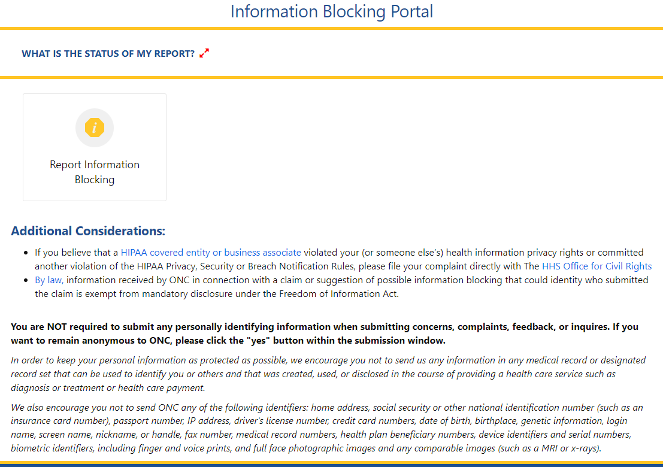
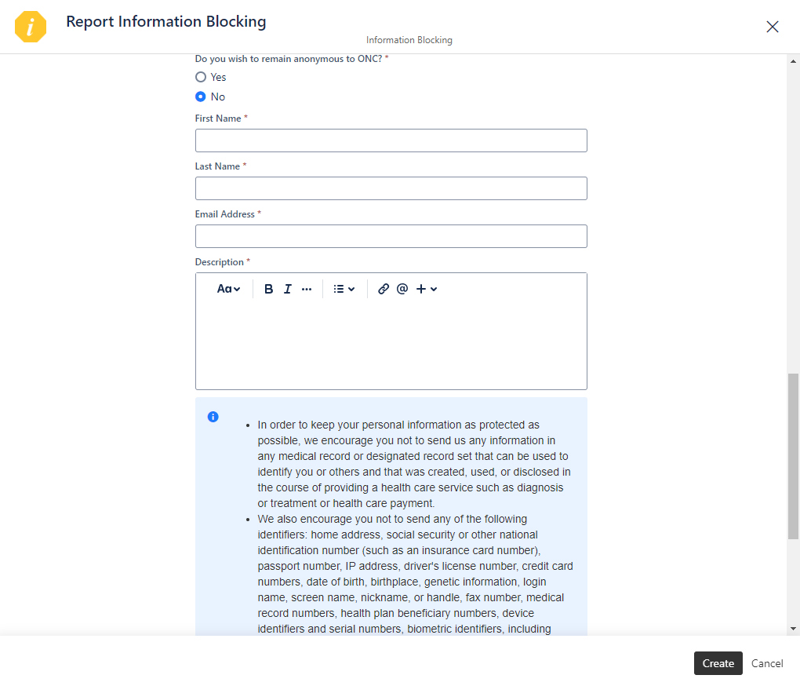
Report Information Blocking Portal Page
Report Information Blocking Portal (direct link):
https://healthit.gov/report-info-blocking

Slide 29
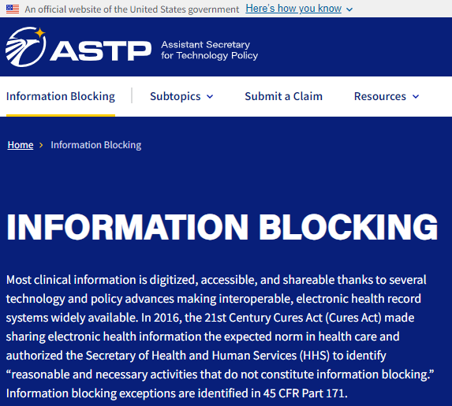

Where to Find More Information
ASTP Website Resources
Information Blocking Webpage (Fact Sheets, FAQs, Blogs, Webinars & Presentations, Press/Media): https://www.healthit.gov/topic/information-blocking
Information Blocking FAQs: https://www.healthit.gov/topic/information-blocking
Health IT Buzz Blog: https://www.healthit.gov/buzz-blog/
ASTP Speaker Request Form: https://www.healthit.gov/speaker-request-form

Slide 30






Reach out via phone or web
  202-690-7151
Feedback & Questions: https://www.healthit.gov/feedback
Report Information Blocking Portal (direct link):
https://healthit.gov/report-info-blocking
ASTP Speaker Request Form: https://www.healthit.gov/speaker-request-form
Stay connected, follow us on socials
  @HHS_TechPolicy
  Assistant Secretary for Technology Policy
www.youtube.com/@HHS_TechPolicy
Subscribe to our weekly eblast at healthit.gov for the latest updates!

Slide 31
IB Claims Data and HIO/Hospital IB Survey Results
February 11, 2025

Slide 32
Information Blocking Claims Received by ASTP: Summary Counts
Summary counts as of 1/31/2026
Total number of information blocking portal submissions received | 1,572
Total number of possible claims of information blocking | 1,483
Total number of submissions received that did not appear to be claims of potential information blocking | 89

Slide 33
Information Blocking Claims Received by ASTP: Summary Counts
*Numbers current as of 1/31/2026

Slide 34
Disclaimers on Information Blocking Claims Counts
The distribution of claims of possible information blocking received by ASTP through the Report Information Blocking Portal is not likely to be completely representative of the totality of possible information blocking that is occurring.
  In national survey data presented by ONC, 92% of responding HIOs and 97% of responding hospitals said they “Never/Rarely” report potential information blocking to HHS.
  Entities may be reluctant to submit claims of possible information blocking to HHS due to concerns about possible retaliation by the subject of their claim. By law, information received by ONC in connection with a claim or suggestion of possible information blocking that could identity who submitted the claim is exempt from mandatory disclosure under the Freedom of Information Act.
Information on categorization of claims is based solely on ASTP’s inference from the facts and allegations as presented by the claimant.
Any determination as to whether an information blocking actor’s conduct met the information blocking definition or not would require a fact-based, case-by-case investigation and review against all elements of the information blocking definition.

Slide 35
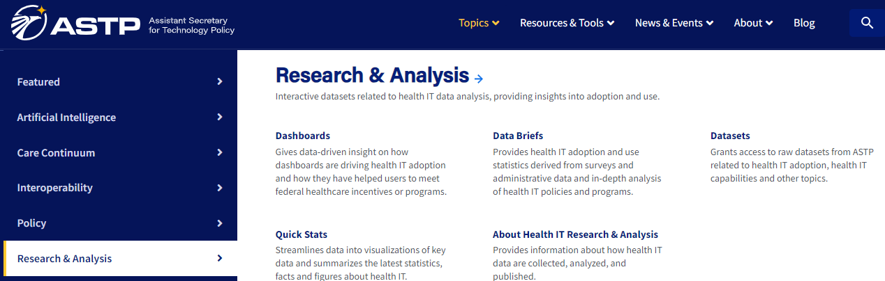
Information Blocking Quick Stats: Information Blocking Claims by the Numbers

Slide 36
Report Information Blocking Portal Page

Slide 37
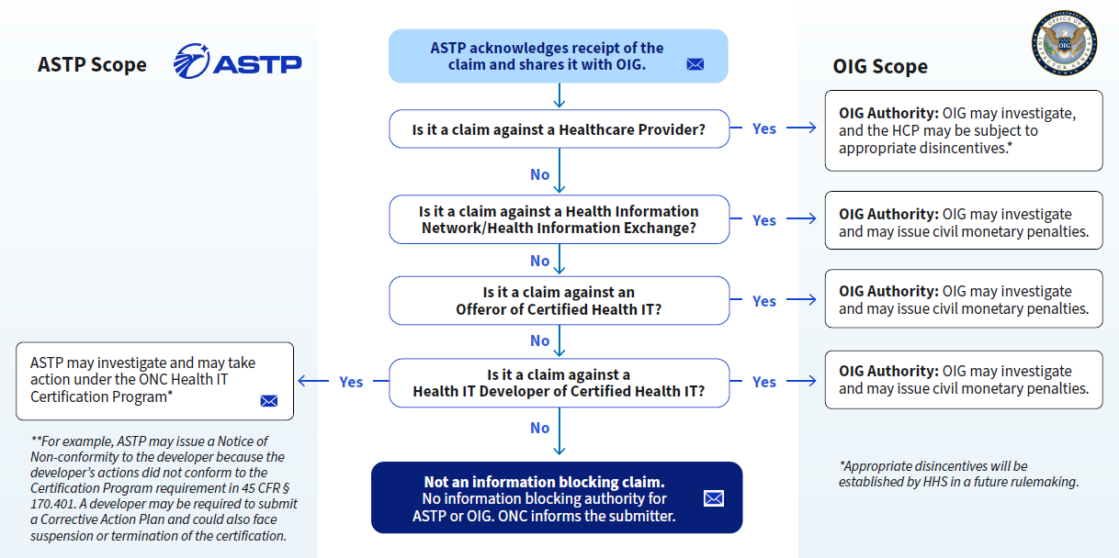

Information Blocking Portal Process – Overview

Slide 38
Health Information Exchange Organizations (HIOs/HDUs)
Experiences of Perceived Information Blocking from a National Survey

Slide 39
The percentage of HIOs reporting potential information blocking across any actor decreased from 2019 to 2025.
Source: National Survey of Health Information Organizations: 2019, 2023 and 2025.

Slide 40
Most HIOs reported that potential information blocking has either a great or moderate impact on information exchange.
Percent of HIOs that reported developers and hospitals sometimes or routinely used types of practices they perceived as potential information blocking.
Percent of HIOs who reported that experiencing potential information blocking affected their services.
Potential Information Blocking Practice | 2019 | 2023 | 2025
Developer of Certified Health IT
Price, unreasonable fees | 81% | 60% | 59%
Artificial barriers | 65% | 49% | 40%
Contract language | 51% | 43% | 30%
Refusal | 52% | 32% | 27%
Hospitals and Health Systems
Strategic affiliations | -- | 45% | 42%
Artificial barriers | 34% | 25% | 22%
Refusal | 52% | 40% | 31%
Source: National Survey of Health Information Organizations, 2019, 2023 and 2025.

Slide 41
Hospitals
Experiences of Perceived Information Blocking from a National Survey

Slide 42
The percentage of hospitals reporting potential information blocking across any actor decreased from 2021 to 2025.
Source: American Hospital Association Information Technology Survey, 2021-2025.

Slide 43
All types of information blocking declined from 2021 to 2025, but certain forms remained common
Percent of Hospitals that Perceived Healthcare Providers Engaged in Three Types of Information Blocking
Percent of Hospitals that Perceived EHR Developers Engaged in Four Types of Information Blocking
Source: American Hospital Association Information Technology Survey, 2021-2025.

Slide 44
Where to Find More Information
ASTP Website Resources
Information Blocking Webpage (Fact Sheets, FAQs, Blogs, Webinars & Presentations, Press/Media): https://www.healthit.gov/topic/information-blocking
Information Blocking FAQs: https://www.healthit.gov/topic/information-blocking
Health IT Buzz Blog: https://www.healthit.gov/buzz-blog/
ASTP Speaker Request Form: https://www.healthit.gov/speaker-request-form

Slide 45
Reach out via phone or web
  202-690-7151
Feedback & Questions: https://www.healthit.gov/feedback
Report Information Blocking Portal (direct link):
https://healthit.gov/report-info-blocking
ASTP Speaker Request Form: https://www.healthit.gov/speaker-request-form
Stay connected, follow us on socials
  @HHS_TechPolicy
  Assistant Secretary for Technology Policy
www.youtube.com/@HHS_TechPolicy
Subscribe to our weekly eblast at healthit.gov for the latest updates!

Slide 46
Preventing Harm Exception
February 11, 2026

Slide 47

Disclaimers
  The contents of this presentation are based on the provisions codified in 45 CFR part 171 and preamble discussion of these provisions in relevant final rules. While every effort has been made to ensure the accuracy of this presentation of those provisions, this presentation is not a legal document. Statutes and regulations have the force of law. Therefore, in the event of any inconsistency between this presentation and any relevant statute or regulation, the statute or regulation controls.
  Please note that other Federal, state or tribal laws may also apply.
  This communication is produced and disseminated at U.S. taxpayer expense.
Information blocking exceptions do not override an actor’s obligation to comply with a mandate in another federal, state, or (where applicable) tribal law, enforceable in court, to make health information available.
The information blocking statute is separate from HIPAA. Information blocking regulations and the HIPAA Privacy, Security, and Breach Notification Rules operate separately and on the basis of their independent statutory authorities.
An actor that is also required to comply with the HIPAA Privacy Rule must comply with the individual right of access as codified in 45 CFR 164.524 regardless of whether the actor may be able to satisfy an exception to the “information blocking” definition with respect to some or all of the PHI they may have for any given individual.

Slide 48
Reminder: Information Blocking Exceptions Are Voluntary
Each information blocking exception is voluntary, and is designed and intended to offer certainty that practices that meet the exception's conditions will not be considered “information blocking.”
An actor’s practice (act or omission) that does not meet the conditions of an exception will not automatically constitute information blocking. Instead, such practices will be evaluated on a case-by-case basis to determine whether information blocking has occurred.

Slide 49


Elements of the Information Blocking Definition
To be “Information Blocking,” a practice (act or omission) must:
Not be required by law;
Be done by actor regulated under the information blocking statute;
Involve electronic health information (EHI);
Be done with requisite knowledge by the actor; and
Be likely to interfere with access, exchange, or use of EHI;
Not be covered by an exception.
Interfere with or interference means to prevent,
materially discourage, or otherwise inhibit.​

Slide 50







Information Blocking Exceptions in Effect Today
Exceptions that involve not fulfilling requests to access, exchange, or use EHI
Manner Exception
Fees Exception
Licensing Exception
10. TEFCA Manner Exception
Exceptions that involve procedures for fulfilling requests to access, exchange, or use EHI
Preventing Harm Exception
Privacy Exception
Security Exception
Infeasibility Exception
Health IT Performance Exception
Protecting Care Access Exception
Exceptions that involve practices related to actors’ participation in TEFCA

Slide 51
The Preventing Harm Exception – § 171.201
§ 171.201 Preventing harm exception—when will an actor's practice that is likely to interfere with the access, exchange, or use of electronic health information in order to prevent harm not be considered information blocking?
An actor's practice that is likely to interfere with the access, exchange, or use of electronic health information in order to prevent harm will not be considered information blocking when the practice meets the conditions in paragraphs (a) and (b) of this section, satisfies at least one condition from each of paragraphs (c), (d), and (f) of this section, and also meets the condition in paragraph (e) of this section when applicable.

Slide 52
The Preventing Harm Exception – § 171.201
Paragraphs (a) and (b) – must always be met in their entirety for exception to cover a practice
Reasonable belief. The actor engaging in the practice must hold a reasonable belief that the practice will substantially reduce a risk of harm to a patient or another natural person that would otherwise arise from the access, exchange, or use of electronic health information affected by the practice. For purposes of this section, “patient” means a natural person who is the subject of the electronic health information affected by the practice.
(b) Practice breadth. The practice must be no broader than necessary to substantially reduce the risk of harm that the practice is implemented to reduce.

Slide 53
The Preventing Harm Exception – § 171.201
Paragraph (c) – a practice must satisfy one of these type of risk conditions for the exception to apply
(c) Type of risk. The risk of harm must:
Be determined on an individualized basis in the exercise of professional judgment by a licensed health care professional who has a current or prior clinician-patient relationship with the patient whose electronic health information is affected by the determination;
or
(2) Arise from data that is known or reasonably suspected to be misidentified or mismatched, corrupt due to technical failure, or erroneous for another reason.

Slide 54
The Preventing Harm Exception – § 171.201
Paragraph (d) – which type of harm must be met turns on the type of risk;
and where the risk is determined on individualized basis on who is seeking whose information
(d) Type of harm. The type of harm must be one that could serve as grounds for a covered entity (as defined in § 160.103 of this title) to deny access (as the term “access” is used in part 164 of this title) to an individual's protected health information under:
(1) Section 164.524(a)(3)(iii) of this title where the practice is likely to, or in fact does, interfere with access, exchange, or use (as these terms are defined in § 171.102) of the patient's electronic health information by their legal representative (including but not limited to personal representatives recognized pursuant to 45 CFR 164.502) and the practice is implemented pursuant to an individualized determination of risk of harm consistent with paragraph (c)(1) of this section;
(2) Section 164.524(a)(3)(ii) of this title where the practice is likely to, or in fact does, interfere with the patient's or their legal representative's access to, use or exchange (as these terms are defined in § 171.102) of information that references another natural person and the practice is implemented pursuant to an individualized determination of risk of harm consistent with paragraph (c)(1) of this section;
(3) Section 164.524(a)(3)(i) of this title where the practice is likely to, or in fact does, interfere with the patient's access, exchange, or use (as these terms are defined in § 171.102) of their own electronic health information, regardless of whether the risk of harm that the practice is implemented to substantially reduce is consistent with paragraph (c)(1) or (2) of this section; or
(4) Section 164.524(a)(3)(i) of this title where the practice is likely to, or in fact does, interfere with a legally permissible access, exchange, or use (as these terms are defined in § 171.102) of electronic health information not described in paragraph (d)(1), (2), or (3) of this section, and regardless of whether the risk of harm the practice is implemented to substantially reduce is consistent with paragraph (c)(1) or (2) of this section.

Slide 55
The Preventing Harm Exception – § 171.201
Paragraph (e) – applies and must be met when the type of risk is determined on individualized basis
(e) Patient right to request review of individualized determination of risk of harm. Where the risk of harm is consistent with paragraph (c)(1) of this section, the actor must implement the practice in a manner consistent with any rights the individual patient whose electronic health information is affected may have under § 164.524(a)(4) of this title, or any Federal, State, or tribal law, to have the determination reviewed and potentially reversed.

Slide 56
The Preventing Harm Exception – § 171.201
Paragraph (f) – a practice must satisfy one of these conditions for exception to apply
(f) Practice implemented based on an organizational policy or a determination specific to the facts and circumstances. The practice must be consistent with an organizational policy that meets paragraph (f)(1) of this section or, in the absence of an organizational policy applicable to the practice or to its use in particular circumstances, the practice must be based on a determination that meets paragraph (f)(2) of this section.
(1) An organizational policy must:
(i) Be in writing;
(ii) Be based on relevant clinical, technical, and other appropriate expertise;
(iii) Be implemented in a consistent and non-discriminatory manner; and
(iv) Conform each practice to the conditions in paragraphs (a) and (b) of this section, as well as the conditions in paragraphs (c) through (e) of this section that are applicable to the practice and its use.
(2) A determination must:
(i) Be based on facts and circumstances known or reasonably believed by the actor at the time the determination was made and while the practice remains in use; and
(ii) Be based on expertise relevant to implementing the practice consistent with the conditions in paragraphs (a) and (b) of this section, as well as the conditions in paragraphs (c) through (e) of this section that are applicable to the practice and its use in particular circumstances.

Slide 57
Using the Preventing Harm Exception
Preventing Harm Exception:
Where type of risk is individually determined, the actor must meet six conditions:
  Reasonable belief;
  Practice breadth;
  Type of risk;
  Type of Harm;
  Practice implemented based on an organizational policy or a determination specific to the facts and circumstances;
  &
  Patient right to request review of individualized determination of risk of harm.
Question:
My ICU patient dies while their spouse is not at the hospital with them. In my professional judgment, it is reasonably likely that patient’s spouse will suffer substantial psychological or emotional harm from first learning via a portal or app that their spouse has died. Can the Preventing Harm Exception cover delaying availability of patient death information in the portal or API until I or a fellow clinician can break the news to them in real time?
*“Practices” will be evaluated on a case-by-case basis to determine whether information blocking has occurred. A practice likely to be an interference may not be information blocking if the actor’s practice is required by law, satisfies the conditions of an exception, or is done without the knowledge required on the part of the actor by the information blocking definition.
Additional Resources:
ONC’s Information Blocking FAQs on HealthIT.gov
This scenario was presented 2/2/2022, “What Healthcare Providers Need to Know…” (Webinar 3)
Recording & Slide deck links available at: https://healthit.gov/information-blocking/#webinars-presentations

Slide 58
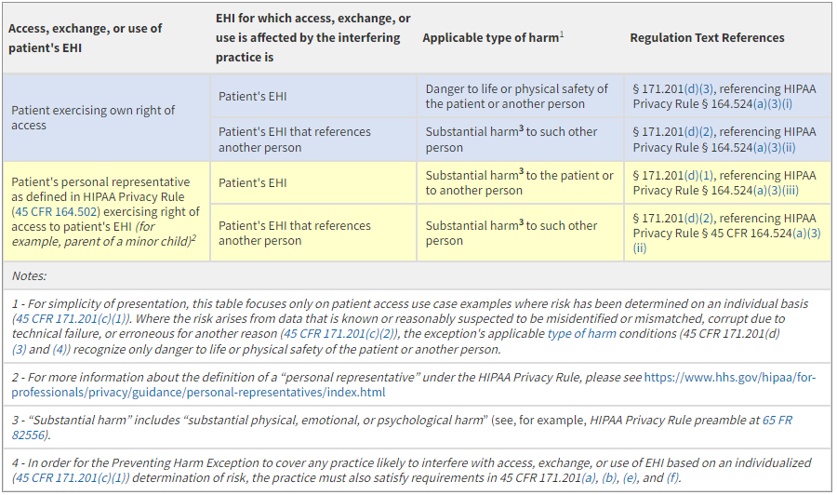
FAQ: In which patient access cases does the Preventing Harm Exception recognize “substantial harm” ?
The Preventing Harm Exception at 45 CFR 171.201 relies on the same types of harm as apply for a covered entity to deny access to protected health information under the HIPAA Privacy Rule (see 45 CFR 164.524(a)(3)). Where an actor's practice, based on an individualized (45 CFR 171.201(c)(1)) determination of risk, is likely to interfere with a patient's or patient representative's access, exchange, or use of the patient's EHI, the type of harm (45 CFR 171.201(d)) needed for the exception to apply depends on who is seeking access to the EHI, and what EHI they are seeking to access.⁴
The table below shows the type of harm recognized under the Preventing Harm Exception for several commonly encountered patient access scenarios.¹
https://www.healthit.gov/faq/which-patient-access-cases-does-preventing-harm-exception-recognize-substantial-harm
ID:IB.FAQ42.1.2022FEB

Slide 59
FAQ: Do the Preventing Harm Exception requirements for the type of harm align with the HIPAA Rules?
Yes. The Preventing Harm Exception’s type of harm condition relies on the same types of harm that serve as grounds for reviewable denial of an individual’s right of access under the Privacy Rule (45 CFR 164.524). (See ONC Cures Act Final Rule preamble Table 3—Mapping of Circumstances Under § 171.201(d) to Applicable Harm Standards.)
In most instances, including where a practice interferes with a patient’s own or the patient’s other health care providers’ legally permissible access, exchange, or use of the patient’s electronic health information (EHI), coverage under the Preventing Harm Exception requires that the risk be of physical harm. (See 45 CFR 171.201(d)(3) and (4).)
However, the Preventing Harm Exception’s type of harm condition applies a “substantial harm” standard for practices interfering with a patient’s representative’s requested access, exchange, or use of the patient’s EHI and to the patient’s or their representative’s access to other persons’ individually identifiable information within the patient’s EHI in some circumstances. (See 45 CFR 171.201(d)(1) and (2)).
ID:IB.FAQ32.1.2021JAN
https://www.healthit.gov/faq/do-preventing-harm-exception-requirements-type-harm-align-hipaa-rules

Slide 60
FAQ: Will the Preventing Harm Exception cover practices interfering with a patient’s access, exchange, or use of their EHI only for the purposes of reducing an imminent or immediate risk of harm?
No. The reasonable belief condition does not include a requirement that the harm be expected to occur within a particular time period or that the likelihood of the harm be high enough to be considered “imminent.” (See 45 CFR 171.201(a)). The Preventing Harm Exception’s reasonable belief condition requires an actor engaging in a practice likely to interfere with a patient’s access, exchange, or use of their own EHI to have a reasonable belief that the practice will substantially reduce a risk to life or physical safety of the patient or another person that would otherwise arise from the affected access, exchange, or use.
https://www.healthit.gov/faq/will-preventing-harm-exception-cover-practices-interfering-patients-access-exchange-or-use
ID:IB.FAQ34.1.2021JAN

Slide 61
FAQ: Would the Preventing Harm Exception cover a “blanket” several day delay on the release of laboratory or other test results to patients so an ordering clinician can evaluate each result for potential risk of harm associated with the release?
No. Blanket delays that affect a broad array of routine results do not qualify for the Preventing Harm Exception. The Preventing Harm Exception is designed to cover only those practices that are no broader than necessary to reduce a risk of harm to the patient or another person.
As we discussed in the Cures Act Final Rule, a clinician generally orders tests in the context of a clinician-patient relationship. In the context of that relationship, the clinician ordering a particular test would know the range of results that could be returned and could prospectively formulate, in the exercise of their professional judgment, an individualized determination for the specific patient that:
withholding the results of the particular test(s) from the patient would substantially reduce a risk to the patient’s or another person’s life or physical safety
- or –
that withholding the results of the particular test(s) from a representative of the patient would substantially reduce a risk of substantial harm to the patient or another person.
Such individualized determinations made in good faith by an ordering clinician, in the exercise of their professional judgment and in the context of the treatment relationship within which they order the test, would satisfy the type of risk and type of harm conditions of the Preventing Harm Exception. Actors, including but not limited to the ordering clinician, could implement practices in reliance on such determinations and the Preventing Harm Exception would cover such practices so long as the practices also satisfy the other four conditions of the exception.
https://www.healthit.gov/faq/would-preventing-harm-exception-cover-blanket-several-day-delay-release-laboratory-or-other
ID:IB.FAQ33.1.2021JAN

Slide 62
FAQ: Where the patient is a minor and to avoid breaching the patient’s confidentiality and trust with the provider, will the Preventing Harm Exception cover an actor’s practices that interfere with a parent or legal representative’s access, exchange, or use of the minor’s EHI?
No. Unless an actor reasonably believes a practice that interferes with a parent or other legal representative’s requested access, exchange, or use of the minor’s electronic health information (EHI) will substantially reduce a risk of at least substantial harm to the patient or another person, the Preventing Harm Exception is not designed to cover that practice.
The Privacy Exception contains a sub-exception (45 CFR 171.202(e)) that covers practices respecting an individual’s request not to share information, subject to certain conditions.
https://healthit.gov/faq/where-patient-minor-and-avoid-breaching-patients-confidentiality-and-trust-provider-will/
ID:IB.FAQ31.1.2021JAN

Slide 63
FAQ: Where the patient is a minor and to reduce a risk of harm other than physical abuse, will the Preventing Harm Exception cover an actor’s practices that interfere with a parent or legal guardian’s access, exchange, or use of the minor’s EHI?
Yes, where the risk of harm has been determined on an individualized basis and all other conditions of the Preventing Harm Exception are met. For example, the practice must be no broader than necessary and the actor must reasonably believe the practice will substantially reduce the risk of harm. (For all the conditions of the Preventing Harm Exception, please see 45 CFR 171.201.)
For purposes of the Preventing Harm Exception, a parent or legal guardian would be considered a patient’s legal representative. The Preventing Harm Exception’s type of harm condition applies a “substantial harm” standard for practices interfering with a patient’s representative’s requested access, exchange, or use of the patient’s EHI. (See 45 CFR 171.201(d)(1)).
The type of harm conditions for Preventing Harm Exception coverage of practices interfering with patients’ and their representatives’ access to EHI on the basis of an individualized determination of risk are specifically aligned with the HIPAA Privacy Rule’s grounds for reviewable denial of an individual’s right of access under the Privacy Rule. (See also ONC Cures Act Final Rule preamble discussion and Table 3—Mapping of Circumstances Under § 171.201(d) to Applicable Harm Standards).
https://healthit.gov/faq/where-patient-minor-and-reduce-risk-harm-other-physical-abuse-will-preventing-harm-exception/
IB.FAQ35.1.2021JAN

Slide 64
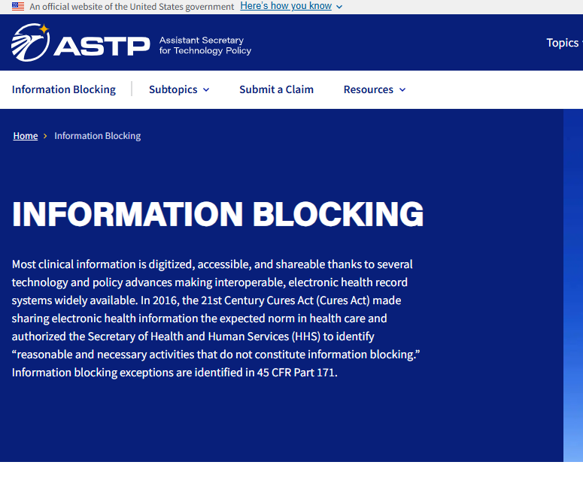
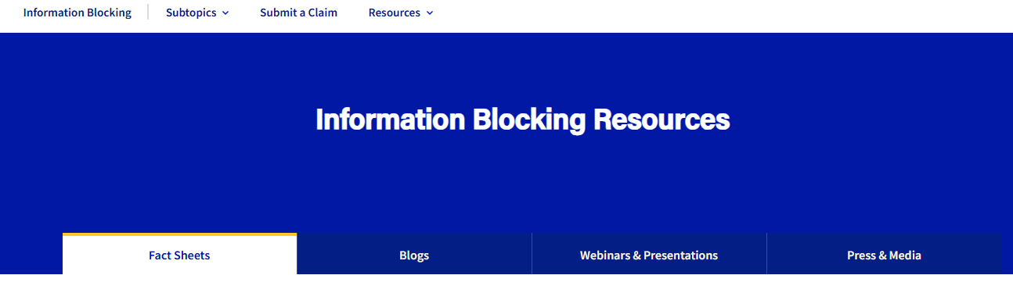
Where to Find More Information
ASTP Website Resources
Information Blocking Webpage (Fact Sheets, FAQs, Blogs, Webinars & Presentations, Press/Media): https://www.healthit.gov/topic/information-blocking
Information Blocking FAQs: https://www.healthit.gov/faqs
Health IT Buzz Blog: https://www.healthit.gov/buzz-blog/
ASTP Speaker Request Form: https://www.healthit.gov/speaker-request-form

Slide 65
Reach out via phone or web
  202-690-7151
Feedback & Questions: https://www.healthit.gov/feedback
Report Information Blocking Portal (direct link):
https://healthit.gov/report-info-blocking
ASTP Speaker Request Form: https://www.healthit.gov/speaker-request-form
Stay connected, follow us on socials
  @HHS_TechPolicy
  Assistant Secretary for Technology Policy
www.youtube.com/@HHS_TechPolicy
Subscribe to our weekly eblast at healthit.gov for the latest updates!

Slide 66
Information Blocking “Office Hours”
Submit your IB questions to us – tell us what you’d like to know and how ASTP/ONC can support IB education and enforcement!
Feedback & Questions: https://www.healthit.gov/feedback
Report Information Blocking Portal (direct link):
https://healthit.gov/report-info-blocking

Slide 67

@HHS_TechPolicy
Share your content on X and don't forget to use the hashtag #ASTP2026

