Slide 2
Listening Across Sectors: Improving Mental Health and Substance Use Care through Health IT
Washington, DC | February 11, 2026 | 4:00 pm
www.ASTPAnnualMeeting.com

Slide 3
ASTP Behavioral Health IT Updates

Slide 4
Behavioral Health IT (BHIT) Initiative

Slide 5



Behavioral Health Information Technology (BHIT) Initiative
The $20M+ SAMHSA/ASTP partnership, began in 2024, and aims to address the need for improved data exchange in behavioral healthcare settings. The BHIT Initiative aims to...
USCDI+BH Data Elements
Establish data content standards for EHRs and health information technology (HIT) that improves efficiency and reduces the cost to adopt technology by removing low-value customization.
Pilot the standards in the real world to further lower barriers to implement, pairing the standards with clinical workflows, and demonstrating the efficacy of the standard to the BH community.
Pilots
Develop a practical Behavioral Health Informational Resource (BHIR) using the lessons learned (e.g., clinical, technology, policy) during standards development and the real-world pilots that will lower the cost to implement EHRs and HIT for future BH providers.
BHIR

Slide 6




BHIT Pilot Objectives
The pilot approach aims to:
Improve Behavioral Health Outcomes: Incentivize and support pilots that improve behavioral health outcomes for individuals. The pilots should have real-world positive impacts on BH care today, not simply be an exercise in interoperability theory.
Real-World Testing of USCDI+ BH: Conduct real-world testing of the USCDI+ BH data element list and associated technical specifications (e.g., the US Behavioral Health Profiles Implementation Guide) with all participating pilot sites, documenting any technical or implementation challenges encountered across behavioral health providers, health information exchanges (HIE), state agencies, technology vendors, and community-based organizations (CBOs).
Identify Behavioral Health Provider Priorities: Identify the top information exchange priorities and current data exchange capabilities of participating SAMHSA subgrantees, focusing on practical considerations related to workflow integration, privacy, consent, and confidentiality.
Discover USCDI+ BH and USCDI Adoption Barriers: Identify and document distinct technical, operational, or policy barriers to USCDI+ BH implementation encountered by participating pilot sites.
Inform the BHIR: Incorporate lessons learned from the pilot projects, including documented challenges and best practices, into the development of the BHIR.
Notes:
Speaker, Brett A

Slide 7
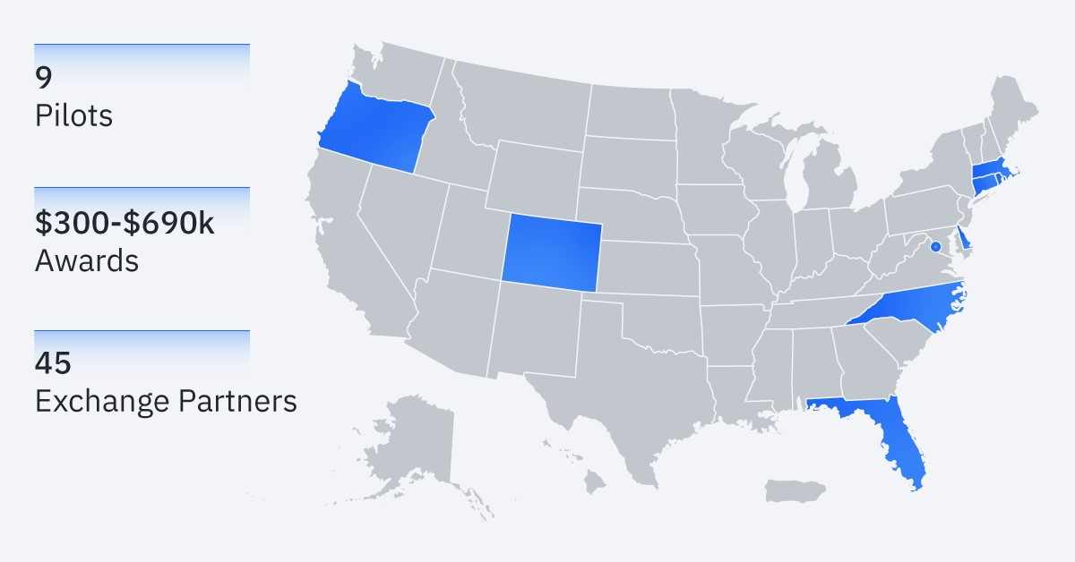
Selected Pilot Participants
Delaware (DTRN 360) Lead: Delaware Division of Substance Abuse and Mental Health (DSAMH)
Florida (InterConnect) Lead: PSYHealth LLC
Colorado (BHX Connect) Lead: Behavioral Health Data Exchange of Colorado (BHX)
North Carolina (ReCODE). Lead: North Carolina Division of Mental Health, Developmental Disabilities, and Substance Use Services
Oregon (MyCarePlanner). Lead: Oregon Health and Science University (OHSU)
Rhode Island. (CCBHC Quality Measurement). Lead: Rhode Island Department of Behavioral Healthcare, Developmental Disabilities, and Hospitals (BHDDH)
Massachusetts (SUD Data Connector). Lead: Massachusetts Department of Public Health, Bureau of Substance Addiction Services (MDPH, BSAS)
Washington, D.C. (BHIT Data Exchange) Lead: District of Columbia Department of Health Care Finance (DHCF)
Connecticut (Consent Management). Lead: Health Information Alliance, (dba Connie).
Pilots will be complete by the end of 2026

Slide 8
2024 National Substance Use and Mental Health Services Survey (N-SUMHSS)

Slide 9
2024 N-SUMHSS Overview and EHR Supplement Highlights
N-SUMHSS is a voluntary annual survey of United States’ mental health and substance use facilities.
2024 participation included 21,205 unique treatment facilities:
15,953 substance use treatment facilities
14,091 mental health treatment facilities
8,839 substance use/mental health treatment facilities
The overall response rate for the 2024 N-SUMHSS among facilities eligible to participate was 90.4%.
ASTP added an EHR-focused supplement to the 2024 survey to examine EHR use, interoperability, and patient engagement.
Below are key findings:
EHR Use
68% use EHR only (no paper)
25% use EHR + paper
7% have no EHR
Interoperability & Queries
44% integrate external clinical data without manual entry
29% electronically query external data almost daily
31% lack capability to search/query external records
Patient Access
39% allow clients to view medical information online
Source: 2024 National Survey of Substance Abuse Treatment Services (N-SUMHSS)

Slide 10
Leap in Health IT Behavioral Health Project with Oregon Health & Science University

Slide 11
LEAP 2024 Area of Interest 2
Area 2: Accelerate adoption of health IT in behavioral health (BH) settings
Awardee: Oregon Health & Science University Project Dates: 2024-2026 Project Overview: Adapt an open-source SMART on FHIR application based on the HL7® Multiple Chronic Condition (MCC) care plan effort for three behavioral health use cases and pilot the application in stand-alone behavioral health clinics with challenges in exchanging health information
Project Overview:
Adapting an open-source SMART on FHIR application based on the HL7 Multiple Chronic Condition Care Plan Implementation Guide
Working with two BH clinics not attached to physical health sites and have limited ability to connect via health information exchange (HIE)
Will implement the application and explore three use cases (see right)
Creating well-defined evaluations specific to the information needs and goals; state success criteria for the use of the application; and share results with BH sites, patients, and key stakeholder groups
Use Cases:
Longitudinal care planning for patients with complex physical and behavioral needs;
Monitoring mood disorders with structured patient reported outcome measurements (GAD-7, PHQ-9, C-SSRS)
Adapting care plans at unplanned transitions of care (e.g., on hospital discharge).

Slide 12

@HHS_TechPolicy
Share your content on X and don't forget to use the hashtag #ASTP2026

Slide 13
Tomorrow’s Agenda
February 12th
8:45 ^{am} – 11:30 ^{am} | Mainstage Sessions: Fireside Chat with Tom Keane and Amy Gleason Accelerating Artificial Intelligence Adoption as Part of Clinical Care Empowering Patients and Providers: Data Liquidity
11:30 ^{am} – 1:00 ^{pm} | Lunch on your own
1:00 ^{pm} – 2:00 ^{pm} | Breakout Sessions IV – View the ASTP Annual Meeting app for details
2:00 ^{pm} – 2:30 ^{pm} | Break
2:30 ^{pm} – 3:30 ^{pm} | Breakout Sessions V – View the ASTP Annual Meeting app for details

Slide 14


We want to hear from you – comment today!
AI in Clinical Care
HTI-5 Proposed Rule
Diagnostic Imaging
Draft USCDI v7
Comments due February 23, 2026
Comments due February 27, 2026
Comments due March 16, 2026
Comments due April 13, 2026

Slide 15
Stay up-to-date on the agenda with the Annual Meeting app!
Download vFairs in the App Store or Google Play.

