Slide 1
Bridging the Gap: TEFCA Supporting the Needs of Rural Communities
ASTP Annual Meeting
Wednesday, February 11, 2026

Slide 2
Current State of TEFCA Participation and Awareness among Rural and Critical Access Hospitals
Vaishali Patel, Wes Barker & Chelsea Richwine
Technical Strategy & Analysis Division and Data Analysis Branch

Slide 3
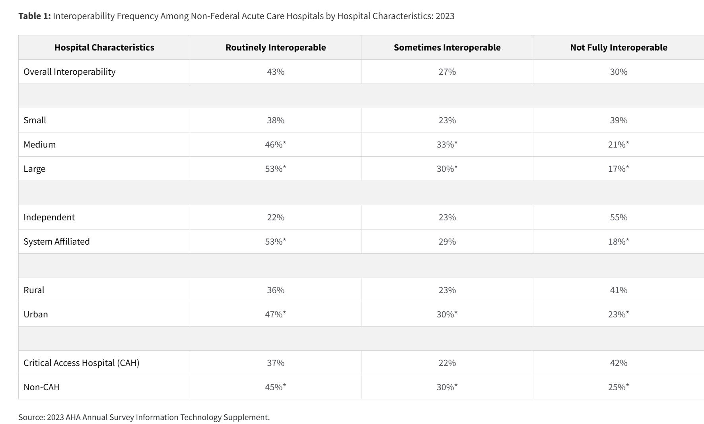
Critical access hospitals (CAH) and rural hospitals have faced gaps in interoperability that TEFCA could help address
Gabriel MH, Richwine C, Strawley C, Barker W, Everson J. Interoperable Exchange of Patient Health Information Among U.S. Hospitals,
2023. ONC. Data Brief: 71. 2024.

Slide 4
Overall, 8 in 10 hospitals participate or plan to participate in TEFCA
Source: American Hospital Association Information Technology Survey, 2025.

Slide 5
Among the other 2 in 10 hospitals, a majority are rural or CAH hospitals
 | Among 20% of hospitals who don’t have plans or don’t know if they will participate
Rural vs. Urban Status
Rural (40%) | 62%
Urban (60%) | 38%
Critical Access Hospital status
CAH (31%) | 52%
Other Rural (15%) | 18%
Urban (54%) | 30%
Source: American Hospital Association Information Technology Survey, 2025. Denominator is among hospitals that do not know or don’t have plans to participate (n=878)

Slide 6
CAH hospitals’ participation and plans to participation in TEFCA increasing but gaps persist
Source: American Hospital Association Information Technology Survey, 2025.

Slide 7
CAH hospitals’ lack of awareness about TEFCA diminishing but gaps persist
Source: American Hospital Association Information Technology Survey, 2025.

Slide 8
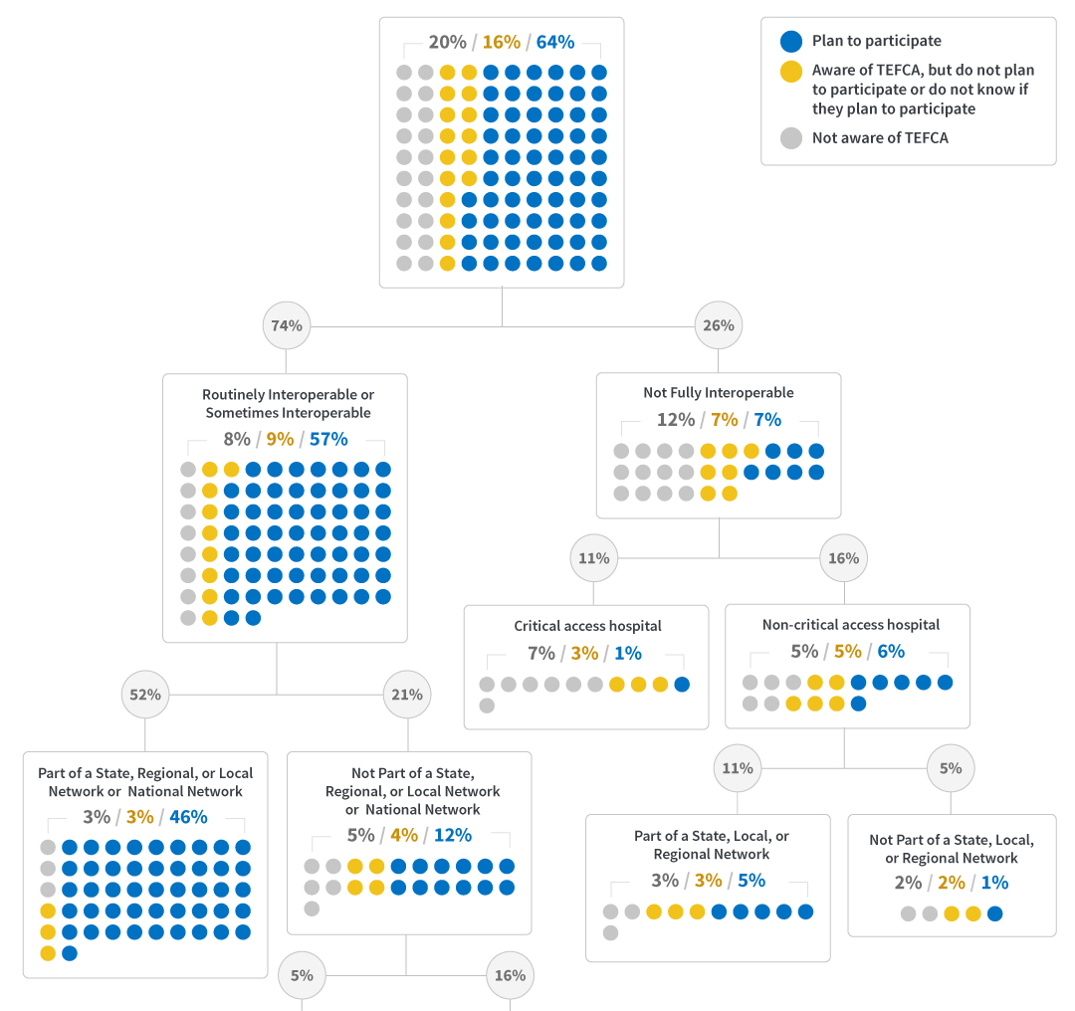
Past analyses indicate that network participation is a major predictor of awareness and plans to participate in TEFCA.
Source: 2023 AHA Annual Survey Information Technology Supplement.

Slide 9
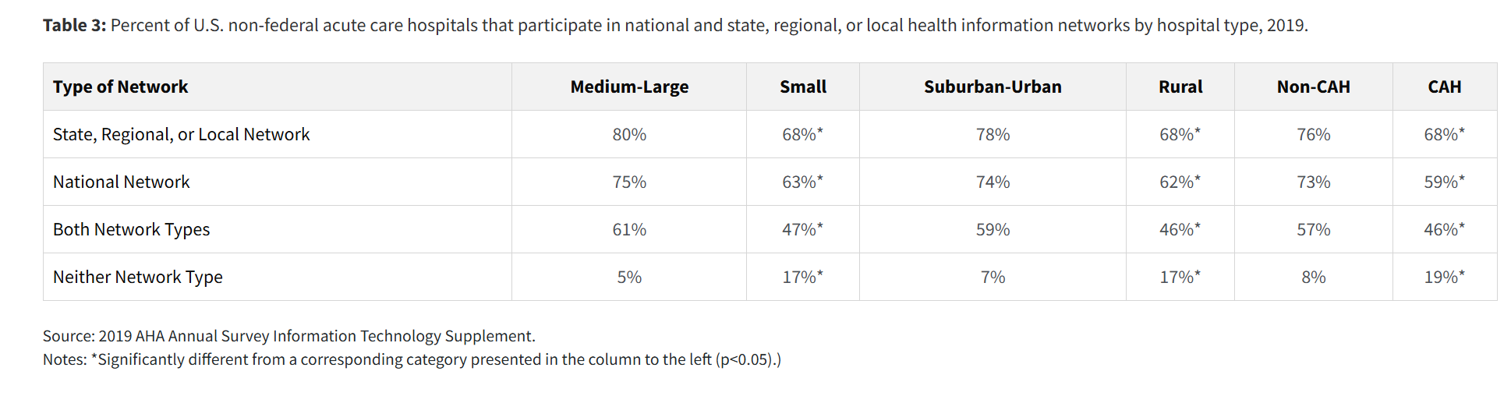
Past data indicate that rural hospitals are less likely to participate in networks that enable connectivity via TEFCA
Johnson C. & Pylypchuk Y. (February 2021). Use of Certified Health IT and Methods to Enable Interoperability by U.S. Non-Federal Acute Care Hospitals, 2019. ONC Data Brief, no.54. Office of the National Coordinator for Health Information Technology: Washington DC.

Slide 10
Key Takeaways
There is a potential for TEFCA to address gaps in interoperability faced by CAH and rural hospitals
While hospitals’ participation and plans to participate in TEFCA overall are growing, there are
about 1 in 5 hospitals that remain on the sidelines
A majority of those hospitals are rural and critical access hospitals
These hospitals awareness and participation rates in TEFCA have grown over time but gaps remain
Past analyses have shown that health information network participation is critical to TEFCA participation
but rural hospitals may have lower rates of participating in those networks compared to their counterparts
Strategies are needed to increase awareness and address specific barriers for rural and CAHs to join
TEFCA such as facilitating participation in networks that connect to TEFCA

