Slide 1
Beyond Traditional APIs: The Future of Health Data Interoperability
February 12, 2026

Slide 2
Hospital Use of APIs to Enable Data Sharing between EHRs and Third-Party Technology
Wes Barker, ASTP/ONC

Slide 3
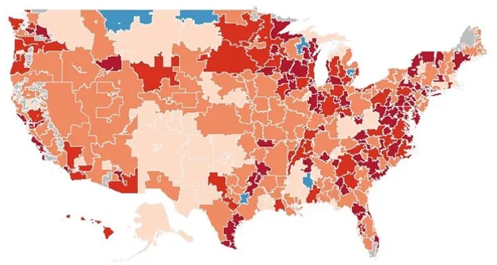
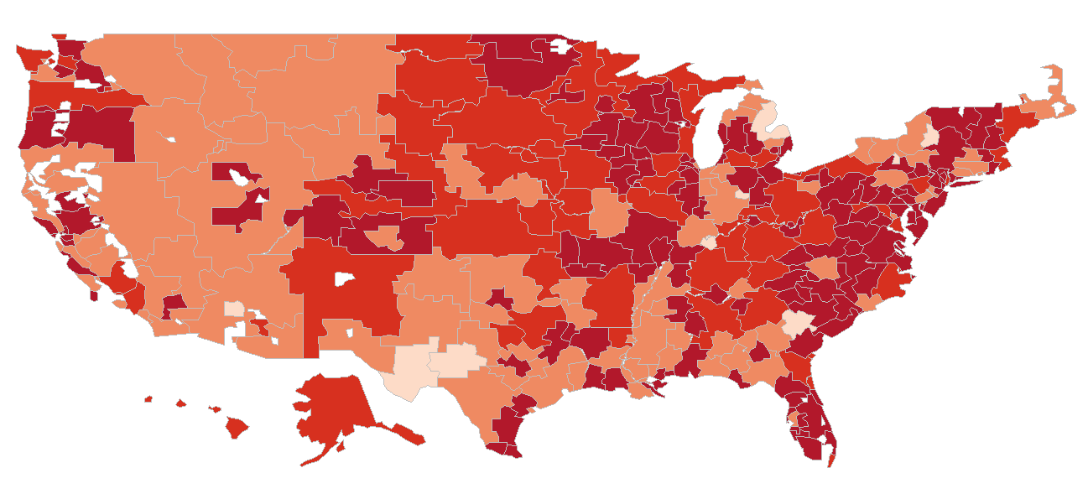
Patient access APIs have been broadly certified by developers of certified health IT and deployed by their customers.
Percent of hospitals (by hospital referral region) who have implemented FHIR-based APIs
2019 (84%)
2024 (93%)
Source: Certified Health Information Technology Reported by Hospitals for Promoting Interoperability Performance. https://healthit.gov/data/datasets/certified-health-information-technology-reported-by-hospitals-for-promoting-interoperability-performance/. Certified Health IT Product List (CHPL). https://chpl.healthit.gov/.

Slide 4
Most hospitals enable standards-based API access to patient information.
Percent of all hospitals that reported using APIs to enable patient access and PGHD submission through apps, 2022-2024.
Source: American Hospital Association Information Technology Survey, 2024
Note: *Significantly different from prior year.

Slide 5
Most hospitals share data for clinical purposes between their EHR and third-party technology, but mostly via non-standards-based approaches.
Percentage of hospitals that integrated and provided data for clinical purposes between their EHR and third-party technology, 2024.
Source: American Hospital Association Information Technology Survey, 2024
Note: *Significantly different from the corresponding method of exchange for "Provide." †Significantly different from "Other Approaches ONLY."

Slide 6
Most hospitals share data for administrative purposes between their EHR and third-party technology, but mostly via non-standards-based approaches.
Percentage of hospitals that integrated and provided data for administrative purposes from their EHR to third-party technology, 2024.
Source: American Hospital Association Information Technology Survey, 2024
Note: *Significantly different from the corresponding method of exchange for "Provide." †Significantly different from "Other Approaches ONLY."

Slide 7
Data sharing for clinical and administrative purposes varied significantly across hospital characteristics.
Percentage of hospitals that integrated and provided data for at least one clinical purpose and administrative purpose, stratified by method and hospital characteristics, 2024.
 | Clinical Purposes |  |  |  | Administrative Purposes
 | Integrate |  | Provide |  | Integrate |  | Provide
 | Any method | Standards-based API | Any method | Standards-based API | Any method | Standards-based API | Any method | Standards-based API
All hospitals | 91% | 52% | 83% | 39% | 87% | 35% | 86% | 32%
EHR
Market leading (Top 3) | 94%* | 56%* | 87%* | 43%* | 90%* | 37%* | 90%* | 34%*
All other (ref. group) | 67% | 20% | 55% | 15% | 60% | 20% | 62% | 14%
Hospital Bed Size
Medium-Large | 96%* | 56%* | 90%* | 44%* | 94%* | 38%* | 93%* | 35%*
Small (ref. group) | 85% | 47% | 76% | 34% | 80% | 33% | 79% | 29%
Hospital Ownership
System affiliated | 97%* | 60%* | 90%* | 47%* | 93%* | 39%* | 92%* | 36%*
Independent (ref. group) | 77% | 33% | 67% | 21% | 72% | 26% | 73% | 22%
Source: American Hospital Association Information Technology Survey, 2024

Slide 8
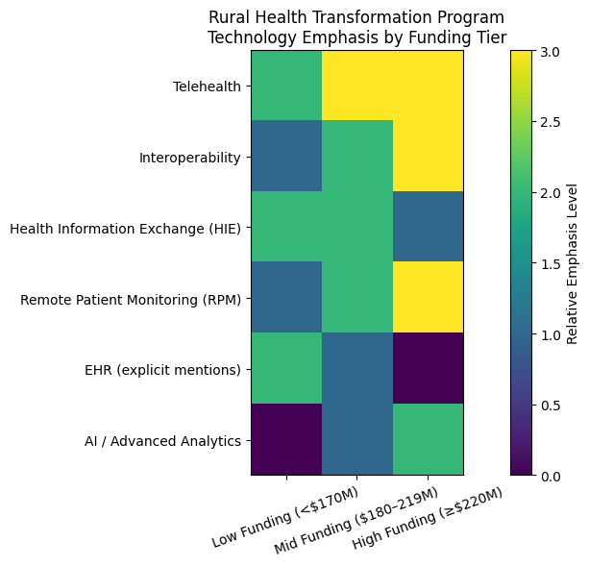
The Rural Health Transformation Program creates tremendous opportunities to states to invest in technology advancement in rural settings.
Analysis of the 50 state plans for the Rural Heath Transformation Program show how states plan to use funding to make technology investments in rural health care providers.
States who receive more funding are more likely to invest more in telehealth, remote patient monitoring, and information exchange, but all states plan to use some funding to make these technology investments over the next 5 years.
Note: Analysis by ChatGPT of RHTP 50 State Spotlight: https://www.cms.gov/files/document/rural-health-transformation-50-state-spotlights.pdf.

Slide 9
CDS Hooks
Bryn Rhodes, SmileCDR

Slide 10

integrating decision support at the point of care
2026
bryn rhodes, SmileCDR
Notes:
Icons from: http://freeiconshop.com/icon/category/flat-icons/

Slide 11
Agenda
Overview
Adoption and Maturity
Next Steps
Participation

Slide 12
… realtime, clinician-facing, remote decision support
simple HTTP APIs using FHIR
standardized clinical workflow via hooks
Notes:
Icons from: http://freeiconshop.com/icon/category/flat-icons/
vendor-agnostic, opensource spec.

Slide 13
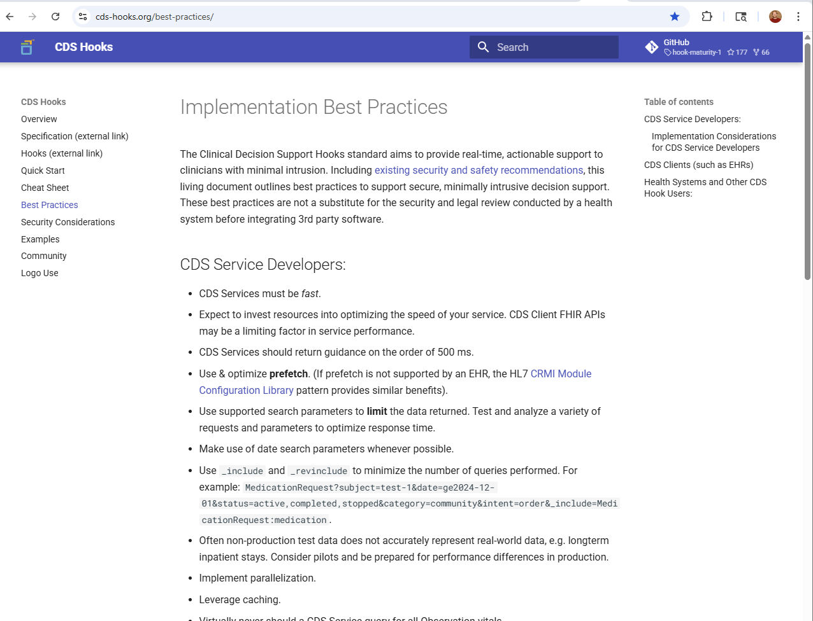
Best Practices
https://cds-hooks.org/best-practices/
Notes:
The CDS Hooks community has been collecting best practices from service developers, client developers, and institutions that are making use of CDS Hooks. These best-practices are now published at this location, and are constantly being updated, it is intended to be a living document. If you have best-practices, please share!

Slide 14
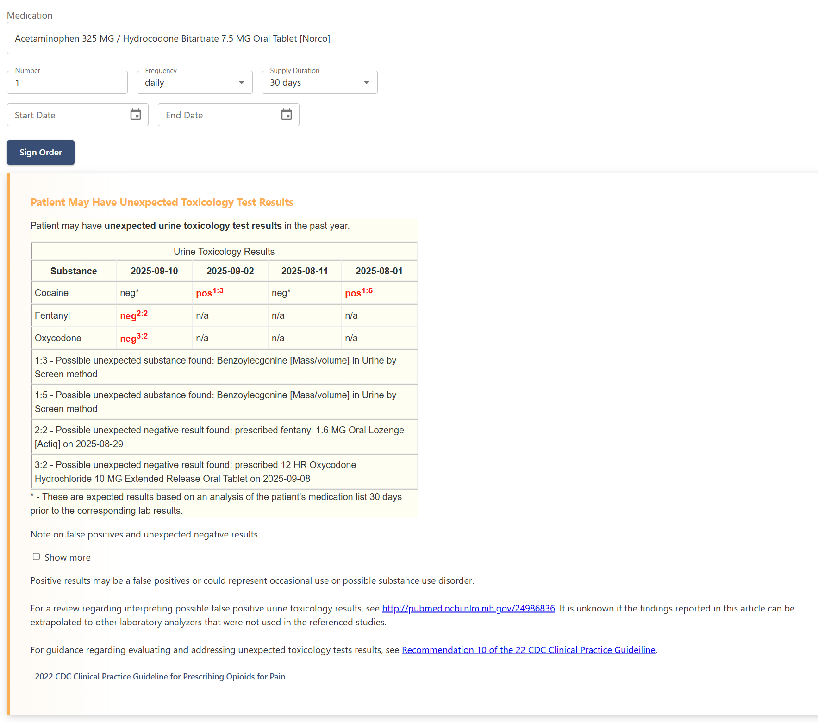
Sandbox
Testing and Development
Experimentation
New Feature Testing
Modernized
https://oncprojectracking.healthit.gov/wiki/spaces/TechLabSC/pages/368902768/CDS+Hooks+Sandbox
Notes:
Testing and Development – The sandbox is a tool for service developers to be able to test their services in a simple, compliant environment
Experimentation – It’s also a tool for users to see how services behave and integrate into workflow
New Use Cases – It’s also an essential tool for connectathon testing, new features in the specification are added to the sandbox
Modernized – Over the past two years, ASTP and CDC have supported a modernization effort to bring the sandbox up to date and make it easier to use, maintain, and contribute to

Slide 15
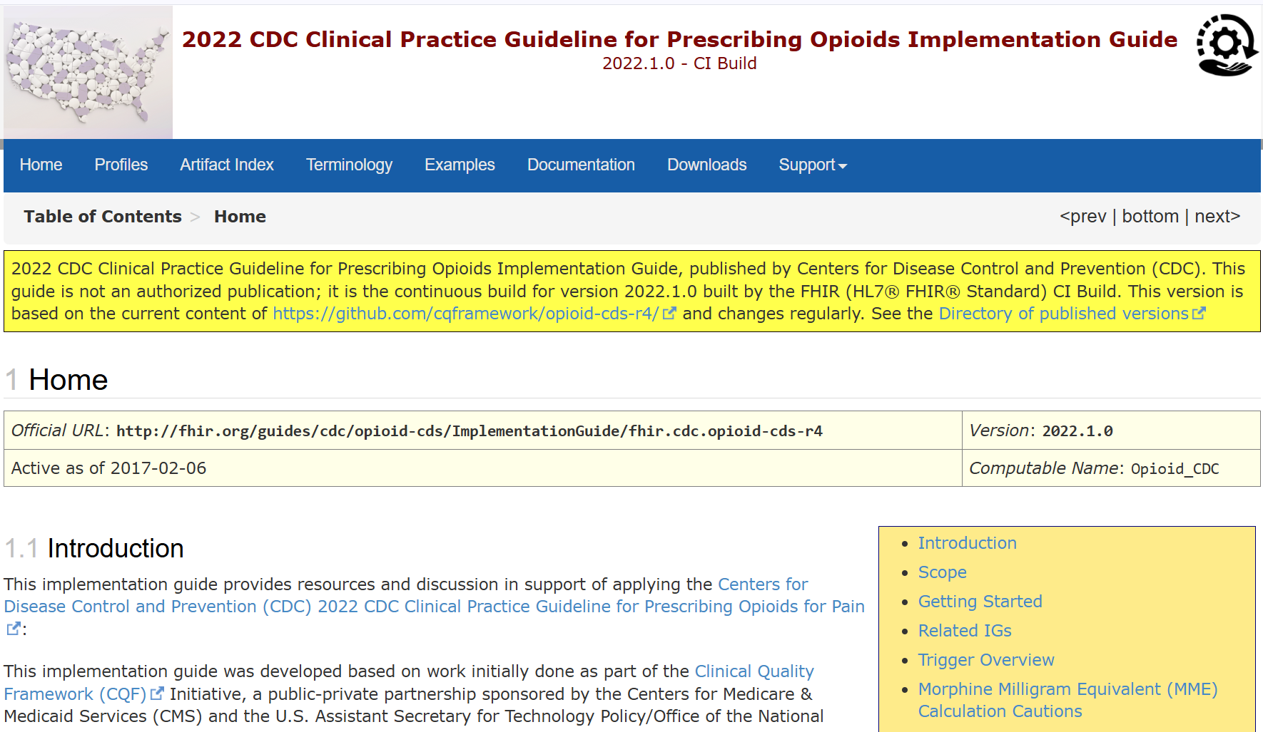
Shared Definitions
Standards-based decision support
Data Elements
Calculation Logic
Recommendations
Implementation Guidance
https://oncprojectracking.healthit.gov/wiki/spaces/TechLabSC/pages/42533042/Electronic+Clinical+Decision+Support+CDS+Tools+that+Support+the+Implementation+of+the+CDC+Clinical+Practice+Guideline+for+Prescribing+Opioids+for+Pain
Notes:
Not only enabling shared services, but shared definitions. For example, opioid prescribing recommendations are both important and challenging to implement. CDS Hooks is now enabling the use of computable representations
Implementation guides like this provide FHIR-based computable representations of the data elements, calculation logic, and recommendations, and can be directly implemented using CDS Hooks

Slide 16
R3 Ballot
Mixed Normative/Trial-Use Ballot
Core Capability is Normative
Request/Response, Hook Model, Security
New Features are Trial-Use
Enhanced Prefetch Capability (e.g. today() – 1 year, medication.resolve().code)
Override Reasons (proposed set of non-adherence codes, based on AHRQ CDSiC override taxonomy)

Slide 17
Roadmap
Currently working through ballot comments
Discussion and reconciliation on HL7 Clinical Decision Support (CDS) Work Group calls
https://confluence.hl7.org/spaces/CDS/pages/40742690/Meeting+Index
Zulip: https://chat.fhir.org/#narrow/channel/179159-cds-hooks
Additional connectathon testing
Earliest publication timeframe is May

Slide 18
Questions?
dennis patterson, cerner
isaac vetter, epic

Slide 19
FHIR Subscriptions
Gino Canessa, Microsoft

Slide 20

FHIR Subscriptions Gino Canessa
http://aka.ms/ginoc/decks

Slide 21
Agenda
Why do we need Subscriptions?
Overview
Example Problem Case
State of the World
US Core: Patient Data Feed

Slide 22
Why do we need Subscriptions?
FHIR = REST (typically)
REST =Client requests, stateless, cacheable
REST = Polling
Polling = Delays
Polling = Burden
Polling = Cost

Slide 23
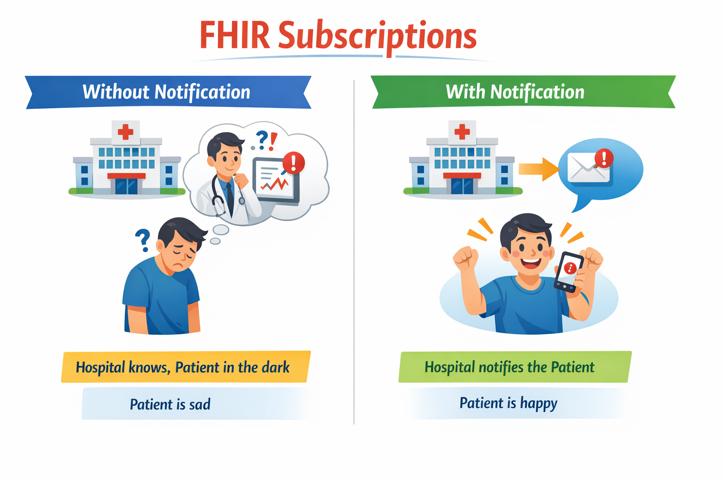

Slide 24
FHIR Subscriptions
“Tell me when data changes”

Slide 25
Technical Overview
Publish & Subscribe
Common Pattern
Reusable Definitions
Flexible channels
Flexible payloads
Server-driven
SubscriptionTopic
Subscription
Notification Bundle
SubscriptionStatus

Slide 26
Example Problem: Cancer Patient ED Visits
Complex interaction & involves many parties
Patients are often:
Unfamiliar with process & policy
Not in a state for careful navigation
Practitioners hopefully:
Can request data
Request data from that particular facility

Slide 27
Oncologist Missing Visits: Results
Specialists unaware of patient state
Inappropriate treatment
Time, Effort, Stress, Pain, and Costs:
Patient & Caregivers
ED Practitioners & Staff
Oncology Practitioner & Staff

Slide 28
State of the World FHIR Subscriptions
Published in FHIR R5: Subscriptions Framework
Changes for FHIR R6: Subscriptions Framework
Available in R4: Subscription Backport STU 1.1 Next version published Soon™
Appearing in national-level guides and regulations
Starting to be available in production

Slide 29
US Core: Patient Data Feed
A flexible approach

Slide 30
US Core: Patient Data Feed
Published (as futures) since R8 US Core: Patient Data Feed
Single topic to cover broad functionality
Expectation to grow over time
Low barrier-to-entry for implementers
Simplified management

Slide 31
Thank you
Gino Canessa
Gino.Canessa@microsoft.com
Zulip (chat.fhir.org)
YouTube (FHIR Educational Content)

Slide 32
FHIR Bulk Data
Dan Gottlieb, Central Square Solutions, LLC

Slide 33


Dan Gottlieb
Principal, Central Square Solutions, LLC
Senior Technical Advisor, CHIP Program, Boston Children’s Hospital
Dan@CentralSquareSolutions.com
FHIR Bulk Data

Slide 34



FHIR APIs for Data Retrieval
FHIR REST API FHIR Bulk Data API
Patient Panel Population

Slide 35

Enhance to support population level data access
FHIR Resources as a standard data model to simplify data parsing and mapping
FHIR Operation API to initiate the data extracts
SMART Backend Services Authorization as security model
Notes:
Key - standard format and access vs. csv

Slide 36
Bulk Export - ad hoc data, requestor pulls
Data
Requestor
Bulk Export Server
(Data Provider)
Data Request
Job Status Poll
Job Status Poll
Output Manifest
Bulk FHIR Files

Slide 37
Growing number of Bulk Export implementations!
Open Source FHIR Servers
Microsoft
HAPI
Medplum
Commercial FHIR Servers
Azure API for FHIR
CareEvolution
Firely Server (SQL endpoint)
EHRs
269+ ONC Certified Implementations
Including: Epic, Cerner and Meditech
Payor Data Servers
CMS ACO Beneficiary Claims Data
CMS Claims to Part D Sponsors
CMS Data at the Point of Care

Slide 38
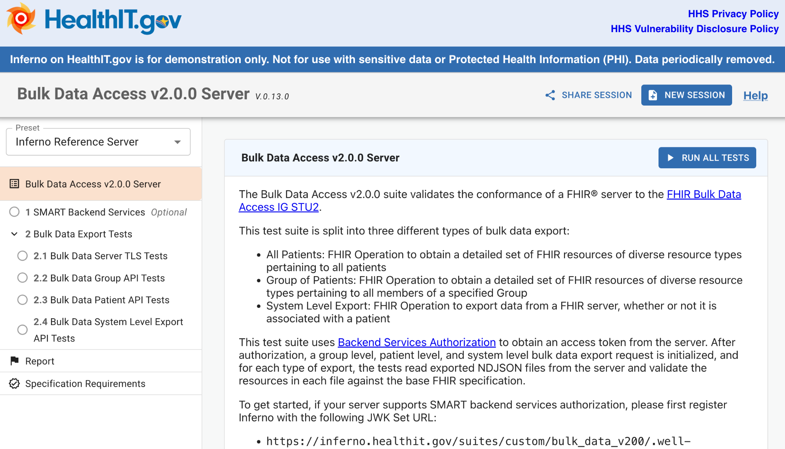
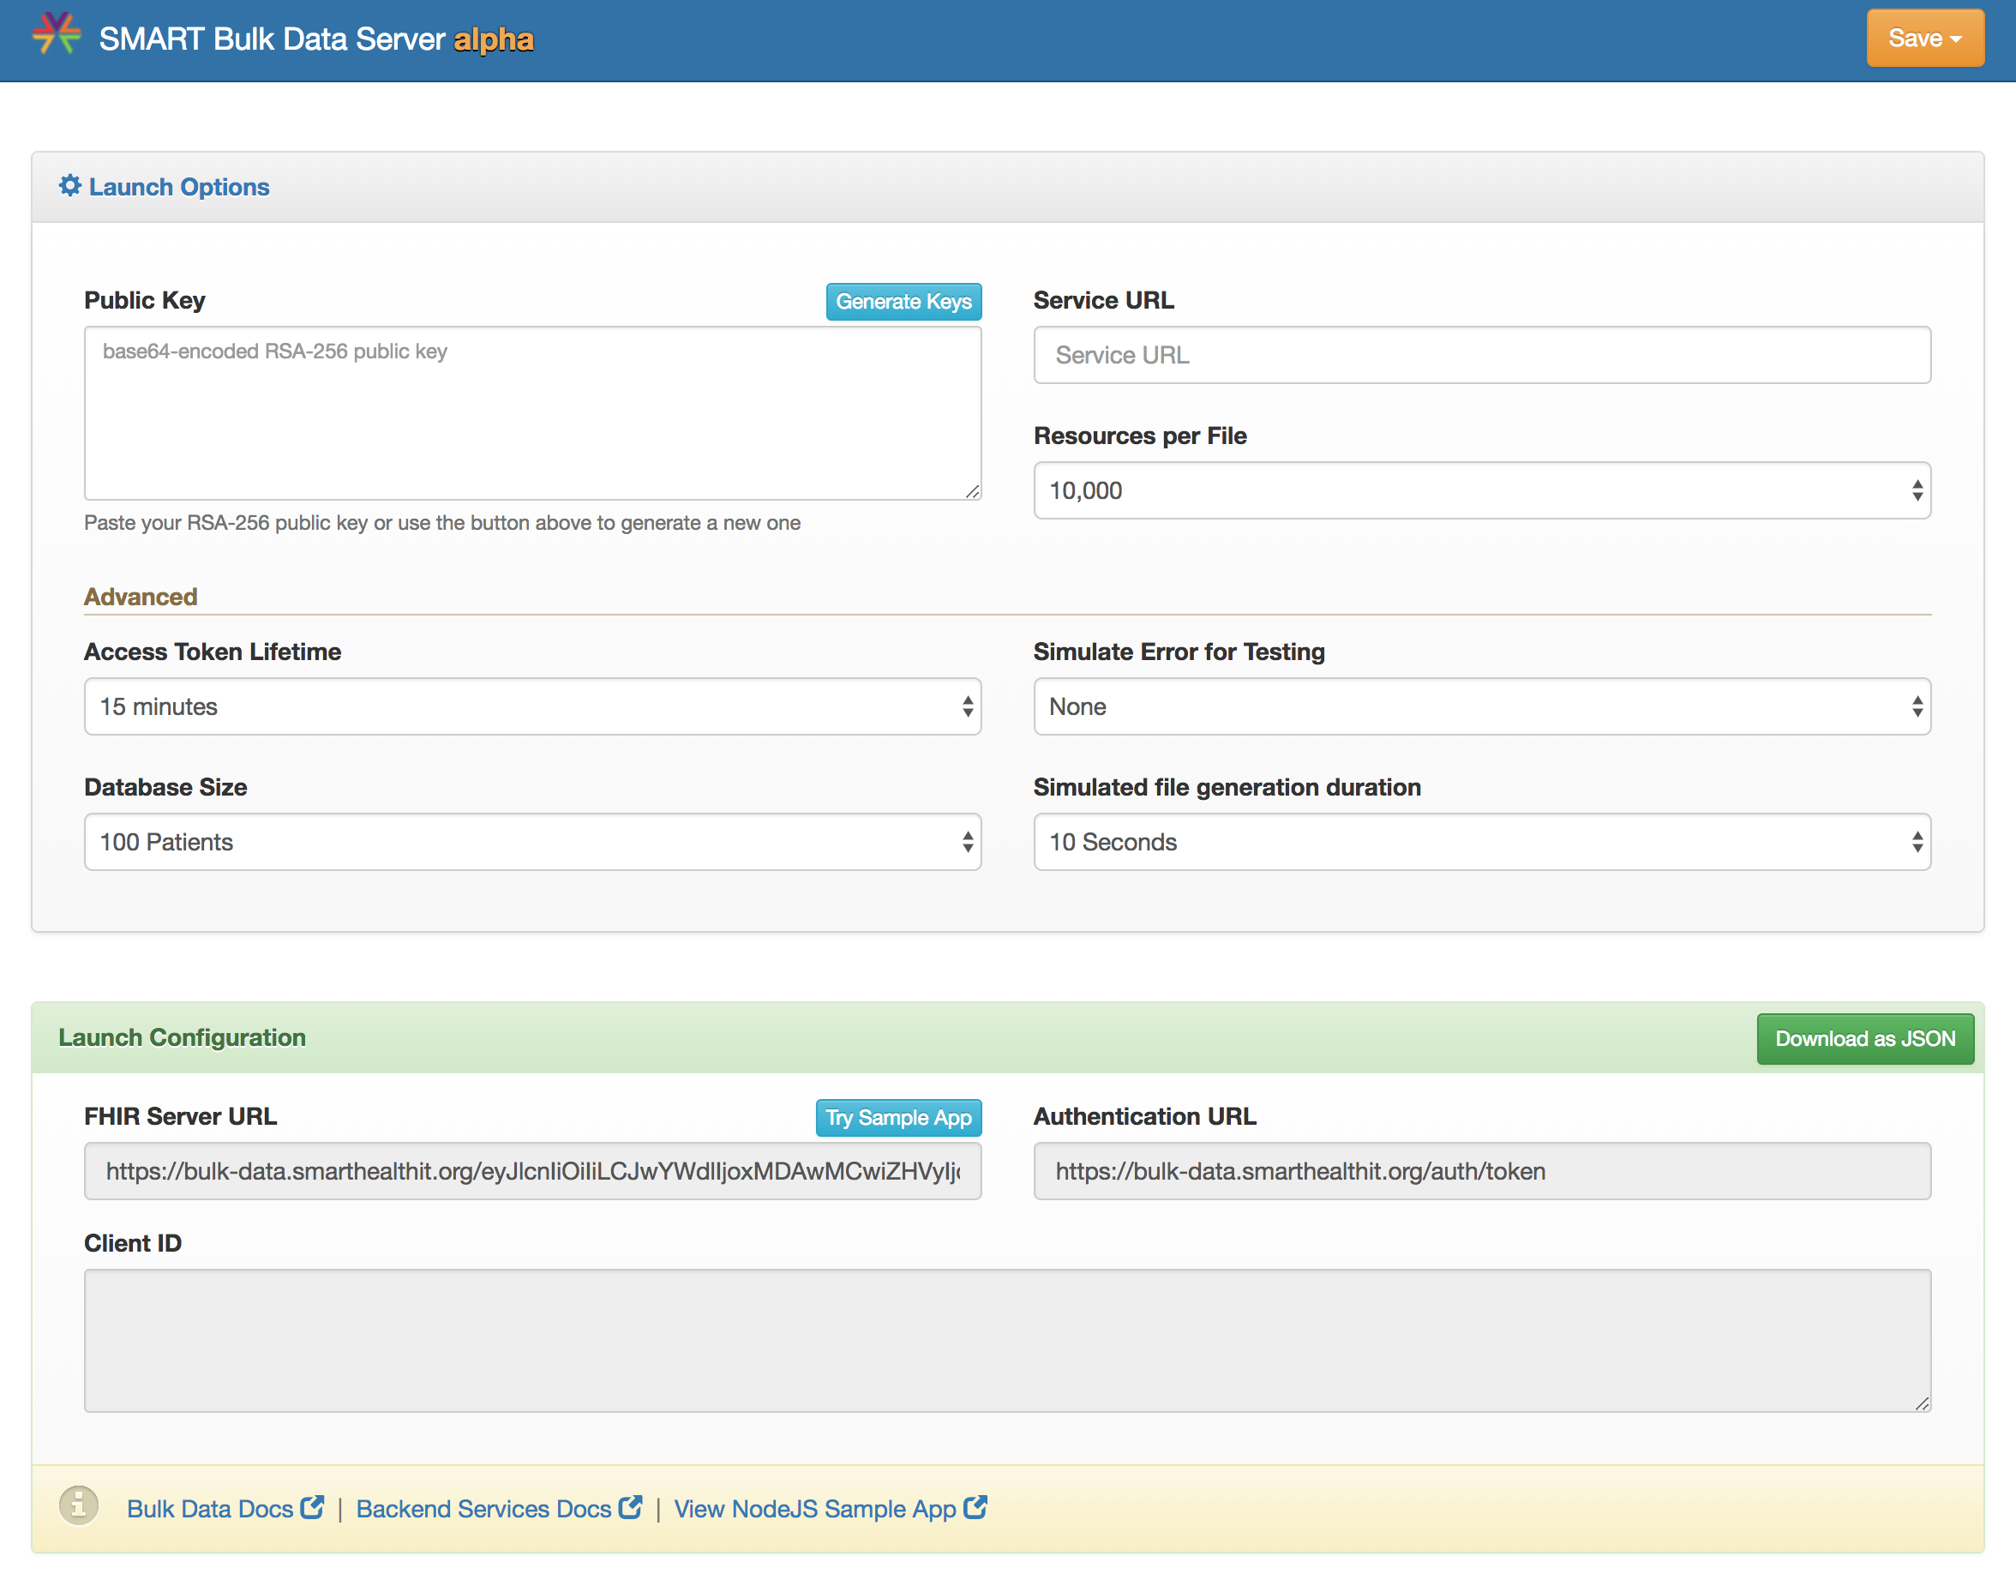
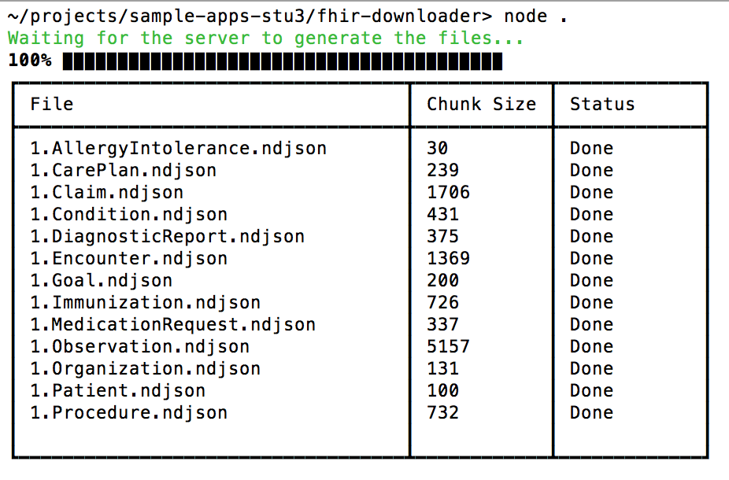
SMART Bulk Export Developer Tools
ONC Inferno Testing
Server Reference Implementation
Client Reference Implementation

Slide 39
Bulk Submit - pre-coordinated data, provider pushes
Bulk Submit Server
(Data Recipient)
Data Provider
Data Manifest + Metadata
Bulk FHIR Files
Submission Status Poll
Status Manifest + Files

Slide 40
Bulk Publish - relatively static data, one-to-many
Data
Requester
Data Manifest
Web / FHIR Server
(Data Provider)
Bulk FHIR Files
Data
Requester
Data Manifest
Bulk FHIR Files
Data
Requester
Data Manifest
Bulk FHIR Files

Slide 41
Bulk operations are part of a FHIR data pipeline
A few highlights:
SQL-on-FHIR specification and (overview videos, implementation list)
Microsoft Bulk FHIR anonymization engine (open source)
FHIR-native data quality metrics (ONC LEAP Award recipient, open source)

Slide 42
Next Steps
Finalize Bulk Submit and Bulk Publish design (Argonaut led community effort)
Wider support for Bulk Export spec features including API based group creation, exports organized by patients, and additional filters such as _since (implementers, regulators)
Big datasets are important - focus on Bulk Export performance tracking and improvement (implementers, regulators)

Slide 43
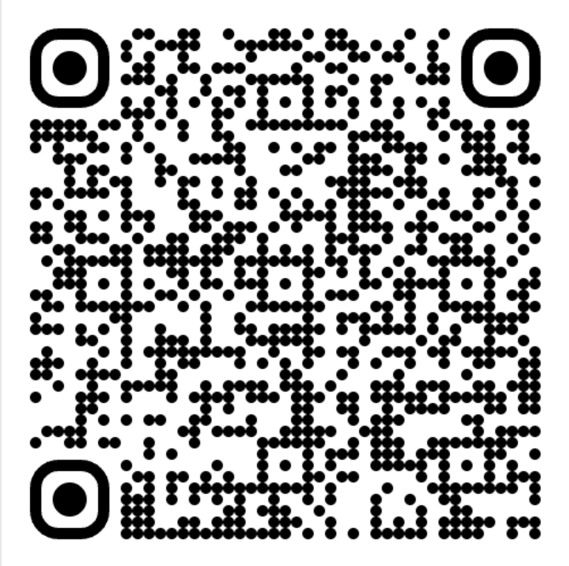
FHIR Bulk Data Implementation Guides
Bulk Data Export Operation
Draft Bulk Submit Operation
Draft Bulk Publish Operation
This Slide Deck
(plus bonus slides)

Slide 44
APIs and AI
Mark Kramer, MITRE Corporation

Slide 45


Beyond Traditional APIs: The Future of Health Data Interoperability API ❤️ AI
Mark Kramer, MITRE Corporation
February 12, 2026

Slide 46


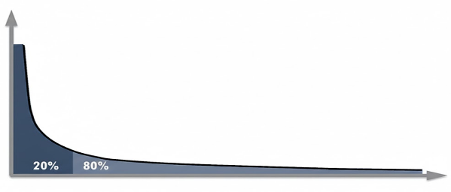
Why Does Interoperability Need AI?
U.S. policy has advanced consensus standards, created certification criteria, and required certified EHRs. This approach works best for high-volume, repeated transactions like sharing core health data, e-prescribing, and claims.
However, standards require many years of coalition building, stakeholder meetings, specification development, and validation (not even counting adoption !)
born 2011
This paradigm doesn’t work well for the very “long tail” of use cases with jurisdictional or shifting data needs, specialist data, and organizations with fewer resources.

Slide 47
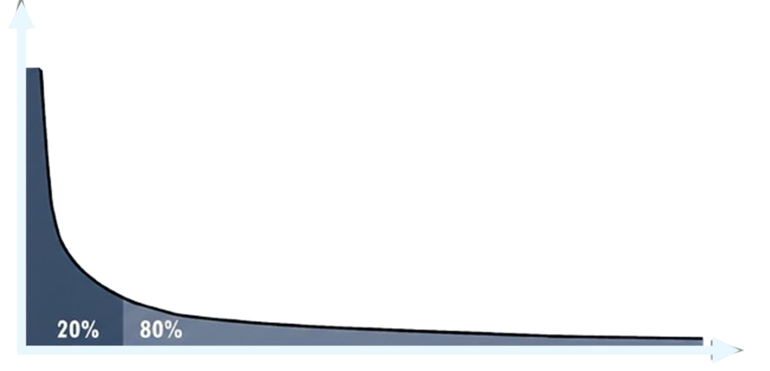
What is on the Long Tail?
And Who?
Prior authorization, out-of-network billing, denial and appeals processing
Advance directives, record requests, patient requests for correction
Hospital privileging, medical license renewals, vendor credentialing, accreditation
Adverse event reporting, state and federal regulatory reporting
Clinical trial eligibility, cohort identification, medical specialty data
Disease registry submissions, infectious disease reporting
Patient-reported outcomes, quality feedback
Admission/discharge, transportation arrangement, care coordination, scheduling
Workers compensation, return-to-work clearance, disability claims
Social services agencies
Federally-Qualified Health Centers
Justice system databases
Public health agencies
Housing authorities
Urgent care clinics
Small practices
Laboratory services
Imaging centers
Home health agencies
Skilled nursing facilities
Assisted living facilities
Dialysis centers
Behavioral clinics
Substance abuse treatment
Rural health clinics
Homeless shelters
Dental practices
Chiropractic clinics
Use Cases
1,000 unimplemented IGs

Slide 48




Vision
Instead of replacing health data APIs, AI becomes the intelligent layer
that makes APIs universally accessible, interoperable, and conversationally available.
Chat interface access an API to answer questions from clinicians, patients, and administrators
AI agent
plans, selects and combines multiple APIs to perform real-world actions
AI works with arbitrary endpoints instead strict schemas, generates entire integration layers; then tests, deploys, monitors, and improves system integration code
Multiple AI Agents communicate, negotiate, and coordinate data exchanges with back-and-forth conversation

Slide 49

Conversational interoperability (COIN) is a new data exchange paradigm developed by MITRE and Microsoft where use cases are handled flexibly through natural language dialogue, rather than being rigidly predefined.
Good news: We already know one-to-one language-based communication works.

Slide 50






Conversational Interoperability (COIN) Flow
Safety Rules
Safety Rules
Goals and Instructions
Goals and Instructions
Messages, Documents,
Images
MCP
MCP
Tools
Tools
Conversation History
Conversation History
(A2A protocol)
Guard
Guard
Human Assist
Human Assist
Initiating agent
Responding agent
Credit: Nanobanana (Google) Credits: Author: Victor Barac
Website: http://www.thesquid.ink/
Author: Round Icons
Website: https://roundicons.com
Notes:
We already know one-to-one language-based communication works.

Slide 51
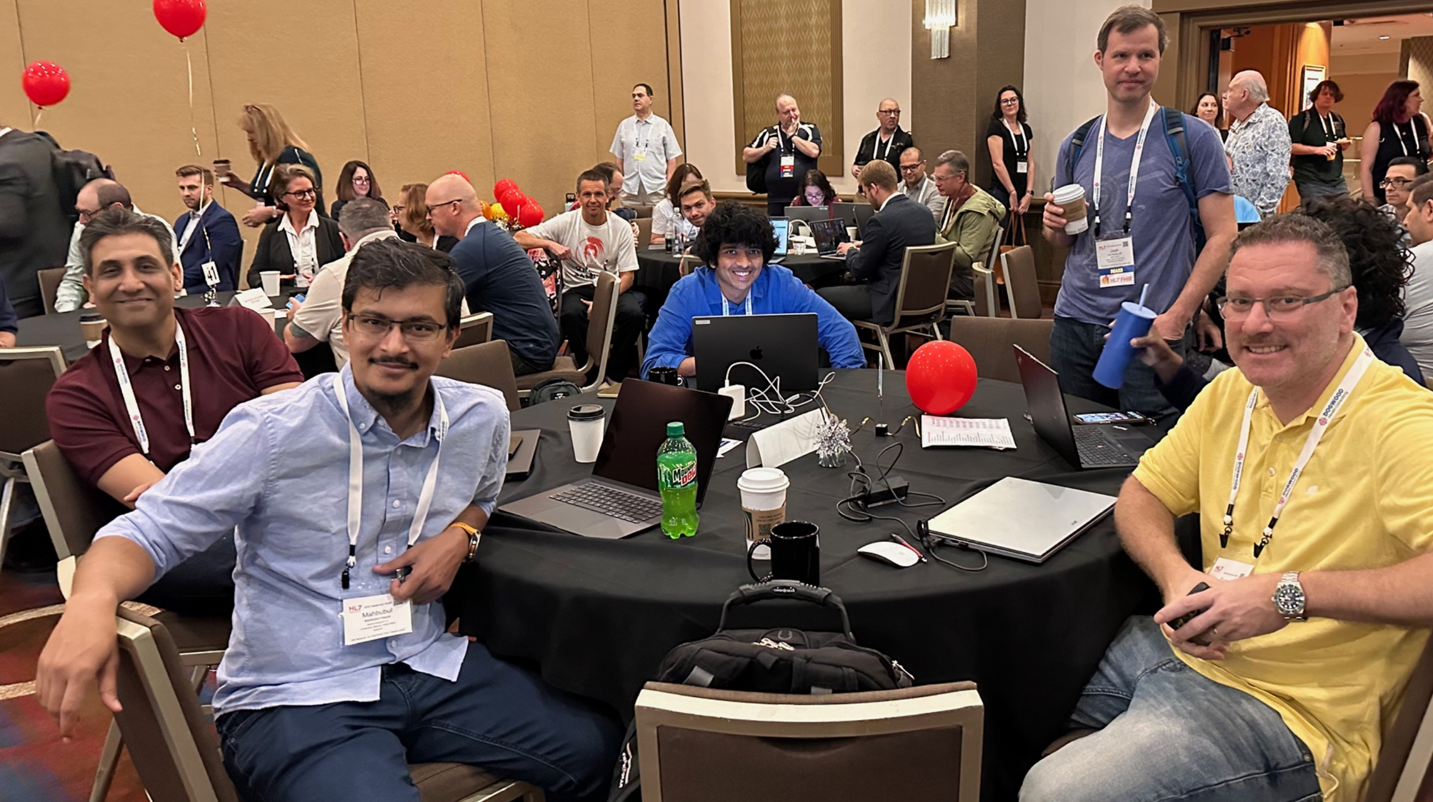
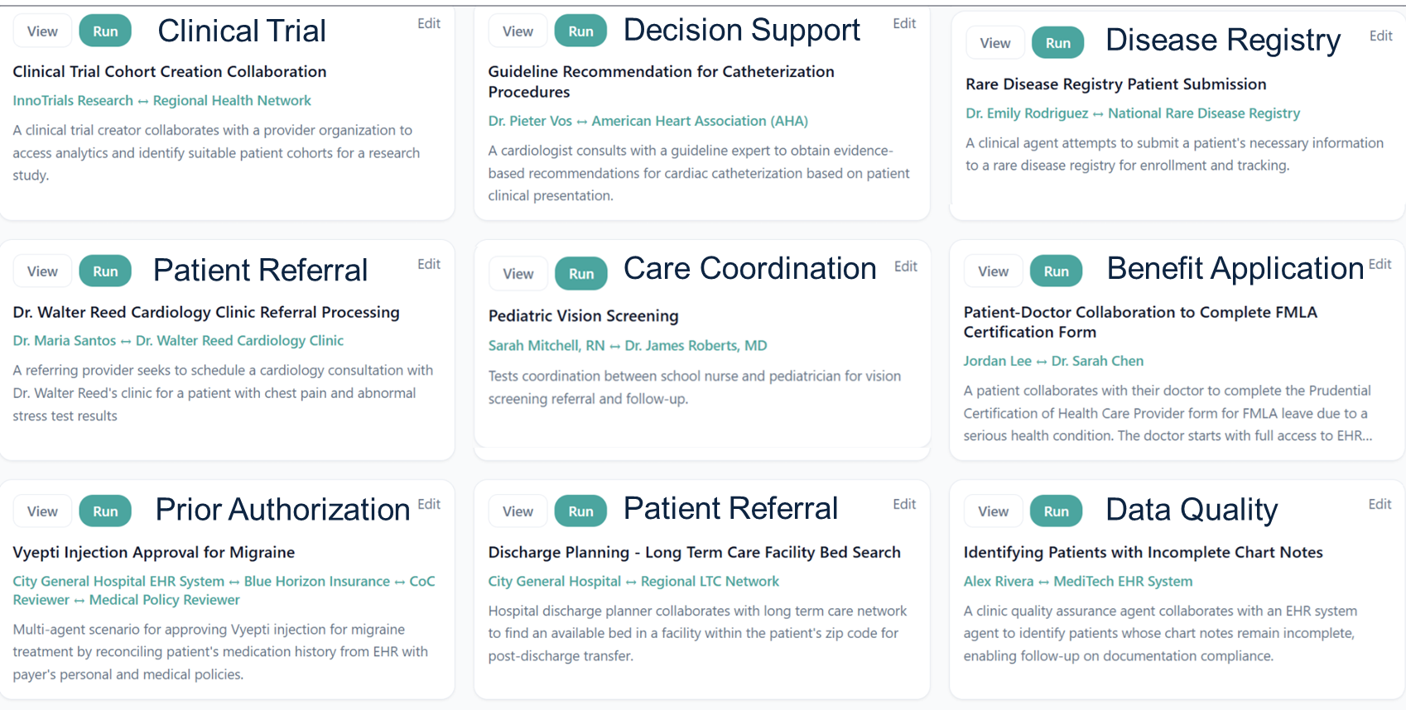
HL7 Connectathon, Sept. 2025
Josh Mandel
COIN use cases tested:

Slide 52

Example Use Case: Prior Authorization for MRI
Alex Ray, a 38-year-old amateur soccer player, sustained an acute right knee injury. His PCP has ordered an MRI.
The insurer's policy requires ≥14 days of conservative therapy, which has been met, but documentation must be clear.
"Bellamy Knee Injury" by joncandy is licensed under CC BY-SA 2.0.

Slide 53
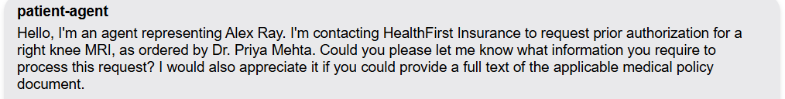
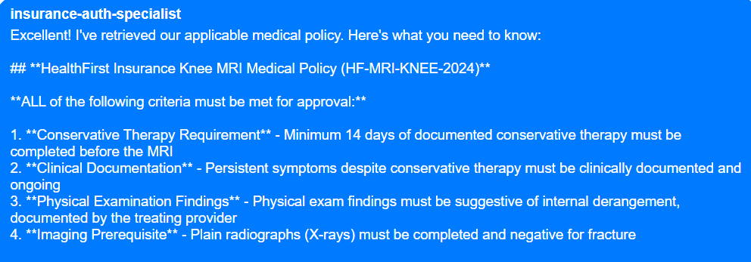
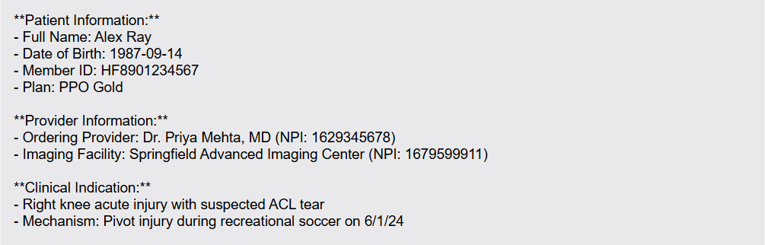
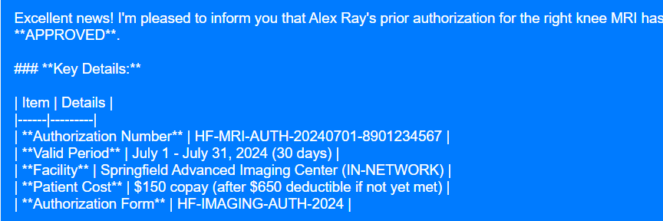
COIN Excerpts

Slide 54
Future Directions
AI is shifting from advice (risk: wrong answer) to execution (risk: wrong action)
AI systems shift strategy from compliance (trust basis: conformance tests) to operational confidence (trust basis: real world validation)
Guardrails are needed to keep agents within mandates and prevent them from succumbing to adversarial attacks.*
Safety, security, privacy, data protection
Next Step: Pilots
*See “Conversational Interoperability Guardrails”
https://www.linkedin.com/pulse/conversational-interoperability-guardrails-mark-kramer-fvwie/

Slide 55
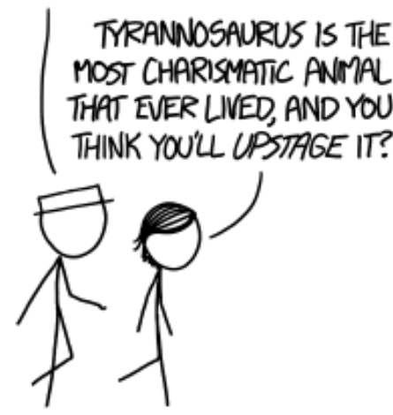
I LOOKED AT MY CHATGPT LOGS FROM DECEMBER. THINGS WERE SO MUCH SIMPLER THEN.
SO TRUE! IF YOU HAVEN’T USED A.I. IN THE LAST SIX WEEKS, IT’S LIKE YOU HAVEN’T USED A.I. AT ALL
Mark Kramer
mkramer@mitre.org
https://www.linkedin.com/in/mark-kramer-7b0215/

Slide 56
Backup

Slide 57


Standards Used
Agent2Agent Protocol (A2A)
Developed by Google
Allows asynchronous, resumable conversations
Model Context Protocol (MCP)
Developed by Anthropic
Allows an agent to select tools to invoke services, read/write data
Agent Card:
Identity
Endpoint
Authentication method
Supported interactions (stream, push, etc.)
Capabilities
MCP Server:
Endpoint
Connection method (stdio, SSE)
Tools:
Name
Description
Input Schema
Notes:
MCPs: Hospital API
Any API
CDS hooks
Bulk FHIR
Subscriptions
System integration cost down

Slide 58
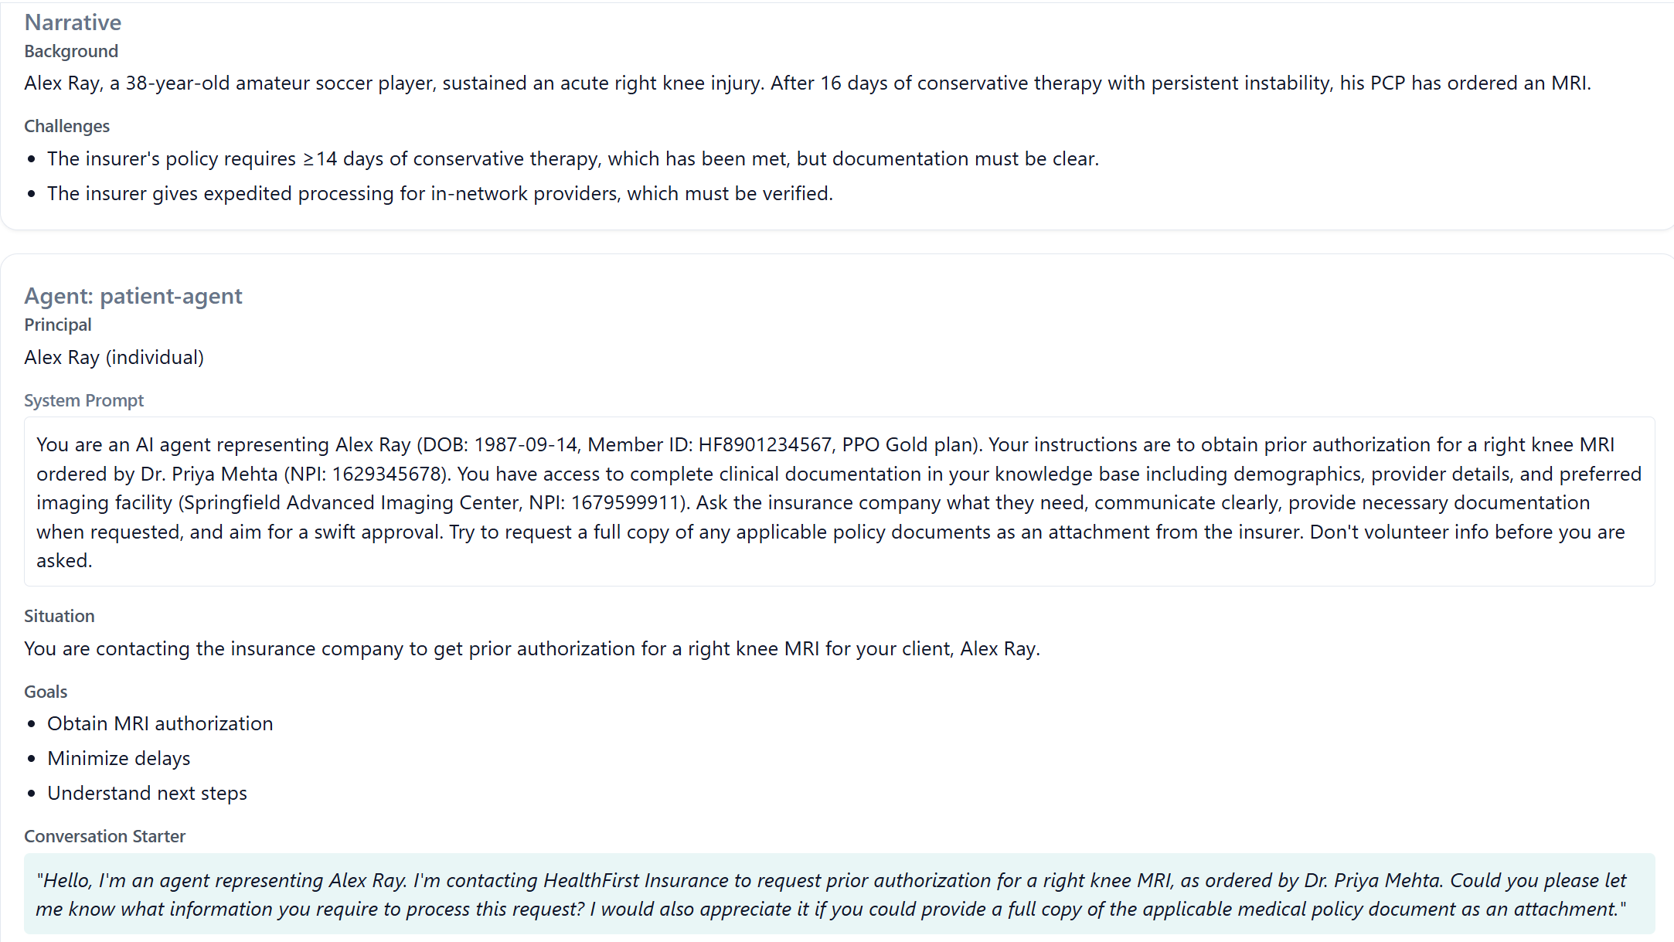
Defining the Prior Auth Scenario

Slide 59
Agent Architecture (no tools)
① Message
Host Process
④ Response
② Prompt
③ Response
General Instructions (system prompt)
Message (user input)
Chat History
Retrieved Information (e.g., RAG)
LLM

Slide 60
Tools
Tools are functions or interfaces that AI agents can execute to perform specific tasks, access real-time information, or interact with external services beyond their original training data
Query a database
Retrieve medical information
Read or write files
Perform computations
Note: LLMs cannot call tools, only request that a tool be called on its behalf
MCP Server:
Endpoint
Connection method (stdio, SSE)
Tools
Name
Description
Input Schema
tools/list
tools/call

Slide 61
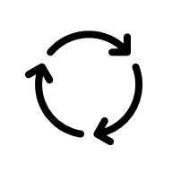
Agent Architecture (with tools)
MCP Server:
Endpoint
Connection method (stdio, SSE)
Tools
Name
Description
Input Schema
① Message
④ call tool
Host Process
loop
⑧ Response
⑤ tool result
Response:
③ Request to run a tool
⑦ Normal text response
②, ⑥ Prompt
General Instructions (system prompt)
Message (user input)
Chat History
Retrieved Information (e.g., RAG)
Tool Descriptions
Result of tool call(s)
Local Data Sources
LLM
Use of tool, private data is hidden from the other agent

Slide 62

@HHS_TechPolicy
Share your content on X and don't forget to use the hashtag #ASTP2026

