Slide 1
TEFCA Implementation Deep Dive
A Panel Discussion
Alan Swenson, RCE
Michael Saito, RCE
Joel Hartsell, Association of Public Health Laboratories
Melissa Massardo, athenahealth
John Helvey, SacValley MedShare
Amy Bagge-Smith, Zus Health
Chantal Worzala, RCE

Slide 2
Thinking about joining TEFCA as a Participant or Subparticipant?
  Identify your needs
  Research QHINs or other connections to TEFCA Exchange, such as an EHR, HIE or exchange platform
  Review the agreement that must include the Terms of Participation
  Select a QHIN or other TEFCA Connector and complete onboarding, technical and compliance steps
  Get listed in the RCE Directory (the directory enables QHINs to identify other QHINs, Participants, and Subparticipants to exchange data)
  Start exchanging

Slide 3
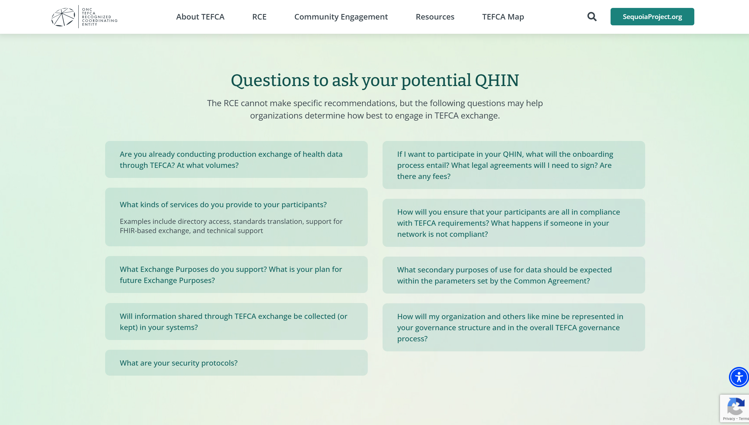

Slide 4
    TEFCA Implementation Deep Dive
    A Panel Discussion
    Joel Hartsell, Association of Public Health Laboratories
    Melissa Massardo, athenahealth
    John Helvey, SacValley MedShare
    Amy Bagge-Smith, Zus Health
    Chantal Worzala, RCE (moderator)

Slide 5

Questions & Answers
For more information: rce.sequoiaproject.org

