Slide 1
Health IT Policymaking on the Horizon Listening Session
February 2026

Slide 2


Disclaimers & Reminders
The contents of this presentation are based on cited references, including the provisions codified in 45 CFR part 171 and preamble discussion of these provisions in relevant final rules. While every effort has been made to ensure the accuracy of this presentation of those provisions, this presentation does not have the force of law. Statutes and regulations have the force of law. Therefore, in the event of any inconsistency between this presentation and any relevant statute or regulation, the statute or regulation controls.
Please note that other Federal, state or tribal laws may also apply.
This communication is produced and disseminated at U.S. taxpayer expense.
The HTI-5: Deregulatory Actions to Unleash Prosperity Proposed Rule includes several proposed revisions to information blocking regulations.​
Find the rule and link to submit public comments at: https://www.federalregister.gov ​
Public comment period closes Feb 27, 2026.​
​
Check Tomorrow’s Agenda for HTI-5 Breakout Session Details

Slide 3

AGENDA
Introduction/Overview
ONC Health IT Certification Program
Standards, Implementation Specifications, and Certification Criteria
Base EHR
FHIR
MAHA
Conditions and Maintenance of Certification Requirements
Information Blocking
Terms
Exceptions

Slide 4
ONC Health IT Certification Program

Slide 5
Regulatory Definitions
Standard
Implementation Specification
Certification Criteria
Means a technical, functional, or performance-based rule, condition, requirement, or specification that stipulates instructions, fields, codes, data, materials, characteristics, or actions.
Means specific requirements or instructions for implementing a standard.
Means criteria:
(1) To establish that health information technology meets applicable standards and implementation specifications adopted by the Secretary; or
(2) That are used to test and certify that health information technology includes required capabilities.
As defined in § 170.102 Definitions

Slide 6
Base EHR (Qualified EHR)
Base EHR Capabilities | Certification Criteria (CY 2026)
Includes patient demographic and clinical health information | Demographics § 170.315(a)(5) (updated as of January 1, 2026) Implantable device list § 170.315(a)(14)
Capacity to provide clinical decision support | Decision support interventions § 170.315(b)(11) (update required by December 31, 2027)
Capacity to support physician order entry | Computerized provider order entry § 170.315(a)(1), (2) or (3)
Capacity to capture and query information relevant to health care quality | Clinical quality measures – record and export § 170.315(c)(1)
Capacity to exchange electronic health information with, and integrate such information from other sources | Transitions of care § 170.315(b)(1) (updated as of January 1, 2026) Application access – patient selection § 170.315(g)(7) Application access – all data request § 170.315(g)(9) (updated as of January 1, 2026) Standardized API for patient and population services § 170.315(g)(10) Direct Project § 170.315(h)(1) or Direct Project, Edge Protocol, and XDR/XDM § 170.315(h)(2)
Capacity to support real-time prescription benefit information | Real-time prescription benefit § 170.315(b)(4) (required as of January 1, 2028)
https://www.healthit.gov/topic/certification-ehrs/base-electronic-health-record-definition

Slide 7
FHIR-Forward Future
The Fast Healthcare Interoperability Resources (FHIR®) standard:
First published by Health Level Seven (HL7®) in 2012; organizes data into granular “resources” that can be created, read, updated, or deleted through standard HTTP operations; designed to help reduce implementer variation, allow for widespread web security conventions to be layered in, and facilitate more incremental adoption through modularity.
The “21st Century Cures Act: Interoperability, Information Blocking, and the ONC Health IT Certification Program” Final Rule (Cures Act Final Rule) (85 FR 25642), adopted a suite of FHIR-based requirements in the Certification Program including:
A FHIR-based API certification criterion (45 CFR 170.315(g)(10)) and the establishment of an API Condition of Certification
HL7's FHIR US Core Implementation Guide (IG)
FHIR Bulk Data Access IG
HL7 SMART Application Launch Framework IG
Since the Cures Act Final Rule, ASTP/ONC and industry established an iterative, annual cycle whereby new versions of the FHIR-based US Core IG are released

Slide 8
FHIR-Forward Future
FHIR’s Future in the Certification Program:
The “Health Data, Technology, and Interoperability: ASTP/ONC Deregulatory Actions to Unleash Prosperity” Proposed Rule (HTI-5 Proposed Rule) proposed to:
Reduce and remove functionality-oriented and non-FHIR-based certification criteria from the Certification Program
Establish a new foundation on which to build FHIR-based API requirements in the future.
In the HTI-5 Proposed Rule, ASTP/ONC stated an intent to advance FHIR specifications and sharpen the Certification Program to prioritize FHIR-based APIs that:
Enhance automation and API performance;
Move beyond read-only interactions; and
Expand the scope of data available to support clinical efficiency, patient-centered care, and timely reporting use cases (e.g., public health, quality, government programs)

Slide 9
USA’s 10-Year FHIR Journey (so far…)
Adopted “Functional” API Certification Requirements
+ Common Clinical Data Set
Oct-2015
Cures Act Final Rule
+USCDI v1
+US Core IG
+Bulk FHIR IG
+FHIR R4
+SMART of FHIR
Cures Act
Capabilities Required
Jan 2023
Functional APIs required for deployment
Jan-2019
2015
2019
2020
2023
2016
2018
2024
2026
21st Century Cures Act
Dec-2016
HL7 Publishes
“US Core” IG on FHIR R4
Supports USCDI v1
HTI-1 Final Rule
+USCDI v3
+US Core IG (new)
HTI-1 Required
Jan 2026
HL7 “Argonaut”
IG on FHIR R2
Apple includes support for FHIR in iOS 11.3

Slide 10
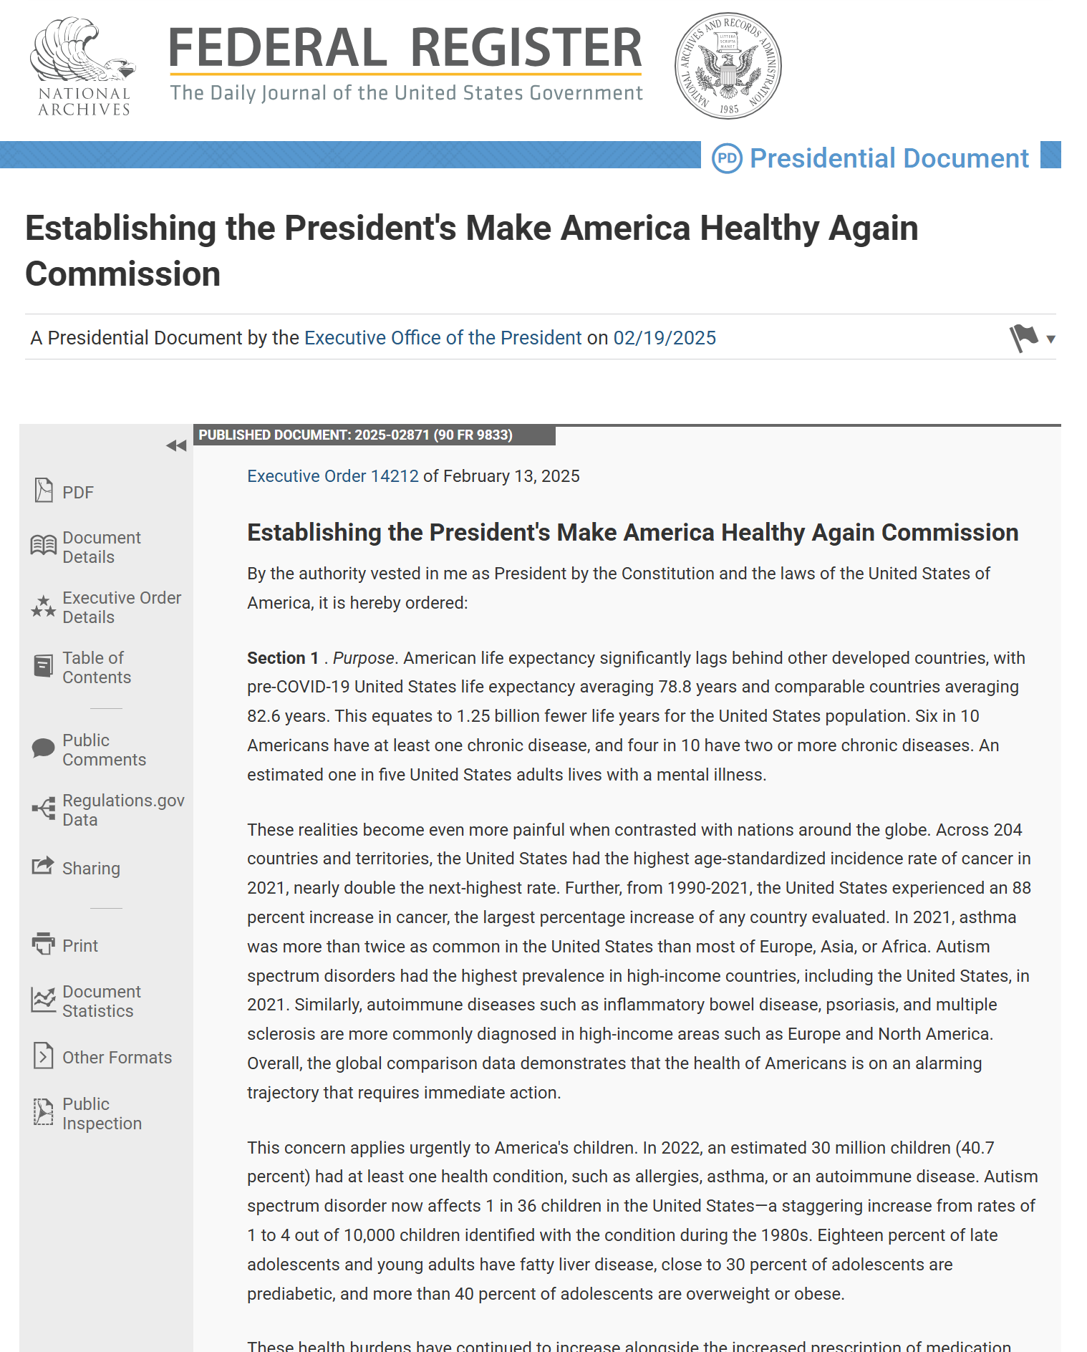

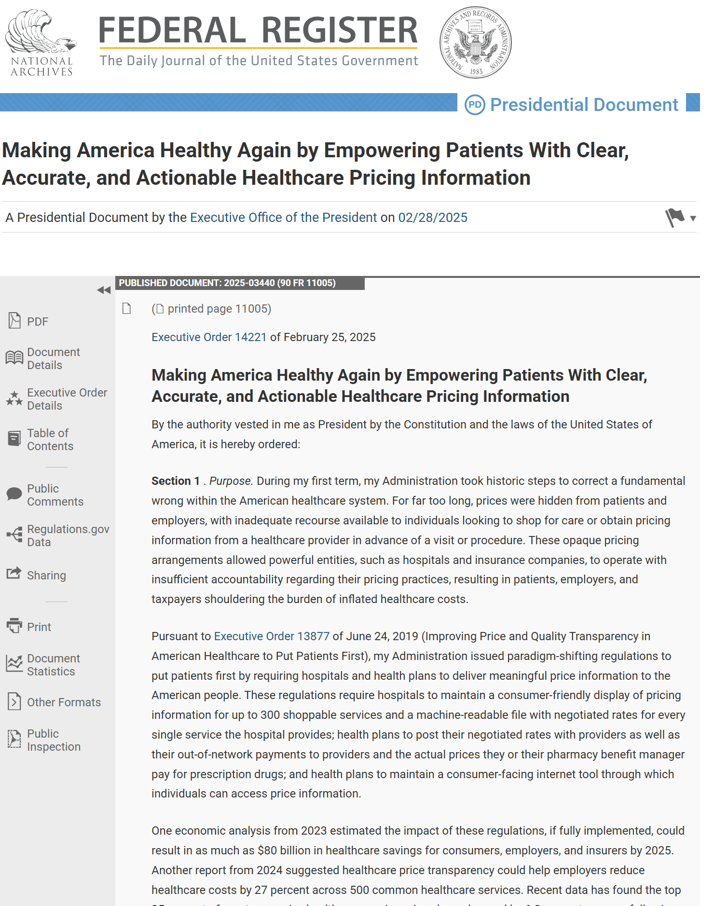
Make America Healthy Again
https://www.federalregister.gov/documents/2025/02/19/2025-02871/establishing-the-presidents-make-america-healthy-again-commission
https://www.federalregister.gov/documents/2025/02/28/2025-03440/making-america-healthy-again-by-empowering-patients-with-clear-accurate-and-actionable-healthcare
https://www.whitehouse.gov/maha/

Slide 11


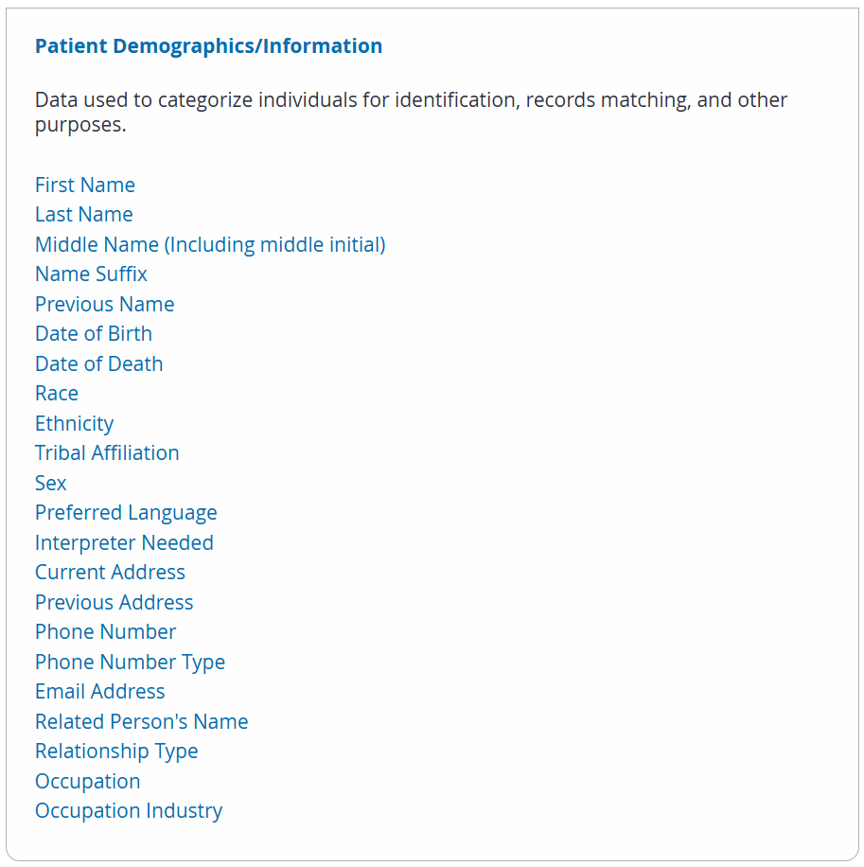
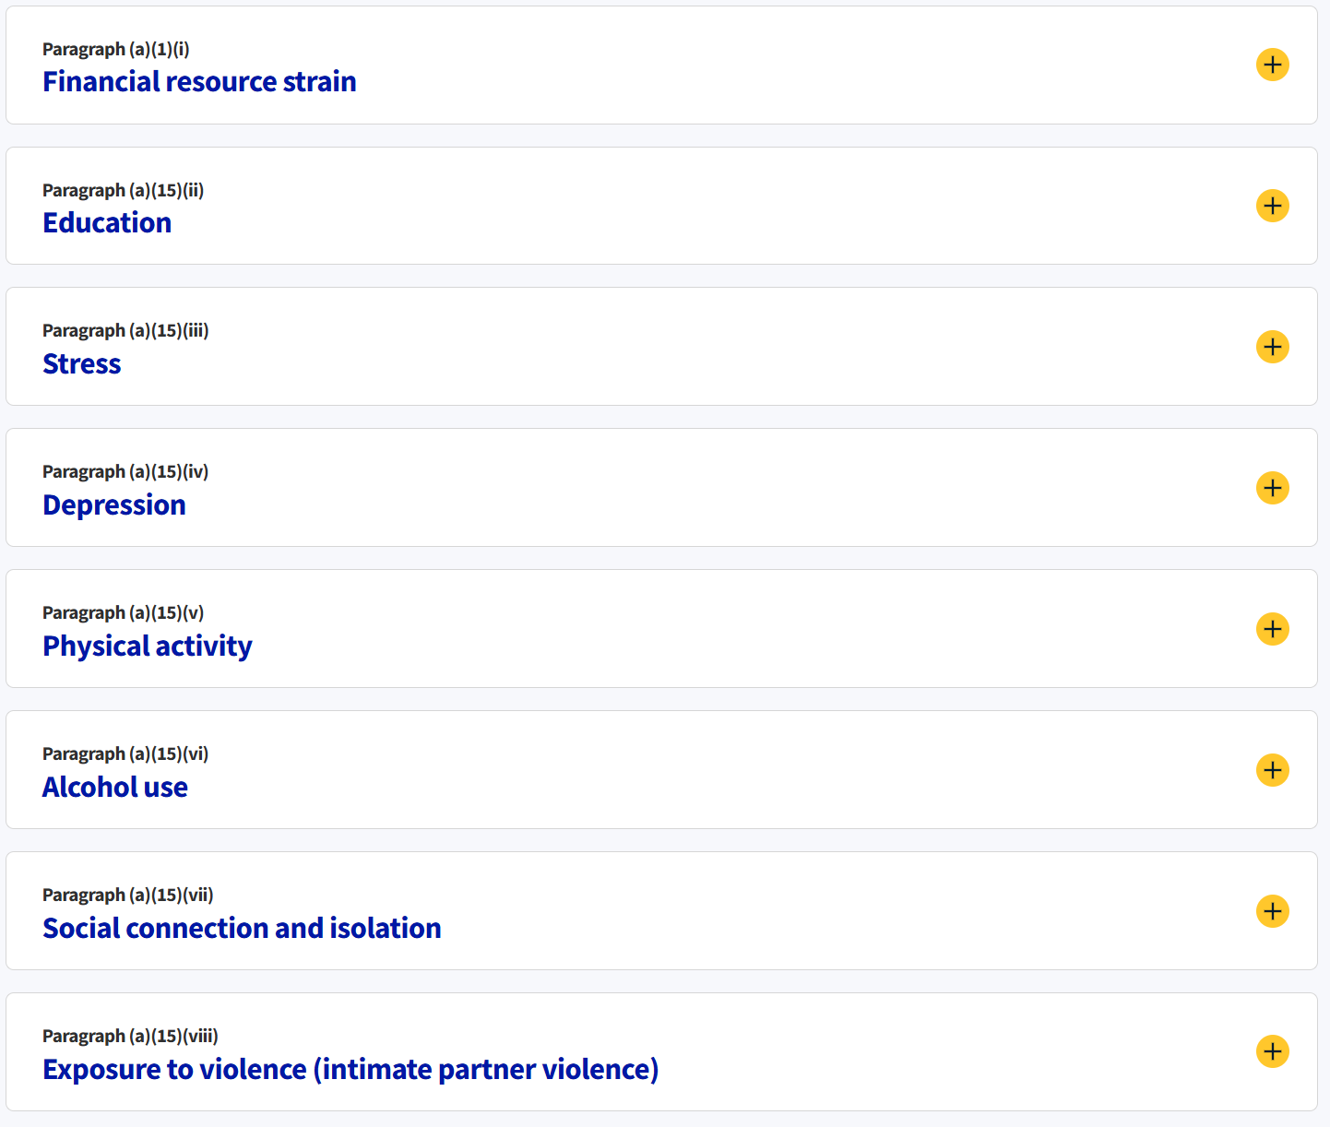
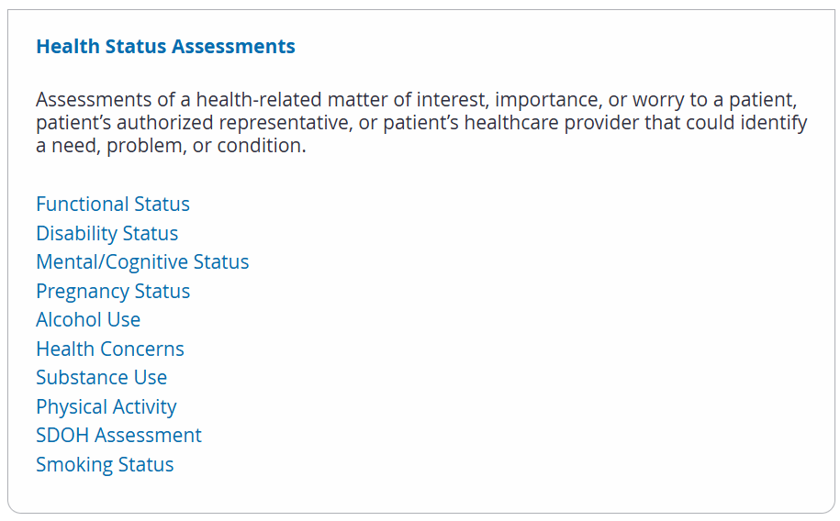
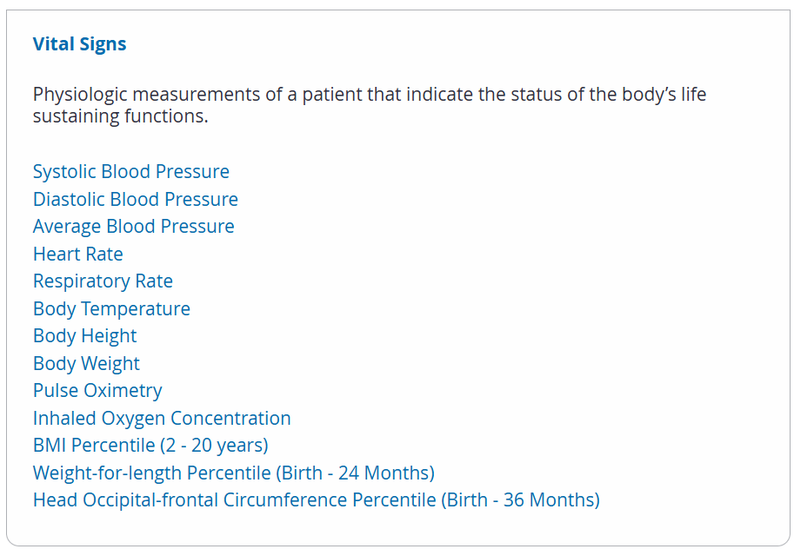
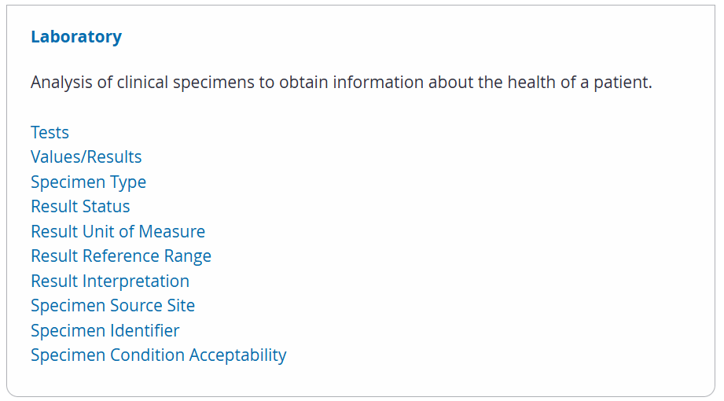
Make America Healthy Again
Version 6
https://healthit.gov/test-method/social-psychological-and-behavioral-data/#cert-guide
https://isp.healthit.gov/united-states-core-data-interoperability-uscdi#uscdi-v6

Slide 12
Conditions and Maintenance of Certification Requirements
Seven (7) Conditions of Certification with Maintenance of Certification Requirements
Information Blocking
Assurances
Communications
Application Programming Interfaces (APIs)
Real World Testing
Attestations
Insights (EHR Reporting Program)
The 21st Century Cures Act requires HHS to establish Conditions and Maintenance of Certification requirements for the ONC Health IT Certification Program.

Slide 13
API Condition of Certification
API Condition and Maintenance of Certification statutory language:
“Not later than 1 year after December 13, 2016, the Secretary, through notice and comment rulemaking, shall require, as a condition of certification and maintenance of certification for programs maintained or recognized under this paragraph, consistent with other conditions and requirements under this title, that the health information technology developer or entity . . . has published application programming interfaces and allows health information from such technology to be accessed, exchanged, and used without special effort through the use of application programming interfaces or successor technology or standards, as provided for under applicable law, including providing access to all data elements of a patient’s electronic health record to the extent permissible under applicable privacy laws;”
42 U.S.C. 300jj–11(c)(5)(D)(iv)
ASTP/ONC finalized the API Condition and Maintenance of Certification requirements in the Cures Act Final Rule in 45 CFR 170.404
The API Condition and Maintenance of Certification requirements apply only to actions and behaviors of health IT developers related to their certified health IT as well as to the certified health IT itself.
API Conditions & Maintenance of Certification Fact Sheet Link:
https://healthit.gov/wp-content/uploads/2025/02/certification-api-condition-responsibilities-obligations-factsheet.pdf

Slide 14
Communications Condition and Maintenance of Certification - § 170.403
Conditions of Certification
A health IT developer may not prohibit or restrict communication of the following:
Usability
Interoperability
Security
User’s experiences when using the health IT
Business practices of developers related to exchanging EHI
Manner in which a user of the health IT has used such technology
Maintenance of Certification
A health IT developer must notify all customers that any communication or contract/agreement provision that violates the Communication Condition of Certification will not be enforced.
Note: A health IT developer is required to amend contracts/agreements to remove or void such provisions when the contracts/agreements are modified for other purposes.
Fact Sheet link: The Communications Condition of Certification

Slide 15
Information Blocking

Slide 16

What is Electronic Health Information?
“Electronic Health Information (EHI)” means electronic protected health information (ePHI) to the extent that the ePHI would be included in a designated record set as these terms are defined for HIPAA.
Except for psychotherapy notes (45 CFR 164.501) and information compiled in reasonable anticipation of, or for use in, a civil, criminal, or administrative action or proceeding.
This is applicable whether or not the information is held by or for a HIPAA covered entity.
You can find the EHI definition in 45 CFR 171.102
Changes and Clarifications from the 21st Century Cures Act Proposed Rule
Focused definition on ePHI included in a DRS
This definition does not expressly include or exclude price information. To the extent that ePHI includes price information and is included in a DRS, it would be considered EHI.

Slide 17
Proposed EHI Definition from the 21st Century Cures Act Proposed Rule
The definition of information blocking applies to electronic health information (EHI) (section 3022(a)(1) of the PHSA). [84 FR 7513-14]. EHI is not specifically defined in the Cures Act, HITECH Act, or other relevant statutes.
Section 3000(4) of the PHSA by reference to section 1171(4) of the Social Security Act defines “health information.”
Sec. 1171(4) of the SSA Act [42 U.S.C. 1320d] defines “health information” as any information, whether oral or recorded in any form or medium, that—
(A) is created or received by a health care provider, health plan, public health authority, employer, life insurer, school or university, or health care clearinghouse; and
(B) relates to the past, present, or future physical or mental health or condition of an individual, the provision of health care to an individual, or the past, present, or future payment for the provision of health care to an individual.
In the Cures Act Proposed Rule, we proposed to define EHI to mean:
(i) Electronic protected health information; and
(ii) any other information that—
is transmitted by or maintained in electronic media, as defined in 45 CFR 160.103;
identifies the individual, or with respect to which there is a reasonable basis to believe the information can be used to identify the individual; and
relates to the past, present, or future health or condition of an individual; the provision of health care to an individual; or the past, present, or future payment for the provision of health care to an individual.
Under our proposed definition, we stated that EHI includes, but is not limited to, electronic protected health information (ePHI) as defined in 45 CFR 160.103. We also stated under our proposed definition that unlike ePHI and health information, EHI is not limited to information that is created or received by a health care provider, health plan, health care clearinghouse, public health authority, employer, life insurer, school, or university.
We stated that this proposed definition provides for an expansive set of EHI, which could include information on an individual's health insurance eligibility and benefits, billing for health care services, and payment information for services to be provided or already provided, which may include price information.

Slide 18



Information Blocking Actors
Information blocking prohibition applies to three types of “actors”
Health Care Providers
Each actor – individual or organization – is uniquely accountable for their own information blocking conduct
Health IT Developers of
Certified Health IT
Health Information Networks (HINs)
& Health Information Exchanges (HIEs)
These terms are defined for purposes of the information blocking regulations in 45 CFR 171.102

Slide 19







Information Blocking Exceptions in Effect Today
Exceptions that involve not fulfilling requests to access, exchange, or use EHI
Manner Exception
Fees Exception
Licensing Exception
10. TEFCA Manner Exception
Exceptions that involve procedures for fulfilling requests to access, exchange, or use EHI
Preventing Harm Exception
Privacy Exception
Security Exception
Infeasibility Exception
Health IT Performance Exception
Protecting Care Access Exception
Exceptions that involve practices related to actors’ participation in TEFCA

Slide 20





Reach out via phone or web
202-690-7151
Feedback Form: https://www.healthit.gov/form/healthit-feedback-form
Stay connected, follow us on socials
@HHS_TechPolicy
Assistant Secretary for Technology Policy
Youtube.com/@HHS_TechPolicy
Subscribe to our weekly eblast at healthit.gov for the latest updates!

